Slide 1


Introduction.
Free Cases
Cases available on pages 4 to 6 of this file can be used free of charge.
Pressing the link button (in slideshow mode) will open the iPax content.
Scanning the QR code will open the case for smartphones.
Paid Cases
From page 7 onward, the content is paid and intended for educational institutions. A contract is required to use this content.
Pressing the link button or scanning the QR code will open the login page.
Please log in with your own ID to access the content. Once logged in, subsequent cases can be accessed without logging in again.
The content is also available on a dedicated paid content website.
If you wish to purchase a license, please visit the iPax Information Page. For invoice payment requests, please contact our company.
Inquiry
Telemedica Inc.
email 3sp@telemedica.co.jp
Dedicated iPax site
https://kikuzosound.com/home
Recording, including screen captures and recordings via online meeting systems, is strictly prohibited. Please adhere to the terms of use while using this service.
iPax Information Page
https://telemedica.site/en/ipax24lp-paypal-en7-features-of-ipax2b/

Slide 2
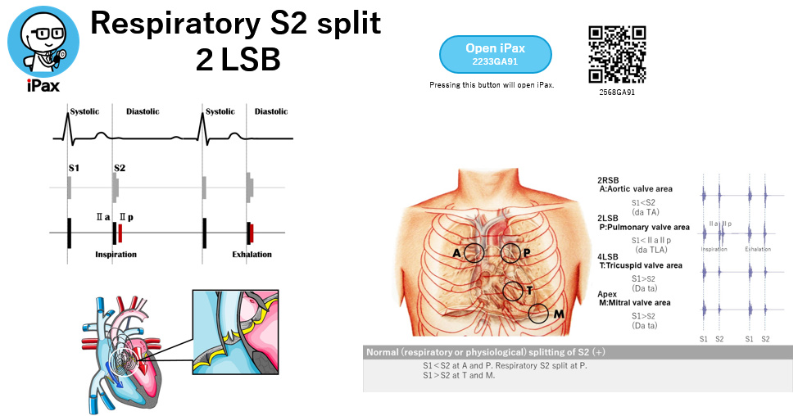
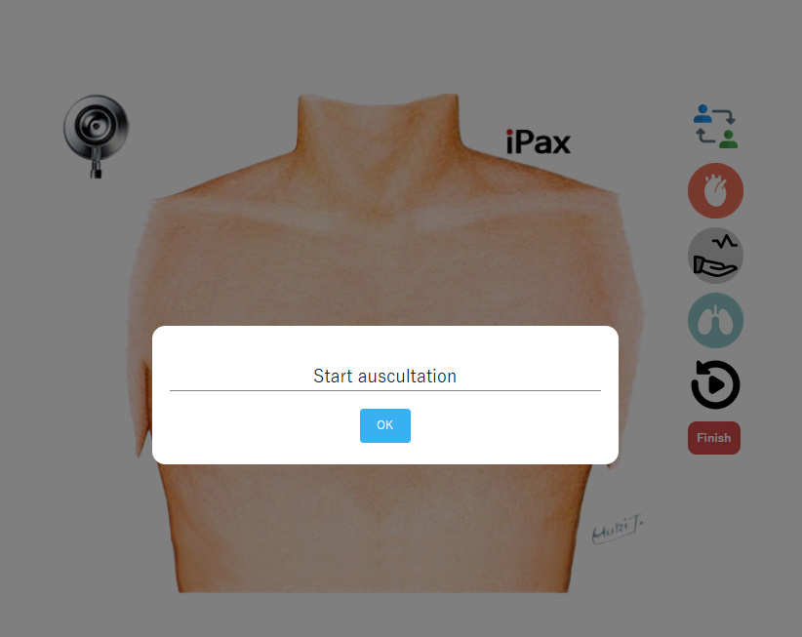
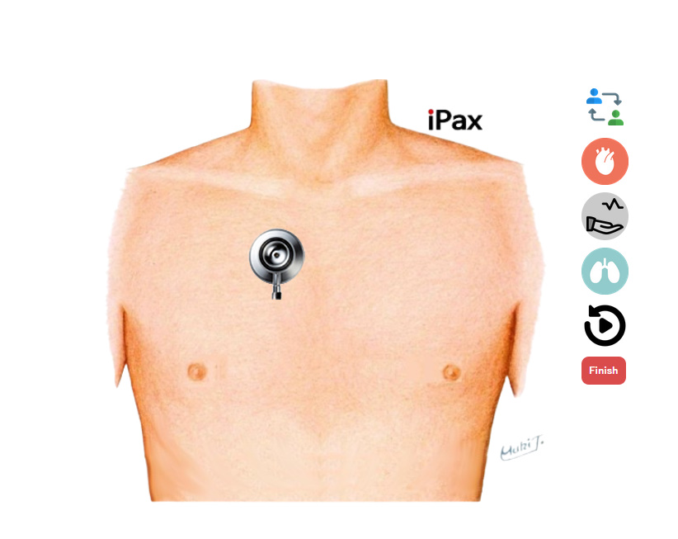
How to use iPax
Scanning the QR code will launch the browser.
Available for student license holders.
Press here to launch the browser. Available for educational institution license holders.
１．Enter the required information on the first page.
２．After login is complete, iPax will be displayed.
３．Press the OK button.
４．Tap the area to auscultate.
５．Chest piece area sound playback．*When listening to sounds, please use external speakers or earphones. Without earphones, the sound may be barely audible.
６．Use the arrow icon at the top right to switch to the back.
７．To exit, press 'Finish' and close the browser.
１．Enter the required information on the first page.
２．After completing the login, iPax will be displayed.
３．Start auscultation.
*When listening to sounds, please use earphones. Without earphones, the sound may be barely audible.
The cases available for use with a student license vary depending on the terms of the contract.
Recording, including screen captures and recordings via online meeting systems, is strictly prohibited. Please adhere to the terms of use while using this service.

Slide 3
Prohibited Actions
Screen captures, recordings via online meeting systems, and all forms of recording or audio recording are strictly prohibited. Please adhere to the terms of use when utilizing this service.
Device Usage
Avoid using low-spec computers or older smartphone models, as they may result in slow performance or an inability to use certain functions.
Listening Environment
When listening to sounds, please use external speakers or canal-type earphones. The built-in speakers of devices may produce minimal sound. It is recommended to use the service in a quiet environment.
Recommended Browsers
Chrome and Safari (latest versions)
Inquiry
Telemedica Inc.
email 3sp@telemedica.co.jp
Dedicated iPax site
https://kikuzosound.com/home
iPax Information Page
https://telemedica.site/en/ipax24lp-paypal-en7-features-of-ipax2b/

Slide 4

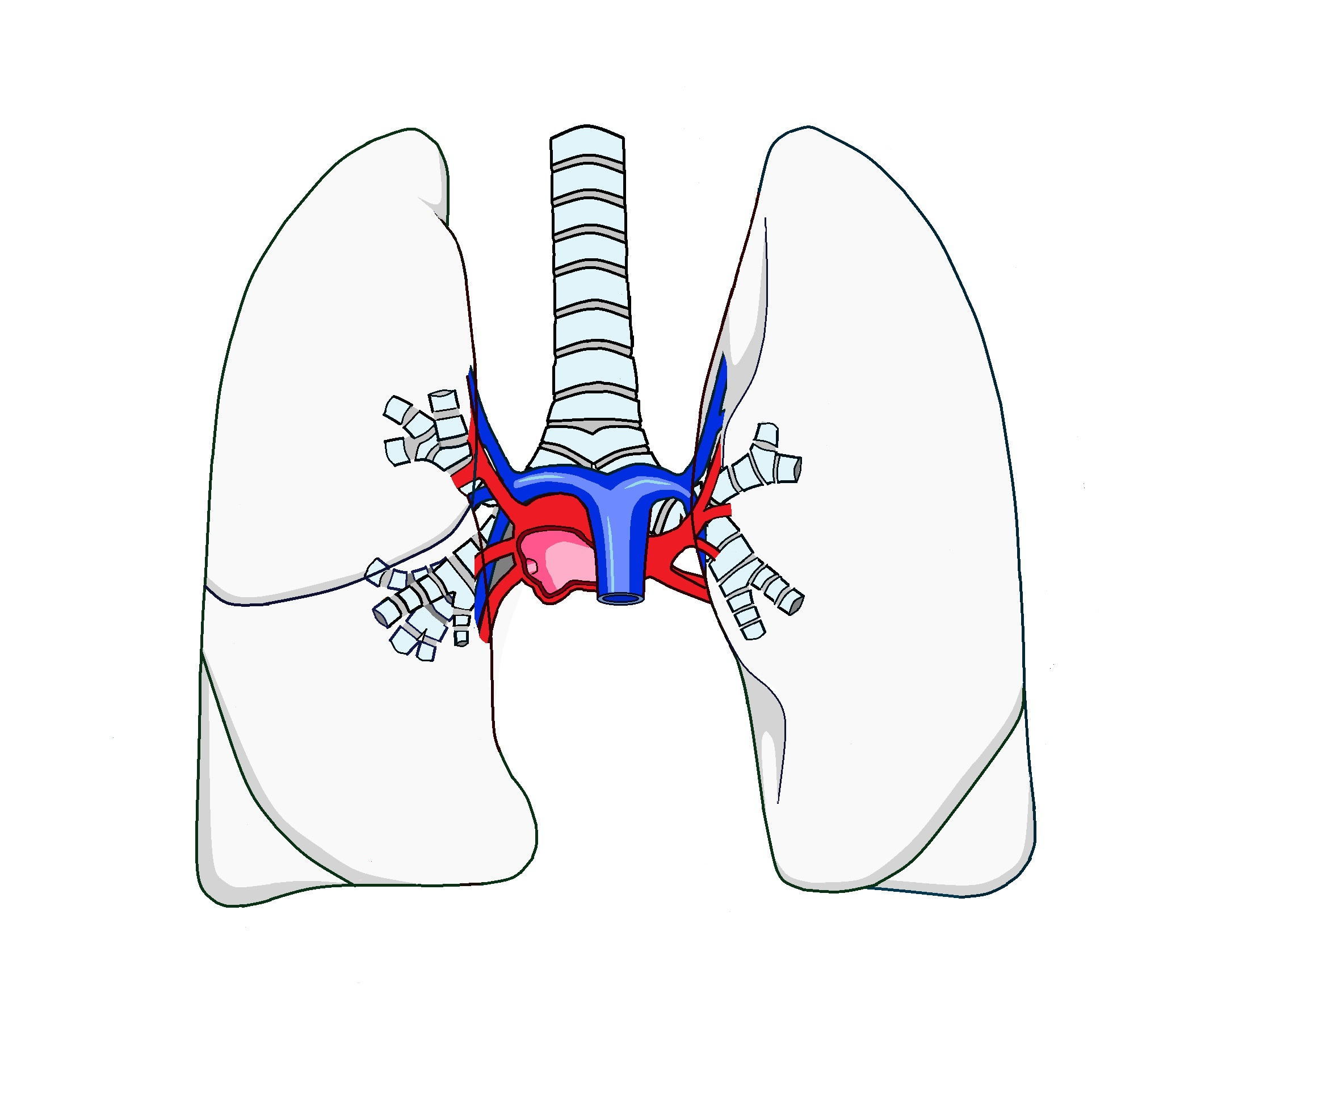
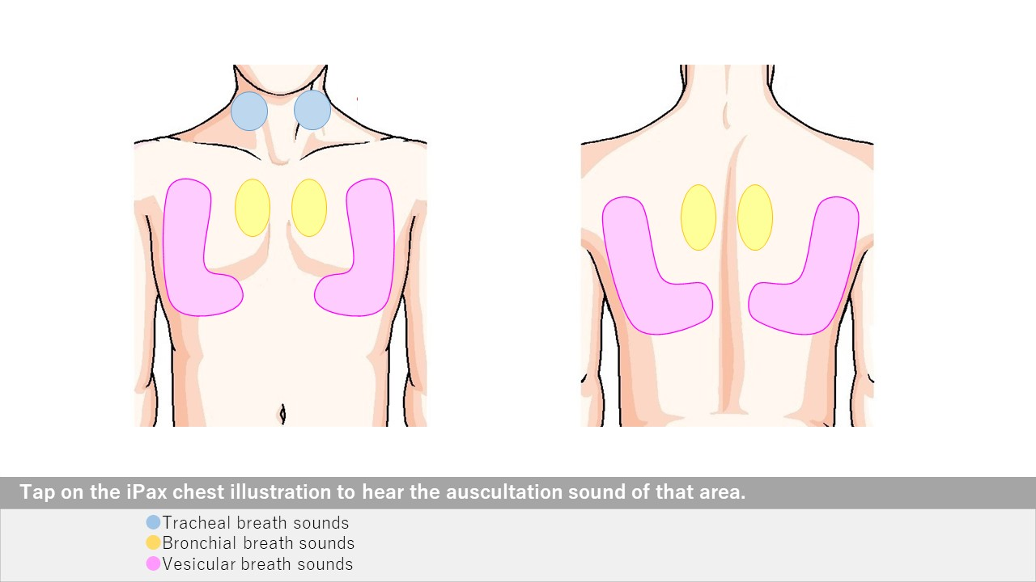
Free
Normal lung sound
Open iPax
2531GA91
Pressing this button will open iPax.
2531GA91
Pressing this button will open mp4.
Tracheal Breath Sound Video
2590GA91
Bronchial Breath Sound Video
2591GA91
Vesicular Breath Sound Video
2592GA91
Dedicated iPax site
https://kikuzosound.com/home
Recording, including screen captures and recordings via online meeting systems, is strictly prohibited. Please adhere to the terms of use while using this service.
iPax Information Page
https://telemedica.site/en/ipax24lp-paypal-en7-features-of-ipax2b/

Slide 5

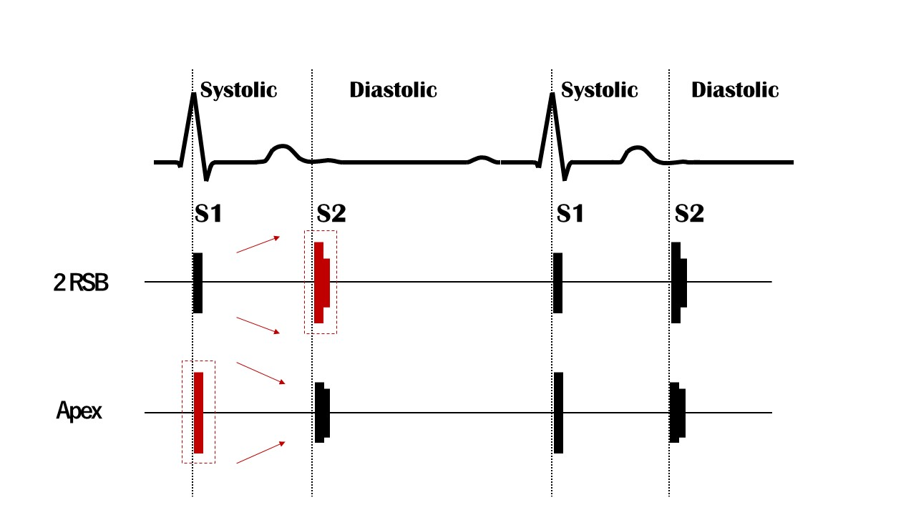
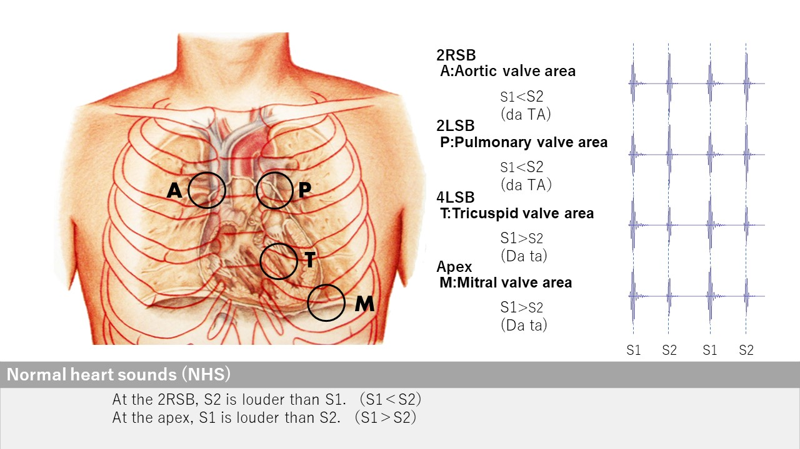
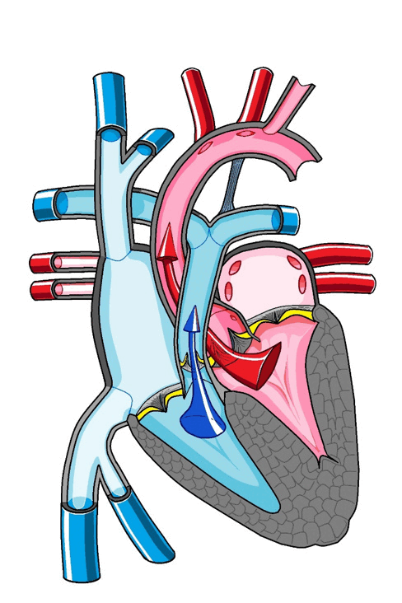
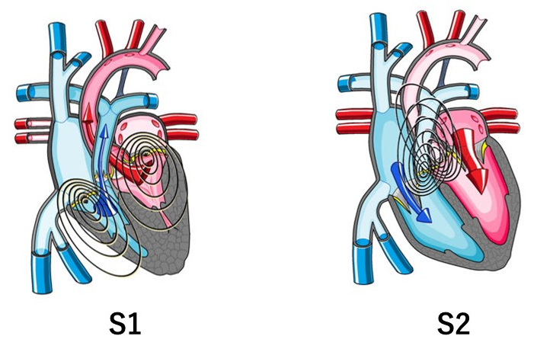
Free
Normal Heart Sound
Normal body illustration
Open iPax
2569GA91
スケルトン削除
Pressing this button will open iPax.
2569GA91
Dedicated iPax site
https://kikuzosound.com/home
Recording, including screen captures and recordings via online meeting systems, is strictly prohibited. Please adhere to the terms of use while using this service.
iPax Information Page
https://telemedica.site/en/ipax24lp-paypal-en7-features-of-ipax2b/

Slide 6

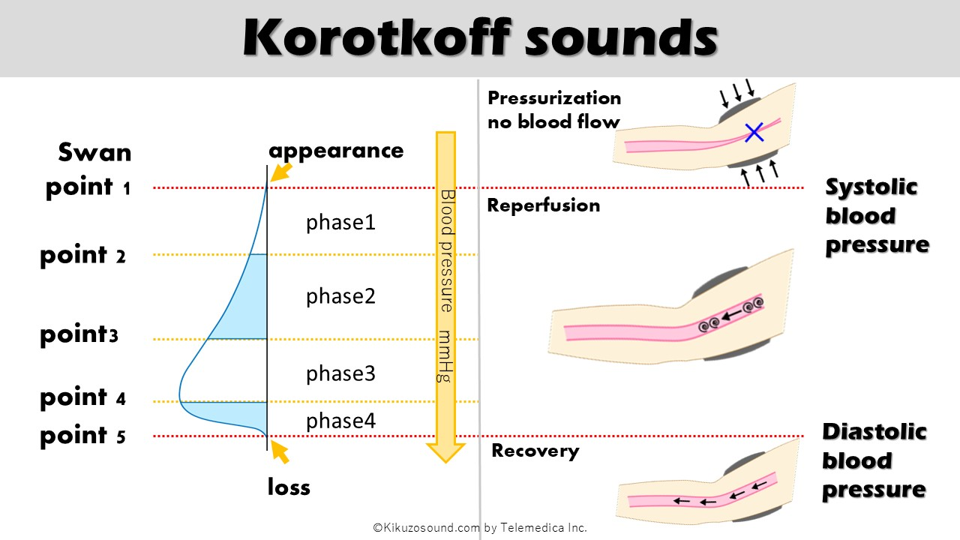
Free
Korotkov sound
Blood Pressure Video
2593GA91
Pressing this button will open iPax.
2593GA91
Paid content includes materials for blood pressure measurement palpation training, as well as bowel sounds and dialysis shunt sounds.
Dedicated iPax site
https://kikuzosound.com/home
Recording, including screen captures and recordings via online meeting systems, is strictly prohibited. Please adhere to the terms of use while using this service.
iPax Information Page
https://telemedica.site/en/ipax24lp-paypal-en7-features-of-ipax2b/

Slide 7

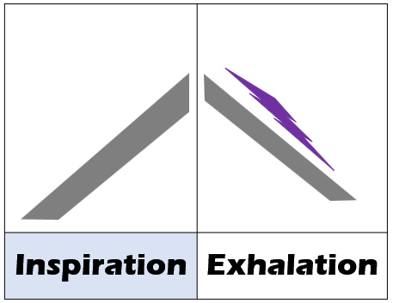
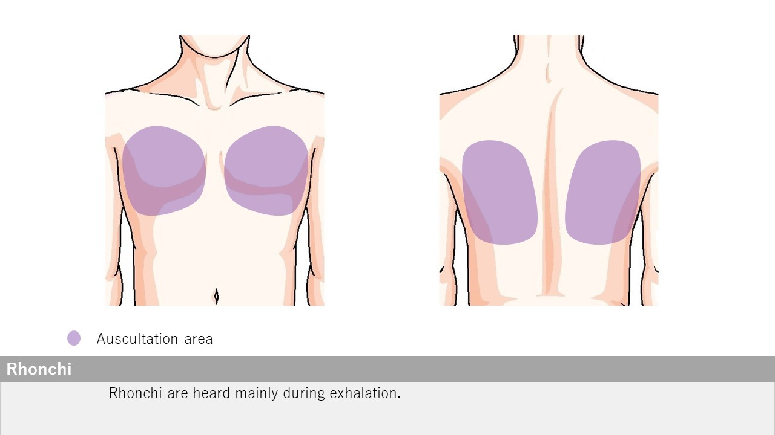
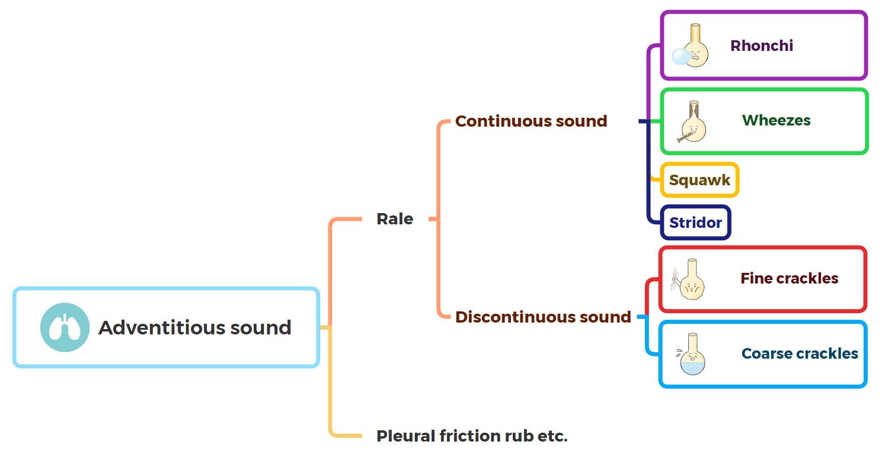
Rhonchi
Open iPax
2528GA91
Pressing this button will open iPax.
2528GA91
Dedicated iPax site
https://kikuzosound.com/home
Recording, including screen captures and recordings via online meeting systems, is strictly prohibited. Please adhere to the terms of use while using this service.
iPax Information Page
https://telemedica.site/en/ipax24lp-paypal-en7-features-of-ipax2b/

Slide 8

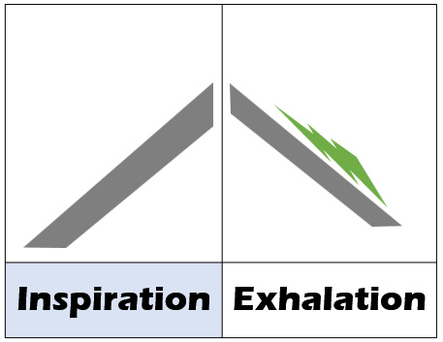
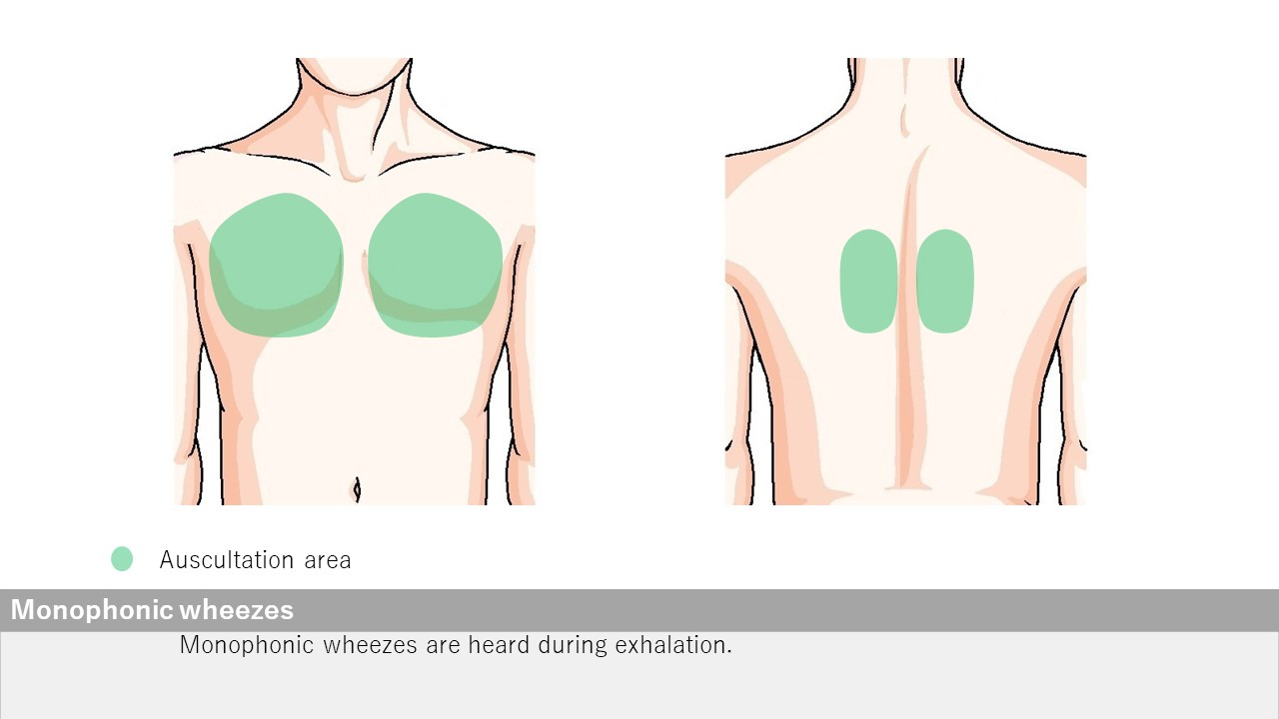
Wheezes monophonic
Open iPax
2527GA91
Pressing this button will open iPax.
2527GA91
Dedicated iPax site
https://kikuzosound.com/home
Recording, including screen captures and recordings via online meeting systems, is strictly prohibited. Please adhere to the terms of use while using this service.
iPax Information Page
https://telemedica.site/en/ipax24lp-paypal-en7-features-of-ipax2b/

Slide 9

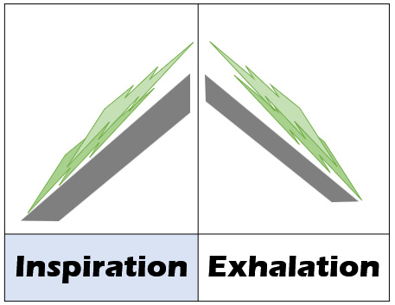
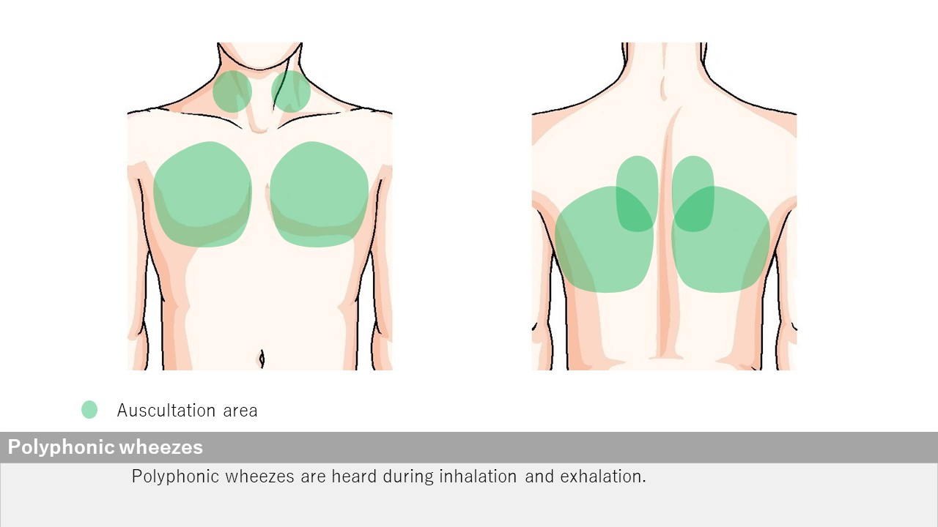
Wheezes polyphonic
Open iPax
2526GA91
Pressing this button will open iPax.
2526GA91
Dedicated iPax site
https://kikuzosound.com/home
Recording, including screen captures and recordings via online meeting systems, is strictly prohibited. Please adhere to the terms of use while using this service.
iPax Information Page
https://telemedica.site/en/ipax24lp-paypal-en7-features-of-ipax2b/

Slide 10

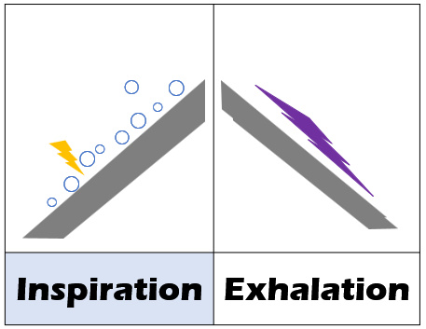
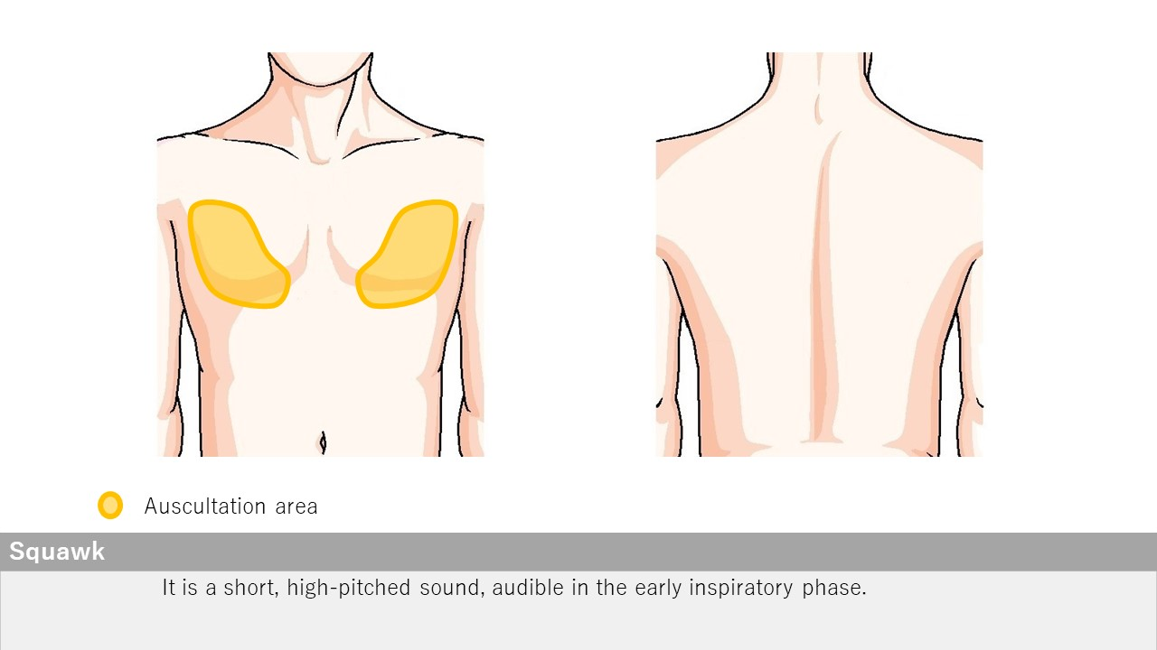
Squawk
Open iPax
2525GA91
Pressing this button will open iPax.
2525GA91
Dedicated iPax site
https://kikuzosound.com/home
Recording, including screen captures and recordings via online meeting systems, is strictly prohibited. Please adhere to the terms of use while using this service.
iPax Information Page
https://telemedica.site/en/ipax24lp-paypal-en7-features-of-ipax2b/

Slide 11

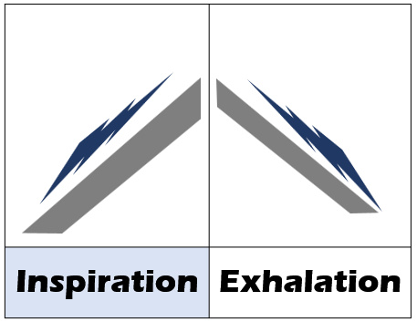
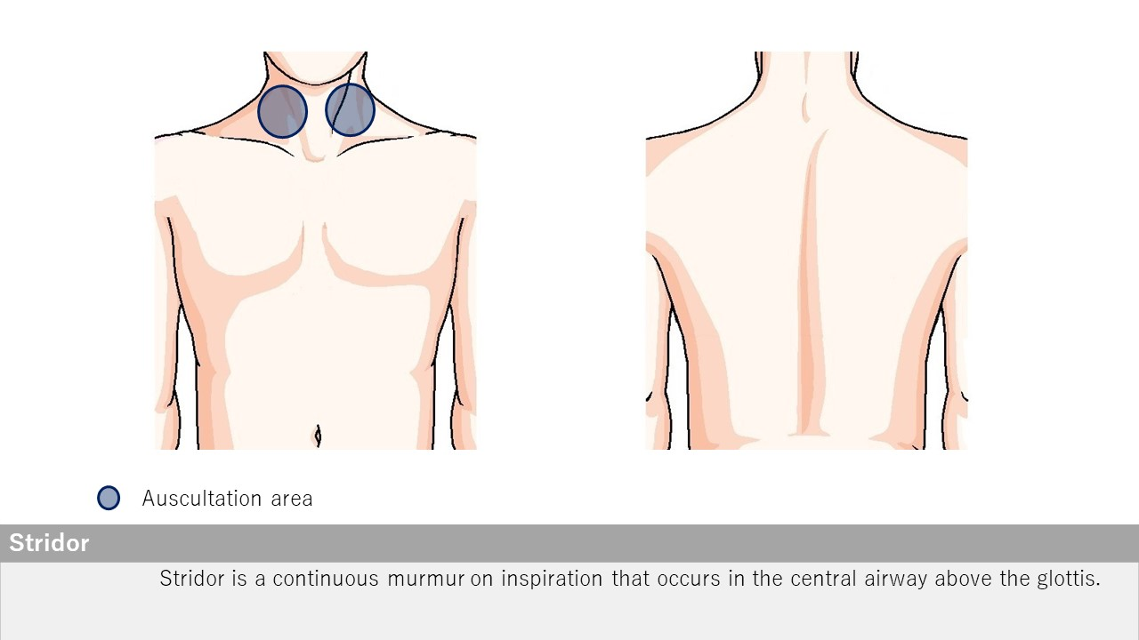
Stridor
Open iPax
2524GA91
Pressing this button will open iPax.
2524GA91
Dedicated iPax site
https://kikuzosound.com/home
Recording, including screen captures and recordings via online meeting systems, is strictly prohibited. Please adhere to the terms of use while using this service.
iPax Information Page
https://telemedica.site/en/ipax24lp-paypal-en7-features-of-ipax2b/

Slide 12

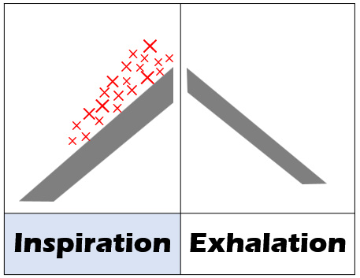
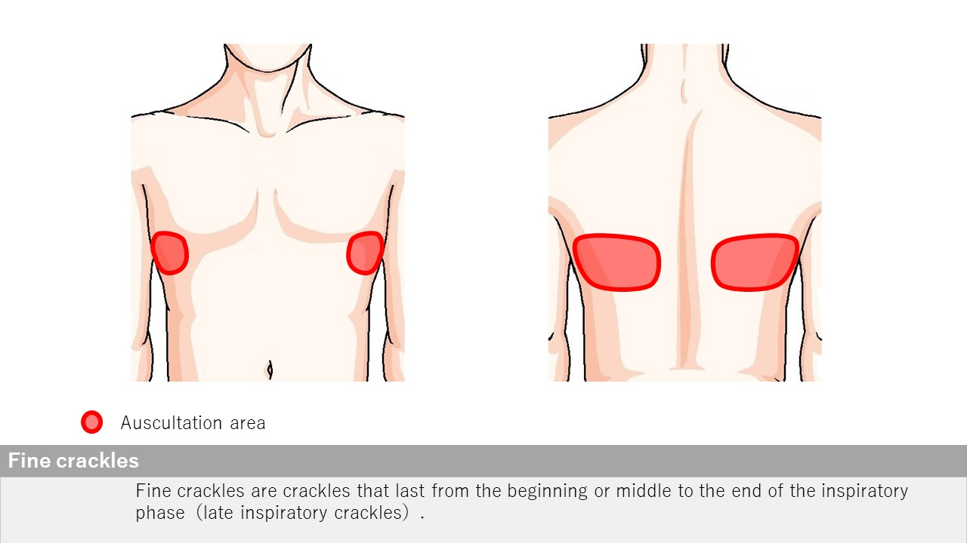
Fine crackles
Open iPax
2523GA91
Pressing this button will open iPax.
2523GA91
Dedicated iPax site
https://kikuzosound.com/home
Recording, including screen captures and recordings via online meeting systems, is strictly prohibited. Please adhere to the terms of use while using this service.
iPax Information Page
https://telemedica.site/en/ipax24lp-paypal-en7-features-of-ipax2b/

Slide 13

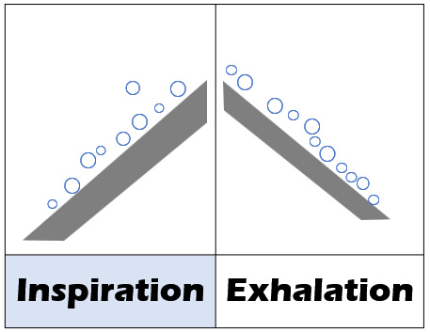
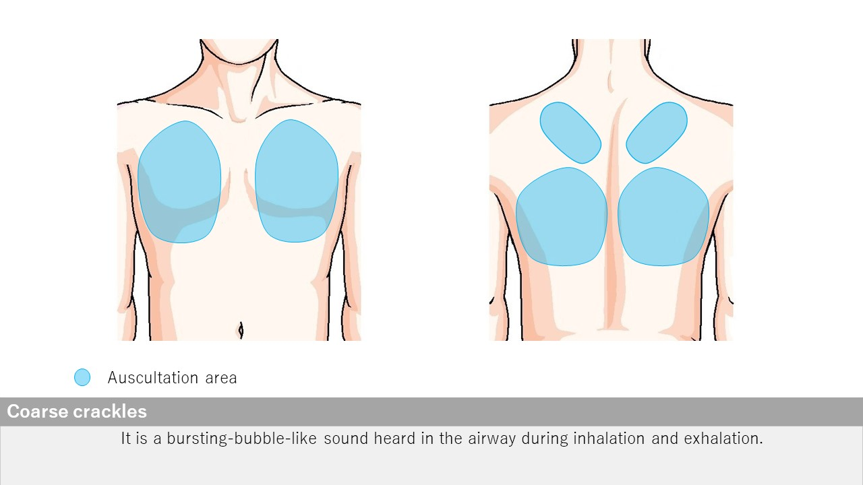
Coarse crackles
Open iPax
2522GA91
Pressing this button will open iPax.
2522GA91
Dedicated iPax site
https://kikuzosound.com/home
Recording, including screen captures and recordings via online meeting systems, is strictly prohibited. Please adhere to the terms of use while using this service.
iPax Information Page
https://telemedica.site/en/ipax24lp-paypal-en7-features-of-ipax2b/

Slide 14

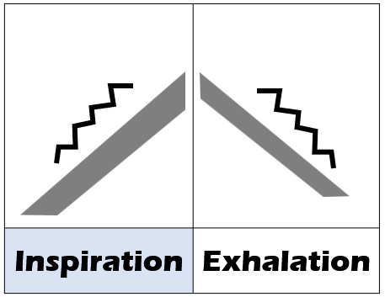
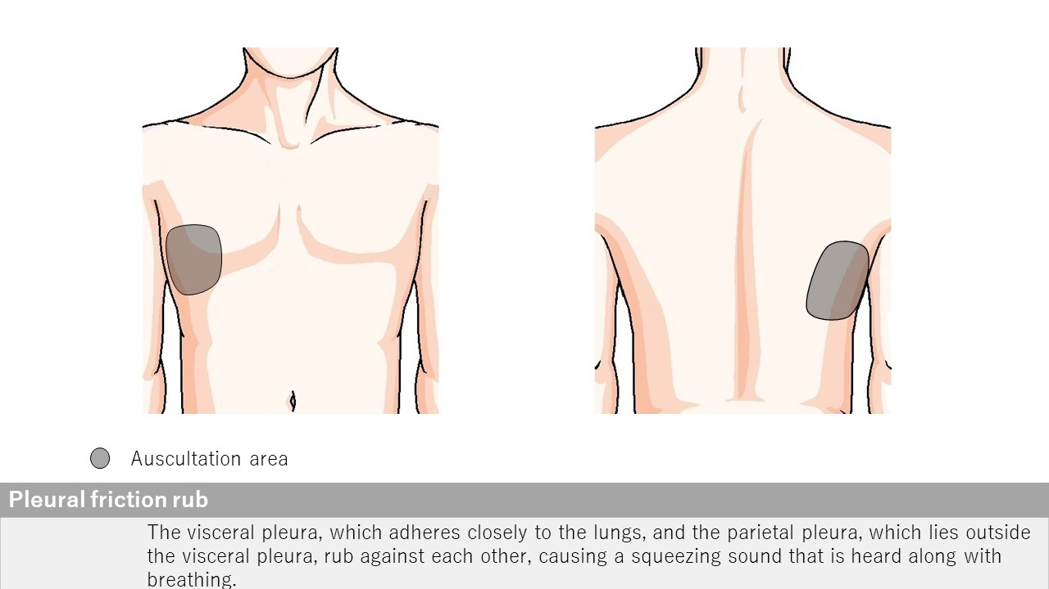
Pleural friction rub
←番号が2522だったので修正。ＱＲコードの症例は未確認
Open iPax
2521GA91
Pressing this button will open iPax.
2521GA91
Dedicated iPax site
https://kikuzosound.com/home
Recording, including screen captures and recordings via online meeting systems, is strictly prohibited. Please adhere to the terms of use while using this service.
iPax Information Page
https://telemedica.site/en/ipax24lp-paypal-en7-features-of-ipax2b/

Slide 15
Decreased Bronchial Breath Sounds
Airway narrowing caused by malignant lymphoma
Changes in Breath Sound
Cavernous Breath Sound
Case:
A 60-year-old woman with pulmonary adenocarcinoma
Case:
An 84-year-old woman with airway narrowing caused by malignant lymphoma
Auscultation Findings:
In the dorsal lower right lung field, "bronchial breath sounds replacing vesicular breath sounds" are observed. Fine crackles are heard in the dorsal lower left lung field.
Auscultation Findings:
Decreased breath sounds are observed in the left bronchial region.
Open iPax
2242GA91
Open iPax
2241GA91
Pressing this button will open iPax.
Pressing this button will open iPax.
Dedicated iPax site
https://kikuzosound.com/home
Recording, including screen captures and recordings via online meeting systems, is strictly prohibited. Please adhere to the terms of use while using this service.
iPax Information Page
https://telemedica.site/en/ipax24lp-paypal-en7-features-of-ipax2b/

Slide 16
Coarse Crackles and Rhonchi
Mucinous Adenocarcinoma of the Lung
Wheezes
Acute Exacerbation of COPD
Case:
A case of acute exacerbation of COPD
Case:
A 70-year-old woman with a one-year history of productive cough and hemoptysis.
Auscultation Findings:
Expiratory wheezes are heard during neck auscultation, with the expiratory phase prolonged to approximately a 1:3 ratio.
Auscultation Findings:
Coarse crackles and rhonchi are heard in the right middle lung field.
Open iPax
2310GA91
Open iPax
2238GA91
Pressing this button will open iPax.
Pressing this button will open iPax.
Dedicated iPax site
https://kikuzosound.com/home
Recording, including screen captures and recordings via online meeting systems, is strictly prohibited. Please adhere to the terms of use while using this service.
iPax Information Page
https://telemedica.site/en/ipax24lp-paypal-en7-features-of-ipax2b/

Slide 17
Coarse Crackles
A Case of Viral Infection
Coarse Crackles
Legionella Pneumonia
Case:
A patient presenting with cough and a fever of 38°C, diagnosed with a viral infection.
Case:
A man with a fever in the 38°C range and a productive cough.
Auscultation Findings:
Coarse crackles are heard in the right anterior chest, and coarse crackles with slight rhonchi are noted in the left dorsal lung base.
Auscultation Findings:
Coarse crackles are heard, more prominent in the right lung field than in the left lung field.
Open iPax
2313GA91
Open iPax
2245GA91
Pressing this button will open iPax.
Pressing this button will open iPax.
Dedicated iPax site
https://kikuzosound.com/home
Recording, including screen captures and recordings via online meeting systems, is strictly prohibited. Please adhere to the terms of use while using this service.
iPax Information Page
https://telemedica.site/en/ipax24lp-paypal-en7-features-of-ipax2b/

Slide 18
Fine Crackles | At Diagnosis
Anti-MDA-5 Antibody-Positive Dermatomyositis
Fine Crackles | After Treatment
Anti-MDA5 Antibody Positive Dermatomyositis
Case:
Interstitial pneumonia in a patient with anti-MDA5 antibody-positive dermatomyositis (at the time of diagnosis).
Case:
Interstitial pneumonia in a patient with anti-MDA5 antibody-positive dermatomyositis (after treatment).
Auscultation Findings:
Fine crackles are heard in the left lung base. In interstitial pneumonia with anti-MDA5 antibody positivity, the sounds are perceived as lower-pitched (low-frequency) compared to those in idiopathic pulmonary fibrosis (IPF).
Auscultation Findings:
The fine crackles previously heard in the left lung base at the time of diagnosis are now minimal.
Open iPax
2308GA91
Open iPax
2309GA91
Pressing this button will open iPax.
Pressing this button will open iPax.
Dedicated iPax site
https://kikuzosound.com/home
Recording, including screen captures and recordings via online meeting systems, is strictly prohibited. Please adhere to the terms of use while using this service.
iPax Information Page
https://telemedica.site/en/ipax24lp-paypal-en7-features-of-ipax2b/

Slide 19
Fine Crackles | Forced Inspiration
Idiopathic Pulmonary Fibrosis (IPF)
Fine Crackles | Resting Respiration
Idiopathic Pulmonary Fibrosis (IPF)
Case:
A case of idiopathic pulmonary fibrosis (IPF).
Case:
A case of idiopathic pulmonary fibrosis (IPF).
Auscultation Findings:
Fine crackles are heard in the lateral chest bilaterally and in the dorsal lung bases during deep inspiration.
Auscultation Findings:
Fine crackles heard during forced inspiration are only faintly audible during resting respiration.
Open iPax
2304GA91
Open iPax
2305GA91
Pressing this button will open iPax.
Pressing this button will open iPax.
Dedicated iPax site
https://kikuzosound.com/home
Recording, including screen captures and recordings via online meeting systems, is strictly prohibited. Please adhere to the terms of use while using this service.
iPax Information Page
https://telemedica.site/en/ipax24lp-paypal-en7-features-of-ipax2b/

Slide 20
Fine Crackles
Drug-Induced Pneumonitis Caused by Kampo Medicine
Fine Crackles
Cryptogenic Organizing Pneumonia (COP)
Case:
A 75-year-old man with a cough lasting for several days.
Case:
A 60-year-old woman with no prior medical history or medications. She developed shortness of breath, cough, and low-grade fever one month ago. Vital signs are normal except for a fever of 37°C.
Auscultation Findings:
Fine crackles are heard in the lateral chest bilaterally and in the dorsal lung bases.
Auscultation Findings:
Fine crackles are heard in the left chest.
Open iPax
2246GA91
Open iPax
2312GA91
Pressing this button will open iPax.
Pressing this button will open iPax.
Dedicated iPax site
https://kikuzosound.com/home
Recording, including screen captures and recordings via online meeting systems, is strictly prohibited. Please adhere to the terms of use while using this service.
iPax Information Page
https://telemedica.site/en/ipax24lp-paypal-en7-features-of-ipax2b/

Slide 21
Fine Crackles
Pneumocystis Pneumonia in an HIV-Positive Patient
Fine Crackles
COVID-19
Case:
A 50-year-old man with a one-month history of dry cough and low-grade fever.
Case:
A 31-year-old woman with a 5-day history of fatigue, fever in the 38°C range, sore throat, and cough.
Auscultation Findings:
Fine crackles are heard in the left anterior chest.
Auscultation Findings:
Fine crackles are heard in the lateral chest (lower lung fields) and the dorsal lung bases.
Open iPax
2244GA91
Open iPax
2247GA91
Pressing this button will open iPax.
Pressing this button will open iPax.
Dedicated iPax site
https://kikuzosound.com/home
Recording, including screen captures and recordings via online meeting systems, is strictly prohibited. Please adhere to the terms of use while using this service.
iPax Information Page
https://telemedica.site/en/ipax24lp-paypal-en7-features-of-ipax2b/

Slide 22
Pleural Friction Rub and Fine Crackles
Pleuritis in a Patient with Rheumatoid Arthritis
Fine Crackles
Idiopathic Pulmonary Fibrosis (IPF)
Case:
A case of interstitial pneumonia associated with rheumatoid arthritis and COPD Stage II.
Case:
A case of idiopathic pulmonary fibrosis (IPF).
Auscultation Findings:
Pleural friction rubs are heard in the right lung and the dorsal right lung base, while fine crackles are heard in the left lung and the dorsal left lung base.
Auscultation Findings:
Fine crackles are heard in the bilateral lateral chest and bilateral lung bases.
Open iPax
2243GA91
Open iPax
2377GA91
Pressing this button will open iPax.
Pressing this button will open iPax.
Dedicated iPax site
https://kikuzosound.com/home
Recording, including screen captures and recordings via online meeting systems, is strictly prohibited. Please adhere to the terms of use while using this service.
iPax Information Page
https://telemedica.site/en/ipax24lp-paypal-en7-features-of-ipax2b/

Slide 23
Vocal Sound Auscultation
Auscultatory Percussion
Auscultation is performed while asking the patient to say "ah" continuously.
Auscultatory percussion is a technique where percussion is performed near the sternal angle while auscultating along the midaxillary line. In areas with pleural effusion, the sound changes to dullness.
Auscultation Findings:
Vocal sounds are heard muffled in the left middle lung field region.
Auscultation Findings:
Percussion sounds change to dullness near the central area of the midaxillary line (blue line).
Open iPax
2236GA91
Open iPax
2237GA91
Pressing this button will open iPax.
Pressing this button will open iPax.
Dedicated iPax site
https://kikuzosound.com/home
Recording, including screen captures and recordings via online meeting systems, is strictly prohibited. Please adhere to the terms of use while using this service.
iPax Information Page
https://telemedica.site/en/ipax24lp-paypal-en7-features-of-ipax2b/

Slide 24
Coarse Crackles and Rhonchi
Carcinomatous Lymphangitis Caused by Lung Cancer
Wheezes
Atelectasis
Case:
A 63-year-old woman with secondary pulmonary hypertension associated with carcinomatous lymphangitis.
Case:
A patient with airway narrowing caused by mediastinal lymph node metastasis of a tumor, resulting in complete obstruction of the right bronchus and subsequent atelectasis.
Auscultation Findings:
Coarse crackles are heard at the end of inspiration in the bilateral lower lung fields, and rhonchi are heard throughout all lung fields. Increased intensity of the second pulmonary sound (Ⅱp) is noted, associated with secondary pulmonary hypertension caused by carcinomatous lymphangitis.
Auscultation Findings:
Wheezes are heard in the right bronchial region (recorded along with the sound of Nasal High Flow therapy).
Open iPax
2378GA91
Open iPax
2141GA91
Pressing this button will open iPax.
Pressing this button will open iPax.
Dedicated iPax site
https://kikuzosound.com/home
Recording, including screen captures and recordings via online meeting systems, is strictly prohibited. Please adhere to the terms of use while using this service.
iPax Information Page
https://telemedica.site/en/ipax24lp-paypal-en7-features-of-ipax2b/

Slide 25
Subcutaneous Crackling Sound | Subcutaneous Emphysema
Auscultation with the Stethoscope Pressed Firmly
Subcutaneous Crackling Sound | Subcutaneous Emphysema
Auscultation at Normal Pressure
Case:
A case of left pneumothorax, mediastinal emphysema, and subcutaneous emphysema (auscultated at normal pressure).
Case:
A case of left pneumothorax, mediastinal emphysema, and subcutaneous emphysema (auscultated with the stethoscope pressed firmly).
Auscultation Findings:
A crackling sound of air is heard in the left anterior chest.
Auscultation Findings:
The stethoscope is pressed firmly against the left anterior chest during auscultation.
Open iPax
2375GA91
Open iPax
2376GA91
Pressing this button will open iPax.
Pressing this button will open iPax.
On a Kikuzo Silicone Surface (at maximum volume), a palpable crackling sensation of air can be felt.
Dedicated iPax site
https://kikuzosound.com/home
Recording, including screen captures and recordings via online meeting systems, is strictly prohibited. Please adhere to the terms of use while using this service.
iPax Information Page
https://telemedica.site/en/ipax24lp-paypal-en7-features-of-ipax2b/

Slide 26

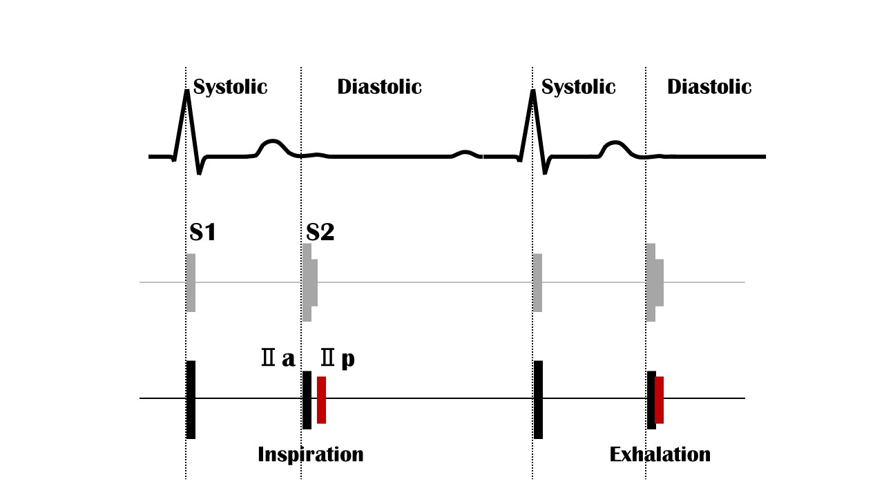

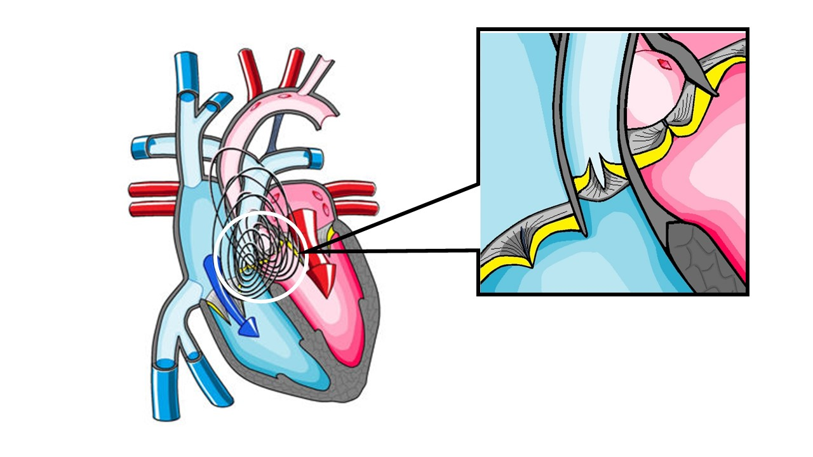
Respiratory S2 split
２LSB
Open iPax
2568GA91
Pressing this button will open iPax.
2568GA91
Dedicated iPax site
https://kikuzosound.com/home
Recording, including screen captures and recordings via online meeting systems, is strictly prohibited. Please adhere to the terms of use while using this service.
iPax Information Page
https://telemedica.site/en/ipax24lp-paypal-en7-features-of-ipax2b/

Slide 27

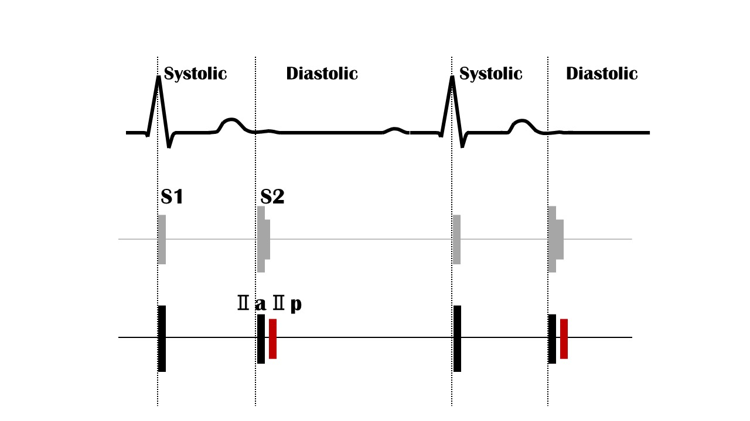
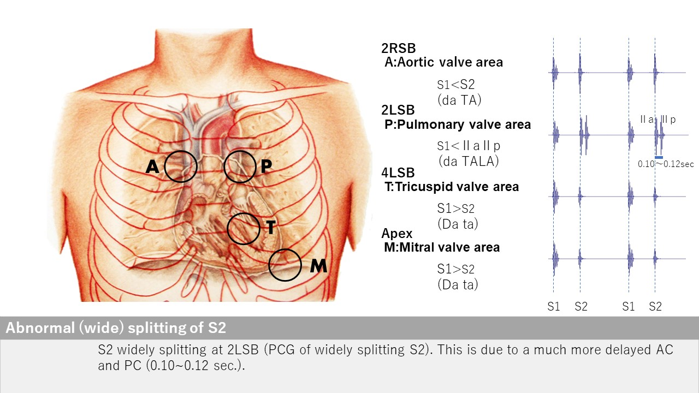
Abnormal S2 split
２LSB
Open iPax
2567GA91
Pressing this button will open iPax.
2567GA91
Dedicated iPax site
https://kikuzosound.com/home
Recording, including screen captures and recordings via online meeting systems, is strictly prohibited. Please adhere to the terms of use while using this service.
iPax Information Page
https://telemedica.site/en/ipax24lp-paypal-en7-features-of-ipax2b/

Slide 28

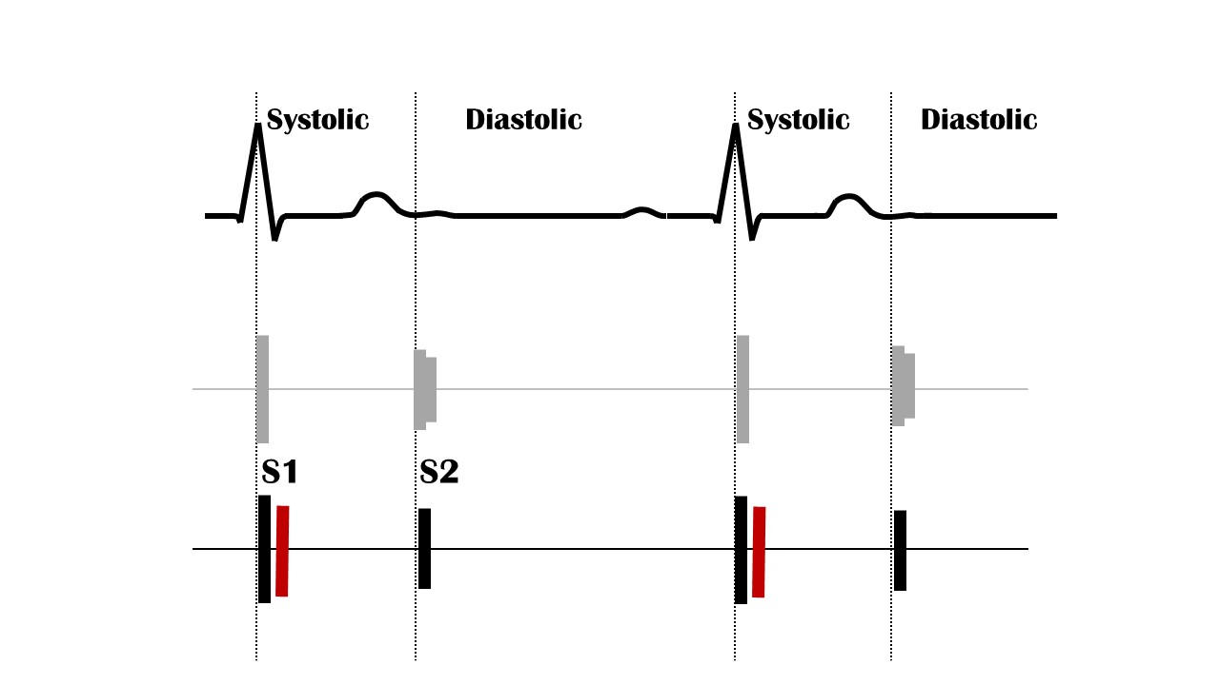
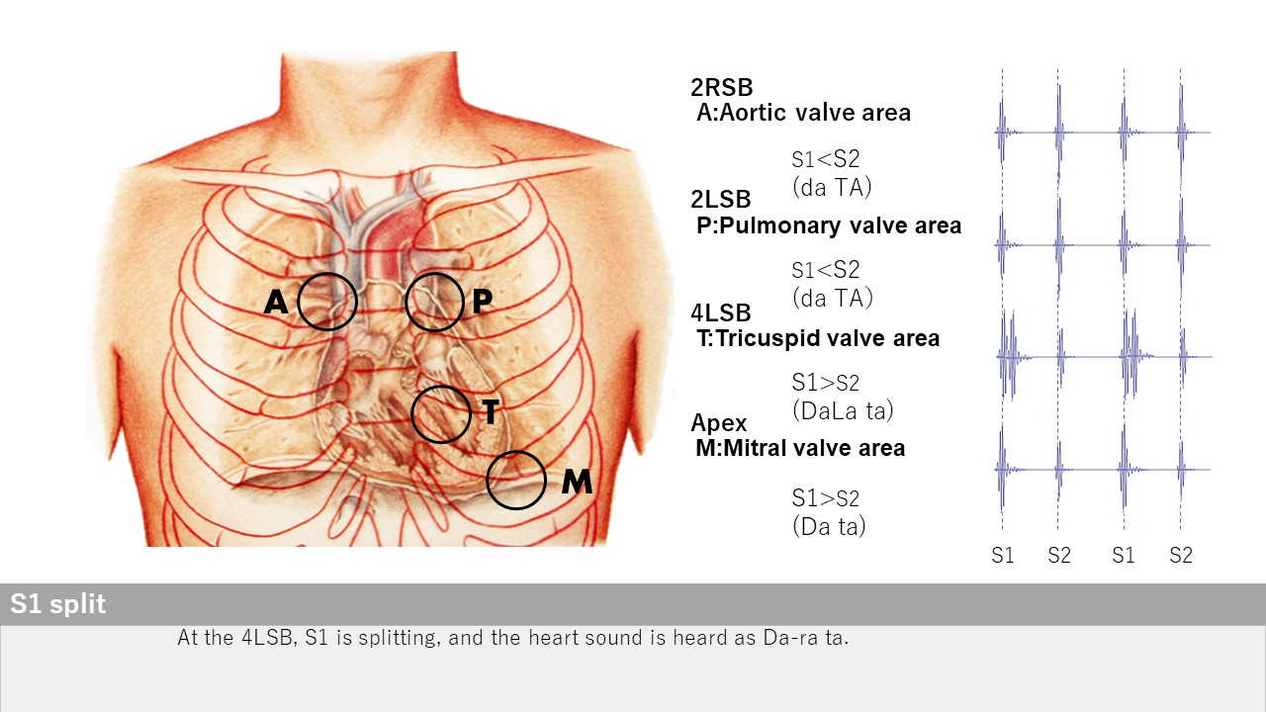
S１ split
４LSB
Open iPax
2566GA91
Pressing this button will open iPax.
2566GA91
Dedicated iPax site
https://kikuzosound.com/home
Recording, including screen captures and recordings via online meeting systems, is strictly prohibited. Please adhere to the terms of use while using this service.
iPax Information Page
https://telemedica.site/en/ipax24lp-paypal-en7-features-of-ipax2b/

Slide 29

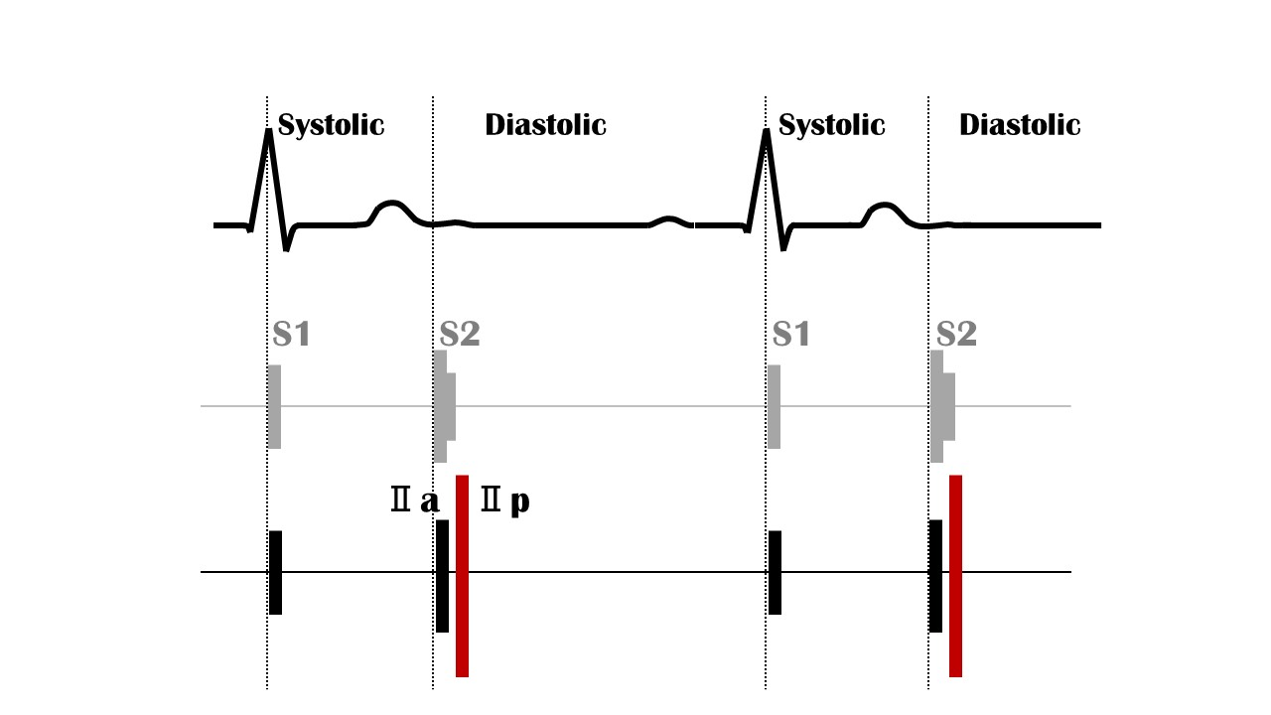

Loud Ⅱp
２LSB
Open iPax
2565GA91
Pressing this button will open iPax.
2565GA91
The lung sounds in this case are set with adventitious sounds.
Dedicated iPax site
https://kikuzosound.com/home
Recording, including screen captures and recordings via online meeting systems, is strictly prohibited. Please adhere to the terms of use while using this service.
iPax Information Page
https://telemedica.site/en/ipax24lp-paypal-en7-features-of-ipax2b/

Slide 30

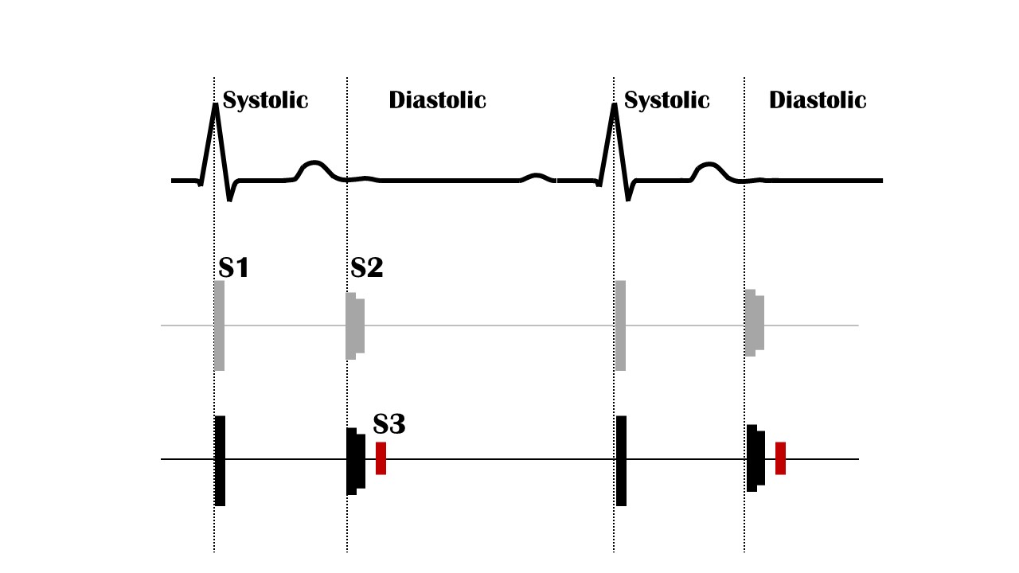

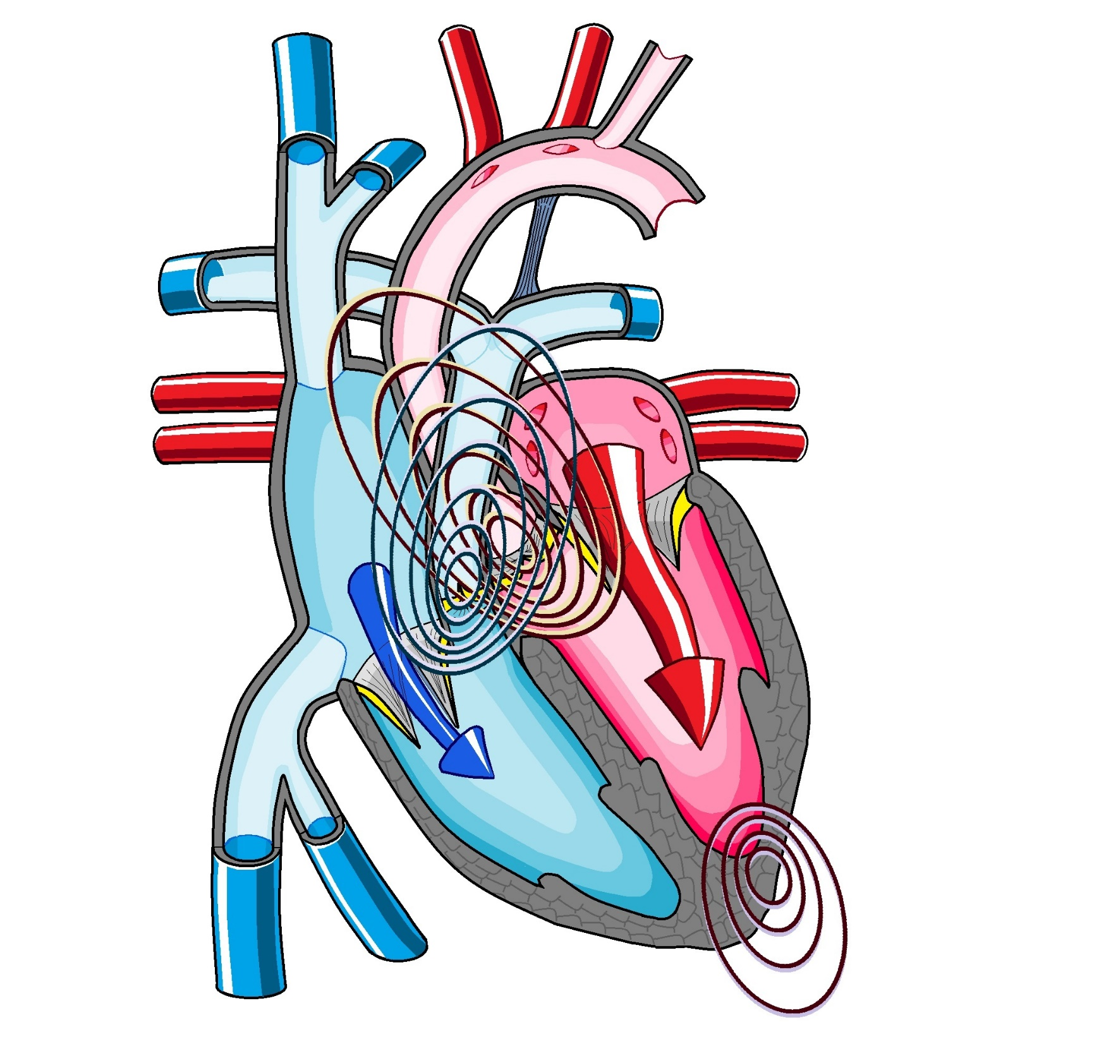

S3 gallop
Apex
Normal S3 volume
Open iPax
2561GA91
Pressing this button will open iPax.
2561GA91
By connecting the Kikuzo and maximizing the volume, the S3 sound can be confirmed through palpation.
Emphasized S3 volume
Open iPax
2563GA91
2563GA91
Dedicated iPax site
https://kikuzosound.com/home
Recording, including screen captures and recordings via online meeting systems, is strictly prohibited. Please adhere to the terms of use while using this service.
iPax Information Page
https://telemedica.site/en/ipax24lp-paypal-en7-features-of-ipax2b/

Slide 31

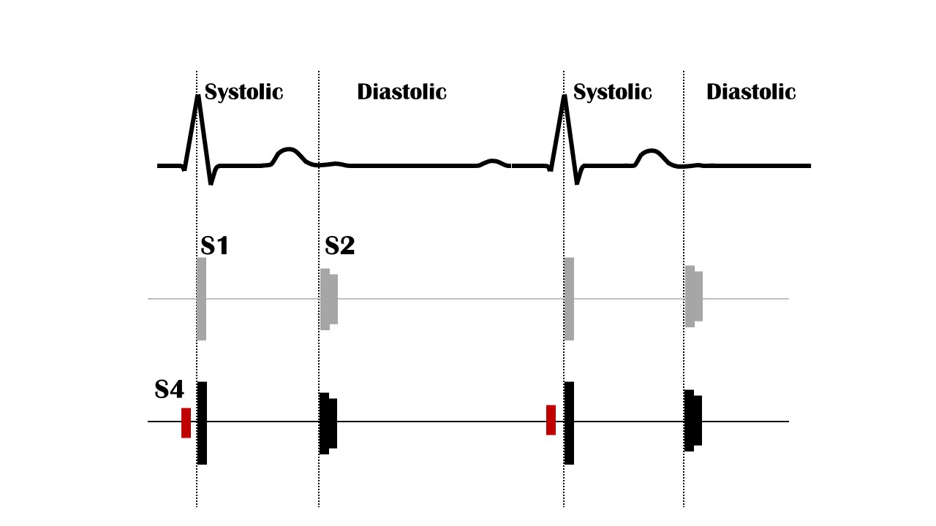

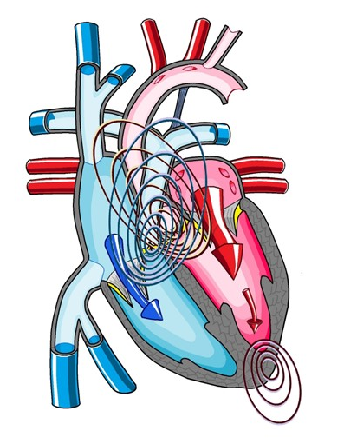

S４ gallop
Apex
Normal S4 volume
Open iPax
2560GA91
Pressing this button will open iPax.
2560GA91
By connecting the Kikuzo and maximizing the volume, the S4 sound can be confirmed through palpation.
Emphasized S4 volume
Open iPax
2562GA91
2562GA91
Dedicated iPax site
https://kikuzosound.com/home
Recording, including screen captures and recordings via online meeting systems, is strictly prohibited. Please adhere to the terms of use while using this service.
iPax Information Page
https://telemedica.site/en/ipax24lp-paypal-en7-features-of-ipax2b/

Slide 32

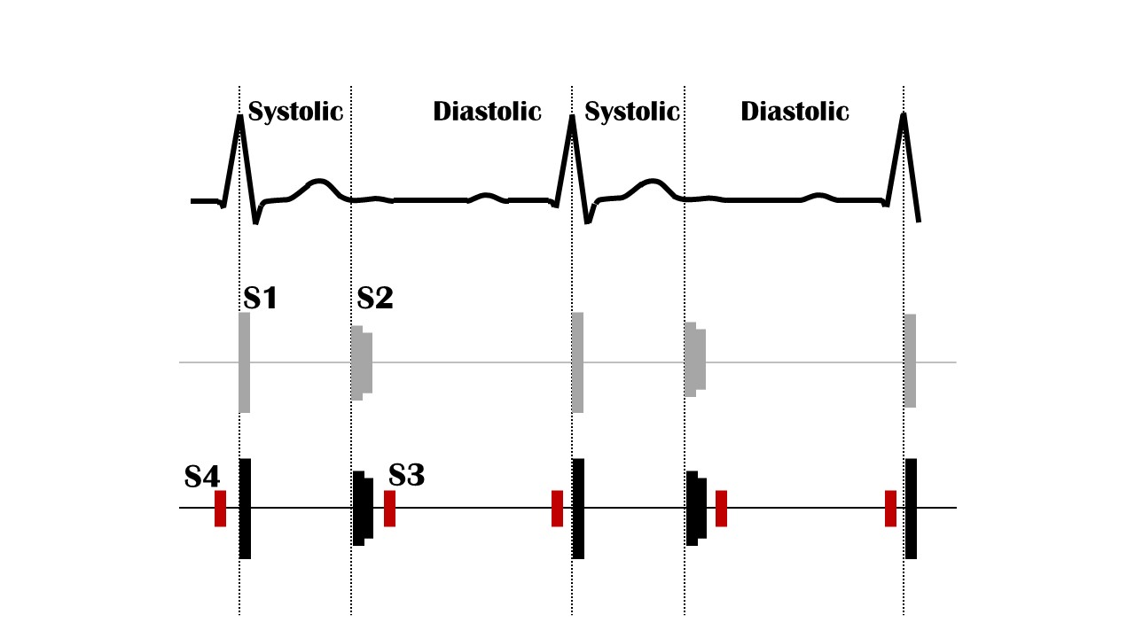
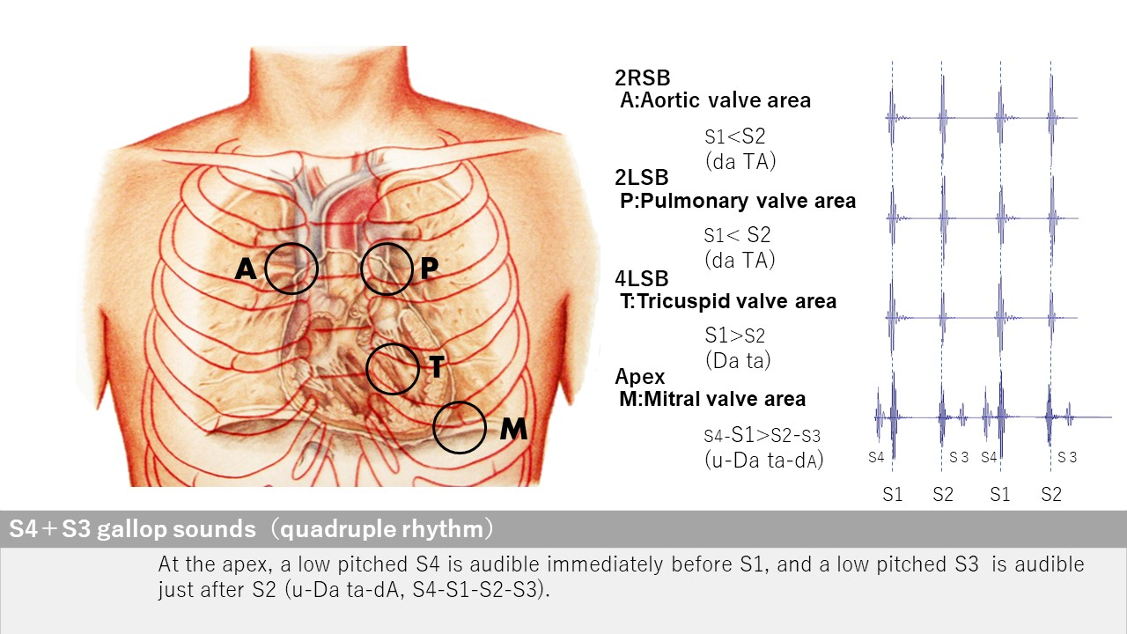
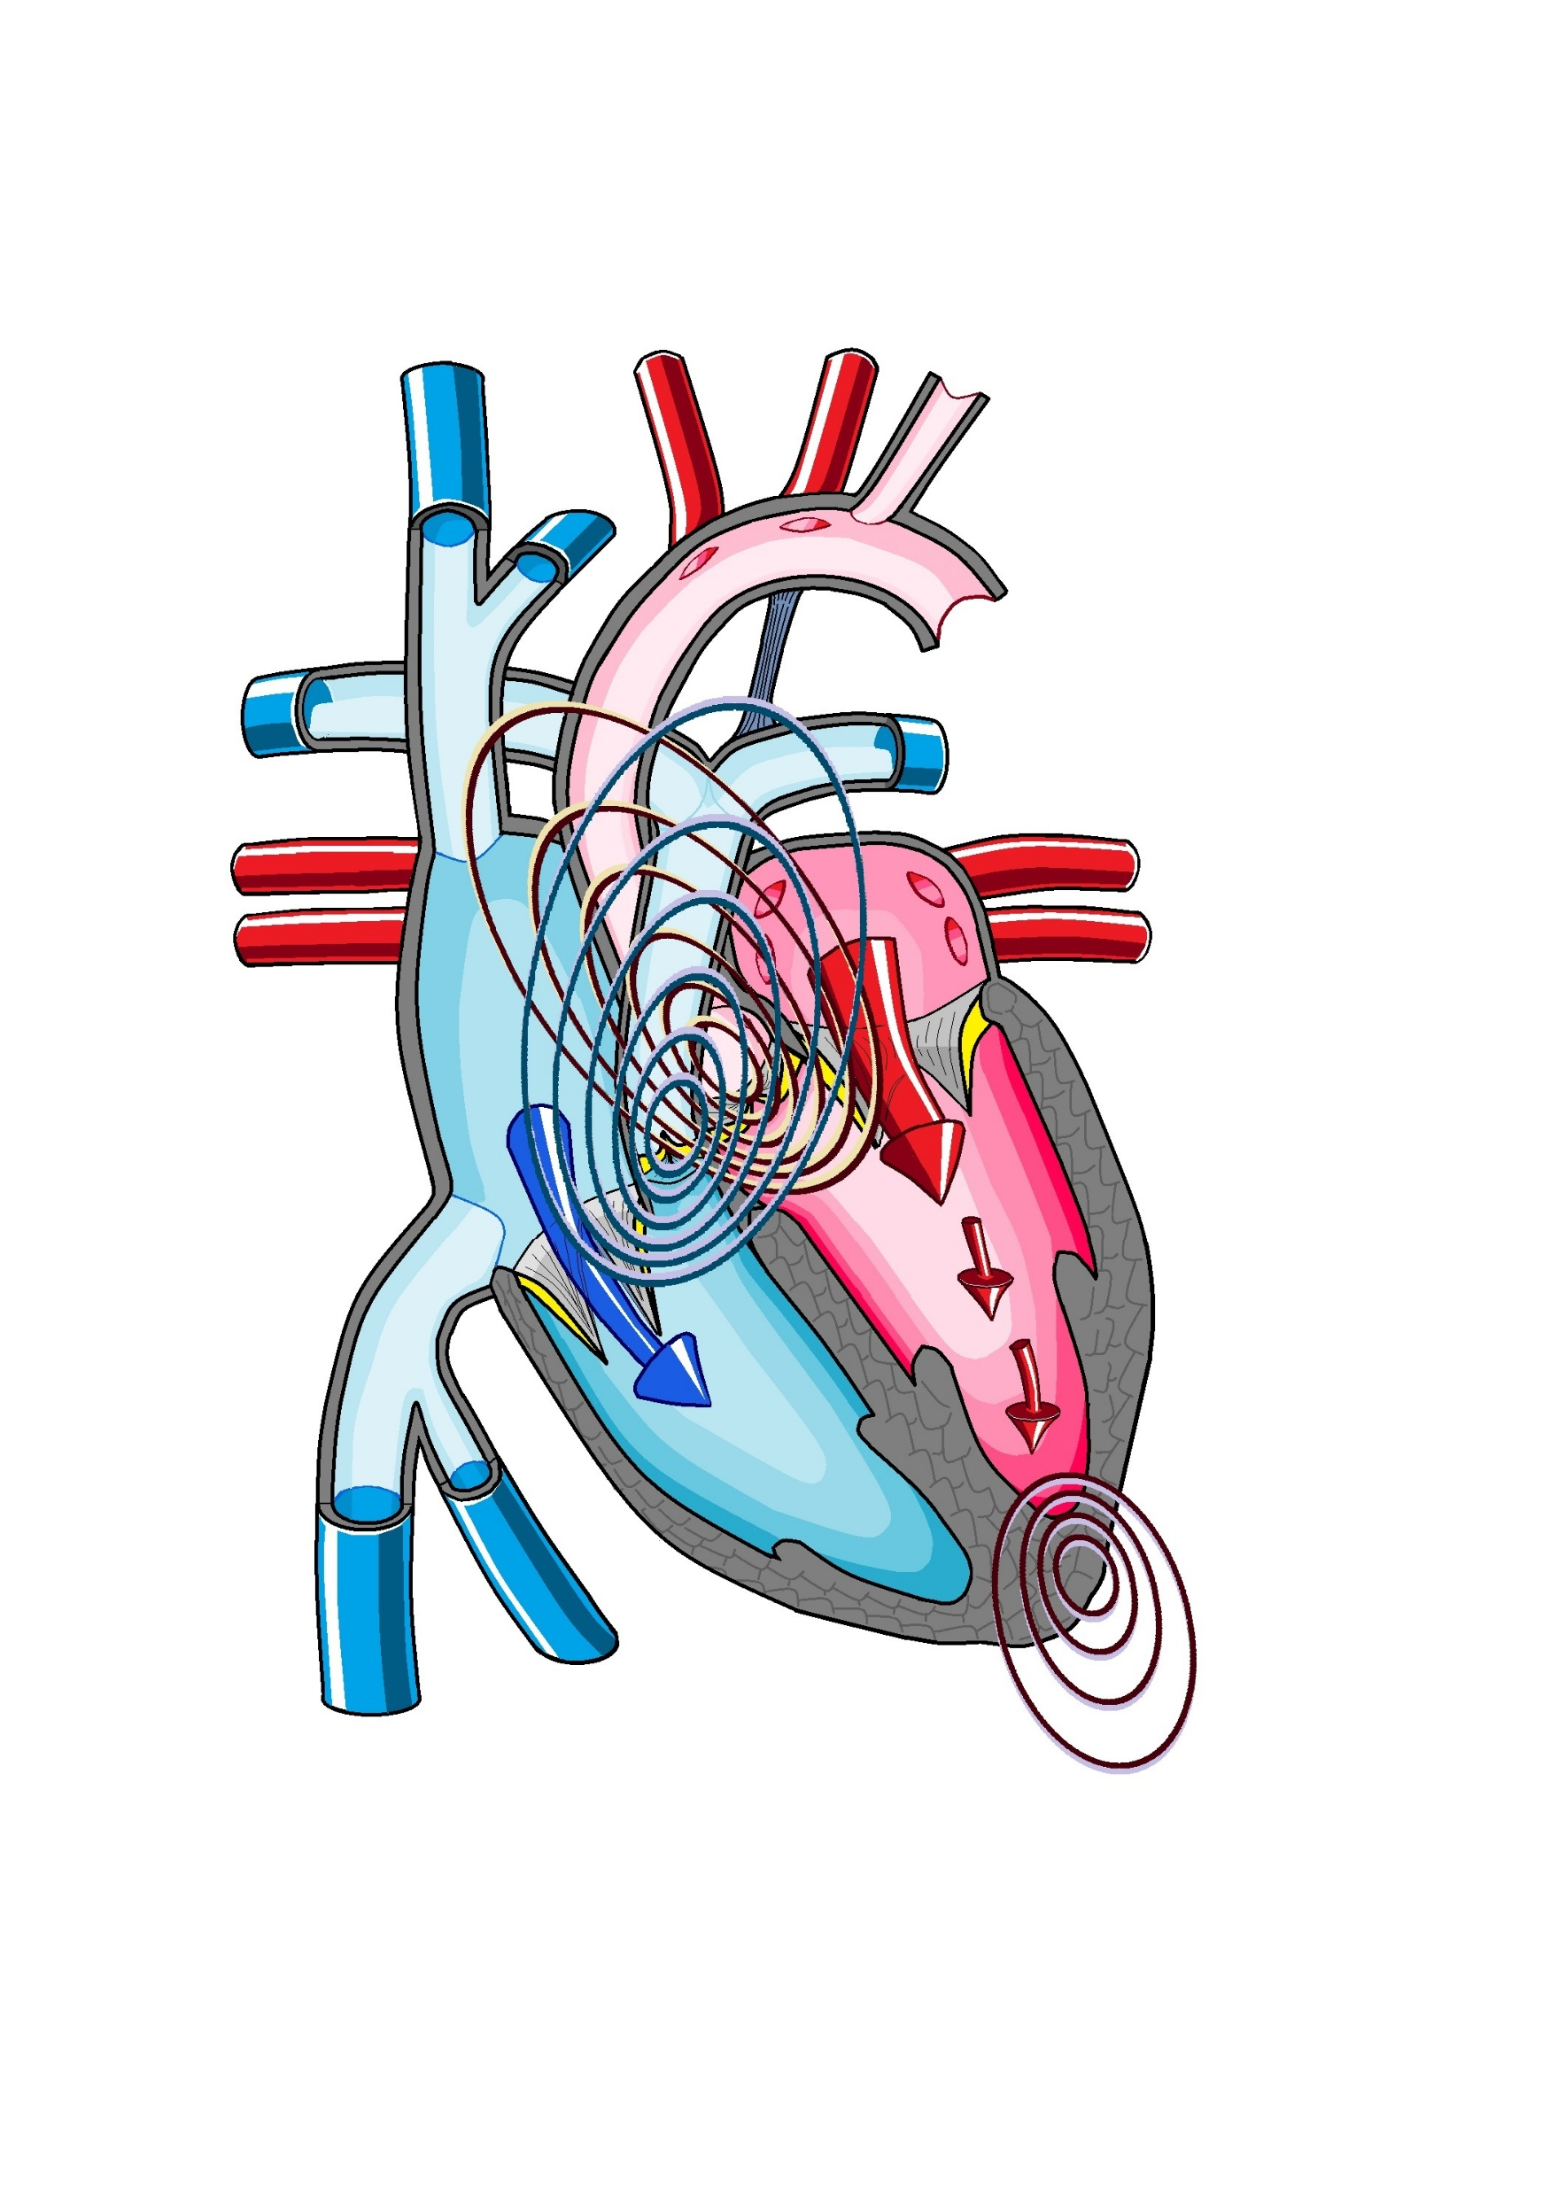
S４+S3
Apex
Open iPax
2559GA91
Pressing this button will open iPax.
2559GA91
Dedicated iPax site
https://kikuzosound.com/home
Recording, including screen captures and recordings via online meeting systems, is strictly prohibited. Please adhere to the terms of use while using this service.
iPax Information Page
https://telemedica.site/en/ipax24lp-paypal-en7-features-of-ipax2b/

Slide 33

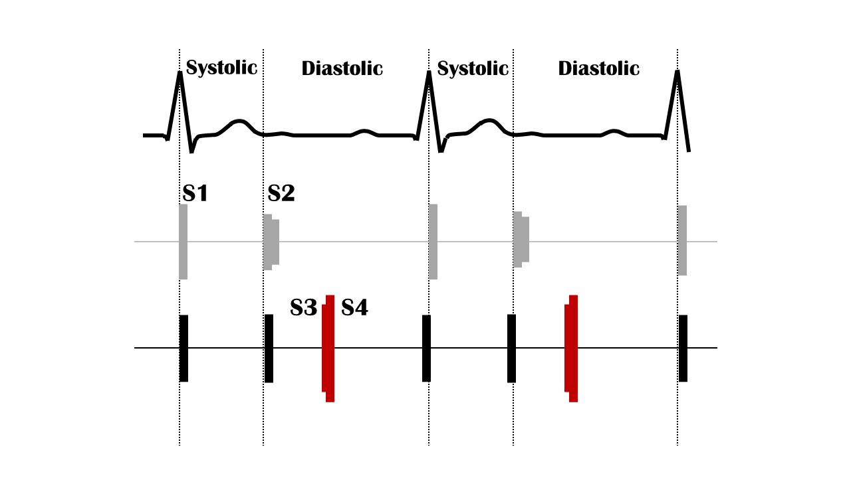
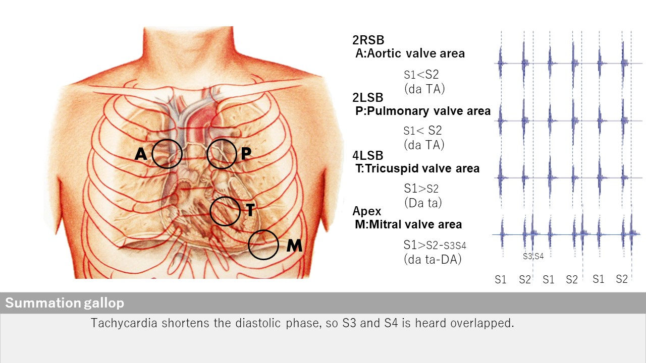
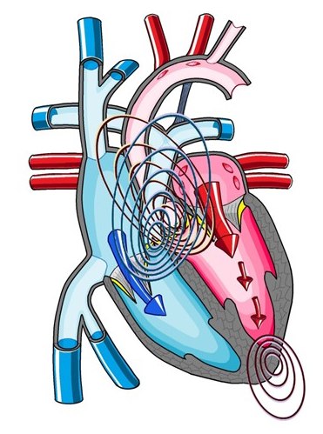
Summation gallop
Apex
Open iPax
2558GA91
Pressing this button will open iPax.
2558GA91
Dedicated iPax site
https://kikuzosound.com/home
Recording, including screen captures and recordings via online meeting systems, is strictly prohibited. Please adhere to the terms of use while using this service.
iPax Information Page
https://telemedica.site/en/ipax24lp-paypal-en7-features-of-ipax2b/

Slide 34

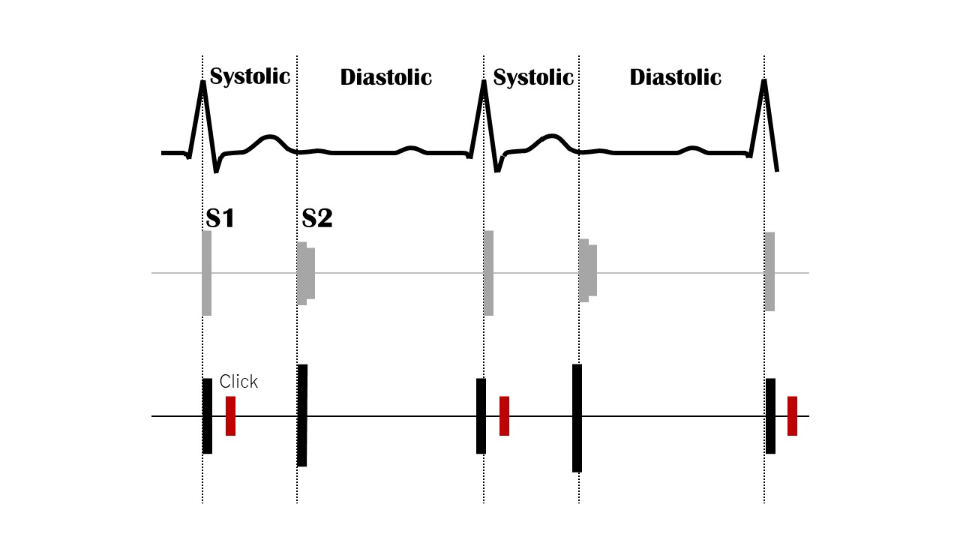
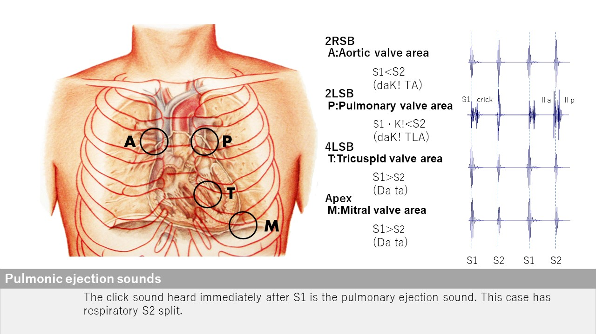
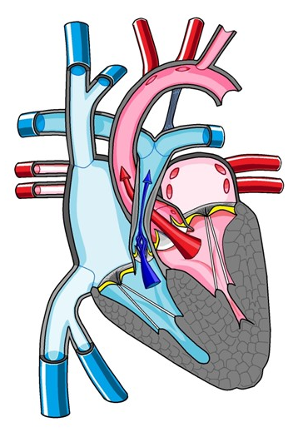
Pulmonic ejection sound
2LSB
Open iPax
2557GA91
Pressing this button will open iPax.
2557GA91
Dedicated iPax site
https://kikuzosound.com/home
Recording, including screen captures and recordings via online meeting systems, is strictly prohibited. Please adhere to the terms of use while using this service.
iPax Information Page
https://telemedica.site/en/ipax24lp-paypal-en7-features-of-ipax2b/

Slide 35

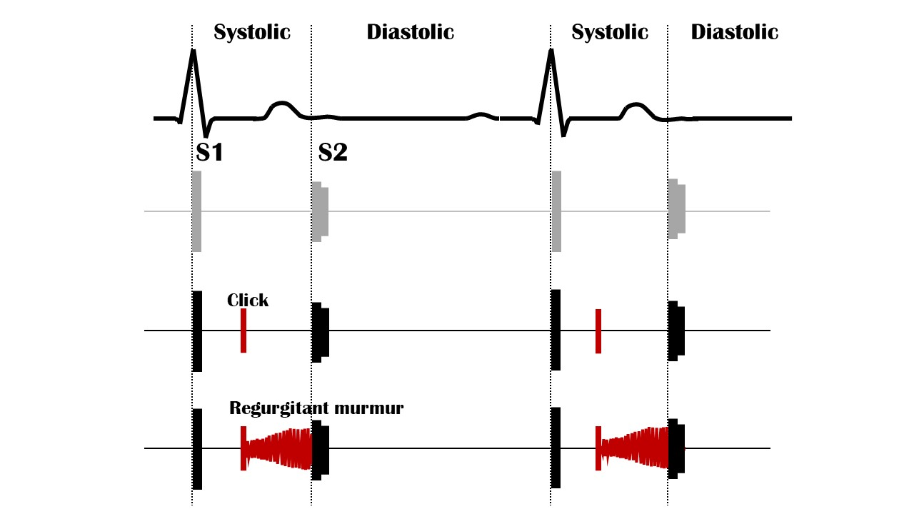

Click sound
Apex
Open iPax
2556GA91
Pressing this button will open iPax.
2556GA91
Dedicated iPax site
https://kikuzosound.com/home
Recording, including screen captures and recordings via online meeting systems, is strictly prohibited. Please adhere to the terms of use while using this service.
iPax Information Page
https://telemedica.site/en/ipax24lp-paypal-en7-features-of-ipax2b/

Slide 36


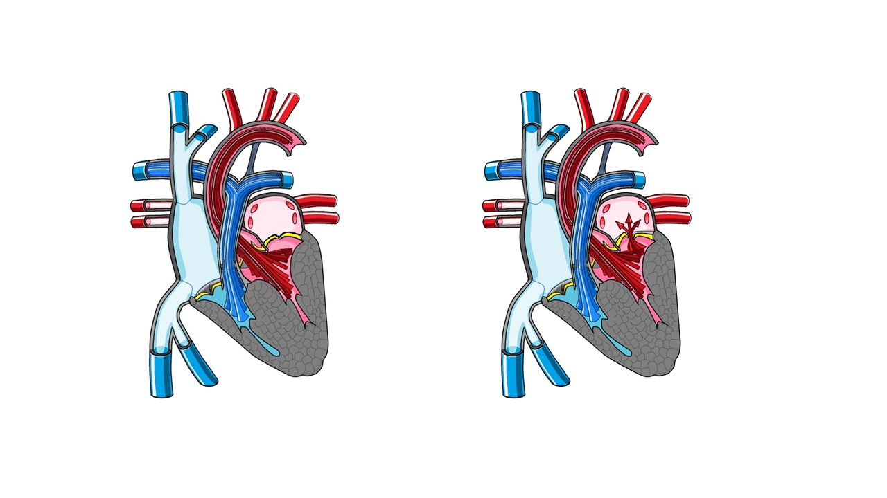
Click + Regurgitant murmur
Apex
Open iPax
2555GA91
Pressing this button will open iPax.
2555GA91
Dedicated iPax site
https://kikuzosound.com/home
Recording, including screen captures and recordings via online meeting systems, is strictly prohibited. Please adhere to the terms of use while using this service.
iPax Information Page
https://telemedica.site/en/ipax24lp-paypal-en7-features-of-ipax2b/

Slide 37

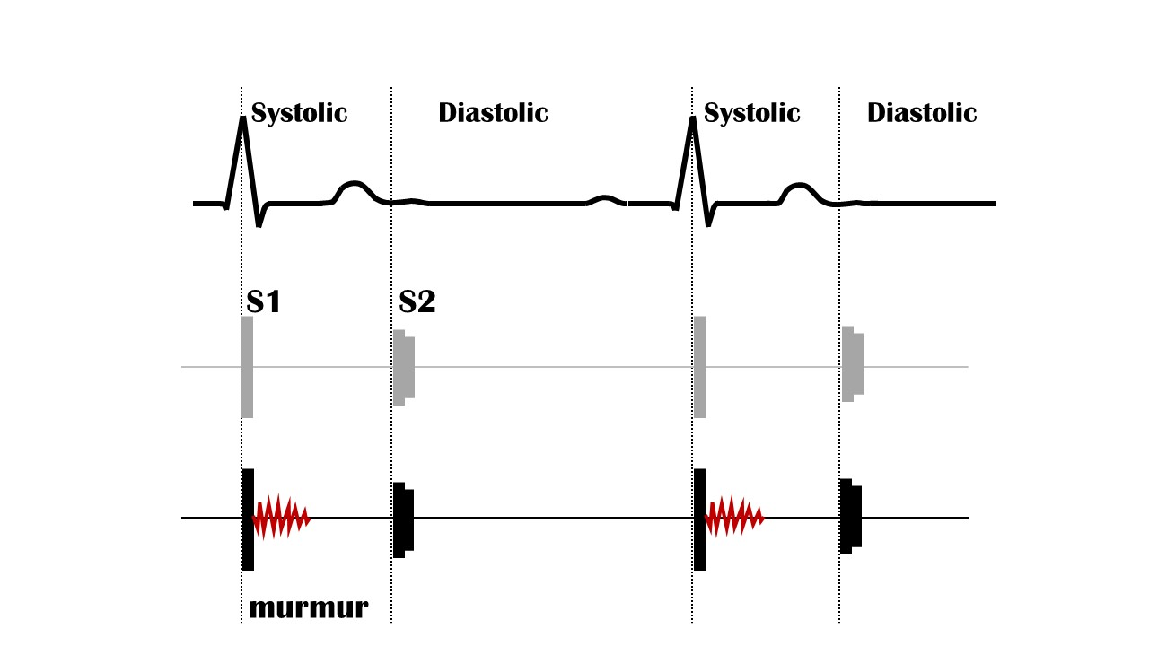

Innocent murmur
2LSB
Open iPax
2553GA91
Pressing this button will open iPax.
2553GA91
Dedicated iPax site
https://kikuzosound.com/home
Recording, including screen captures and recordings via online meeting systems, is strictly prohibited. Please adhere to the terms of use while using this service.
iPax Information Page
https://telemedica.site/en/ipax24lp-paypal-en7-features-of-ipax2b/

Slide 38




Aortic stenosis
2RSB
Open iPax
2552GA91
Pressing this button will open iPax.
2552GA91
By connecting the Kikuzo and maximizing the volume, you can feel the thrill using the Kikuzo.
Dedicated iPax site
https://kikuzosound.com/home
Recording, including screen captures and recordings via online meeting systems, is strictly prohibited. Please adhere to the terms of use while using this service.
iPax Information Page
https://telemedica.site/en/ipax24lp-paypal-en7-features-of-ipax2b/

Slide 39





Tricuspid regurgitation
４LSB
Open iPax
2550GA91
Pressing this button will open iPax.
2550GA91
Enhanced
Rivelo-Carvallo sign
Open iPax
2551GA91
2551GA91
Dedicated iPax site
https://kikuzosound.com/home
Recording, including screen captures and recordings via online meeting systems, is strictly prohibited. Please adhere to the terms of use while using this service.
iPax Information Page
https://telemedica.site/en/ipax24lp-paypal-en7-features-of-ipax2b/

Slide 40




Mitral regurgitation
Apex
Open iPax
2549GA91
Pressing this button will open iPax.
2549GA91
Dedicated iPax site
https://kikuzosound.com/home
Recording, including screen captures and recordings via online meeting systems, is strictly prohibited. Please adhere to the terms of use while using this service.
iPax Information Page
https://telemedica.site/en/ipax24lp-paypal-en7-features-of-ipax2b/

Slide 41




Mitral valvular prolapse
Apex
Open iPax
2548GA91
Pressing this button will open iPax.
2548GA91
Dedicated iPax site
https://kikuzosound.com/home
Recording, including screen captures and recordings via online meeting systems, is strictly prohibited. Please adhere to the terms of use while using this service.
iPax Information Page
https://telemedica.site/en/ipax24lp-paypal-en7-features-of-ipax2b/

Slide 42




Hypertrophic cardiomyopathy
４LSB
Open iPax
2547GA91
Pressing this button will open iPax.
2547GA91
Dedicated iPax site
https://kikuzosound.com/home
Recording, including screen captures and recordings via online meeting systems, is strictly prohibited. Please adhere to the terms of use while using this service.
iPax Information Page
https://telemedica.site/en/ipax24lp-paypal-en7-features-of-ipax2b/

Slide 43




Dilated cardiomyopathy
Apex
Open iPax
2546GA91
Pressing this button will open iPax.
2546GA91
Dedicated iPax site
https://kikuzosound.com/home
Recording, including screen captures and recordings via online meeting systems, is strictly prohibited. Please adhere to the terms of use while using this service.
iPax Information Page
https://telemedica.site/en/ipax24lp-paypal-en7-features-of-ipax2b/

Slide 44




Aortic regurgitation
３LSB
Open iPax
2545GA91
Pressing this button will open iPax.
2545GA91
Dedicated iPax site
https://kikuzosound.com/home
Recording, including screen captures and recordings via online meeting systems, is strictly prohibited. Please adhere to the terms of use while using this service.
iPax Information Page
https://telemedica.site/en/ipax24lp-paypal-en7-features-of-ipax2b/

Slide 45




Mitral stenosis
Apex
Open iPax
2544GA91
Pressing this button will open iPax.
2544GA91
Dedicated iPax site
https://kikuzosound.com/home
Recording, including screen captures and recordings via online meeting systems, is strictly prohibited. Please adhere to the terms of use while using this service.
iPax Information Page
https://telemedica.site/en/ipax24lp-paypal-en7-features-of-ipax2b/

Slide 46




Pulmonic valvular stenosis
２LSB
Open iPax
2543GA91
Pressing this button will open iPax.
2543GA91
Dedicated iPax site
https://kikuzosound.com/home
Recording, including screen captures and recordings via online meeting systems, is strictly prohibited. Please adhere to the terms of use while using this service.
iPax Information Page
https://telemedica.site/en/ipax24lp-paypal-en7-features-of-ipax2b/

Slide 47




ASD + PH
２LSB, 4LSB
Open iPax
2542GA91
Pressing this button will open iPax.
2542GA91
Dedicated iPax site
https://kikuzosound.com/home
Recording, including screen captures and recordings via online meeting systems, is strictly prohibited. Please adhere to the terms of use while using this service.
iPax Information Page
https://telemedica.site/en/ipax24lp-paypal-en7-features-of-ipax2b/

Slide 48



ASD
２LSB
Open iPax
2541GA91
Pressing this button will open iPax.
2541GA91
Dedicated iPax site
https://kikuzosound.com/home
Recording, including screen captures and recordings via online meeting systems, is strictly prohibited. Please adhere to the terms of use while using this service.
iPax Information Page
https://telemedica.site/en/ipax24lp-paypal-en7-features-of-ipax2b/

Slide 49




VSD
４LSB
Open iPax
2540GA91
Pressing this button will open iPax.
2540GA91
Dedicated iPax site
https://kikuzosound.com/home
Recording, including screen captures and recordings via online meeting systems, is strictly prohibited. Please adhere to the terms of use while using this service.
iPax Information Page
https://telemedica.site/en/ipax24lp-paypal-en7-features-of-ipax2b/

Slide 50




Patent ductus arteriosus
２LSB
Open iPax
2538GA91
Pressing this button will open iPax.
2538GA91
Dedicated iPax site
https://kikuzosound.com/home
Recording, including screen captures and recordings via online meeting systems, is strictly prohibited. Please adhere to the terms of use while using this service.
iPax Information Page
https://telemedica.site/en/ipax24lp-paypal-en7-features-of-ipax2b/

