Slide 1
Introduction.
Free Cases Cases available on pages 4 to 6 of this file can be used free of charge. Pressing the link button (in slideshow mode) will open the iPax content. Scanning the QR code will open the case for smartphones.
Paid Cases From page 7 onward, the content is paid and intended for educational institutions. A contract is required to use this content. Pressing the link button or scanning the QR code will open the login page. Please log in with your own ID to access the content. Once logged in, subsequent cases can be accessed without logging in again. The content is also available on a dedicated paid content website. If you wish to purchase a license, please visit the iPax Information Page. For invoice payment requests, please contact our company.
Inquiry
Telemedica Inc.
email 3sp@telemedica.co.jp
Dedicated iPax site
https://kikuzosound.com/home
Recording, including screen captures and recordings via online meeting systems, is strictly prohibited. Please adhere to the terms of use while using this service.
iPax Information Page
https://telemedica.site/en/ipax24lp-paypal-en7-features-of-ipax2b/

Slide 2
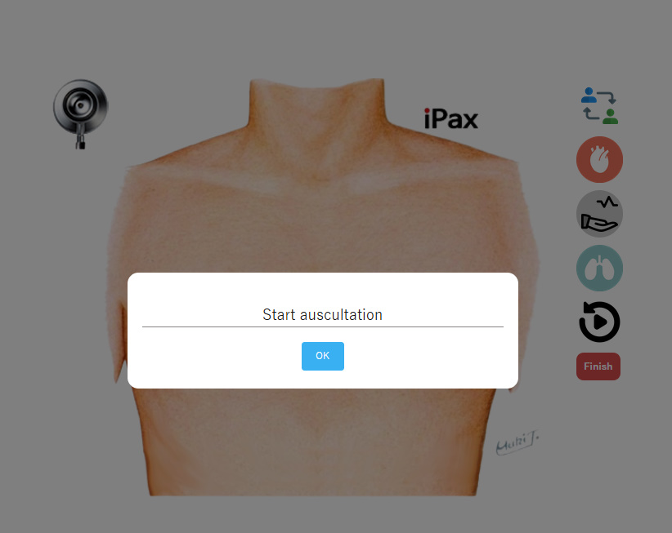
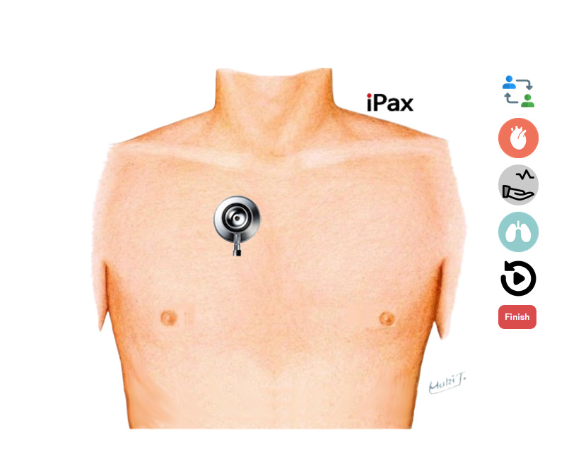
How to use iPax
Scanning the QR code will launch the browser. Available for student license holders.
Press here to launch the browser. Available for educational institution license holders.
１．Enter the required information on the first page.
２．After login is complete, iPax will be displayed.
３．Press the OK button.
４．Tap the area to auscultate.
５．Chest piece area sound playback．*When listening to sounds, please use external speakers or earphones. Without earphones, the sound may be barely audible.
６．Use the arrow icon at the top right to switch to the back.
７．To exit, press 'Finish' and close the browser.
１．Enter the required information on the first page.
２．After completing the login, iPax will be displayed.
３．Start auscultation.
*When listening to sounds, please use earphones. Without earphones, the sound may be barely audible.
The cases available for use with a student license vary depending on the terms of the contract.
Recording, including screen captures and recordings via online meeting systems, is strictly prohibited. Please adhere to the terms of use while using this service.

Slide 3
Prohibited Actions Screen captures, recordings via online meeting systems, and all forms of recording or audio recording are strictly prohibited. Please adhere to the terms of use when utilizing this service.
Device Usage Avoid using low-spec computers or older smartphone models, as they may result in slow performance or an inability to use certain functions.
Listening Environment When listening to sounds, please use external speakers or canal-type earphones. The built-in speakers of devices may produce minimal sound. It is recommended to use the service in a quiet environment.
Recommended Browsers Chrome and Safari (latest versions)
Inquiry
Telemedica Inc.
email 3sp@telemedica.co.jp
Dedicated iPax site
https://kikuzosound.com/home
iPax Information Page
https://telemedica.site/en/ipax24lp-paypal-en7-features-of-ipax2b/

Slide 4
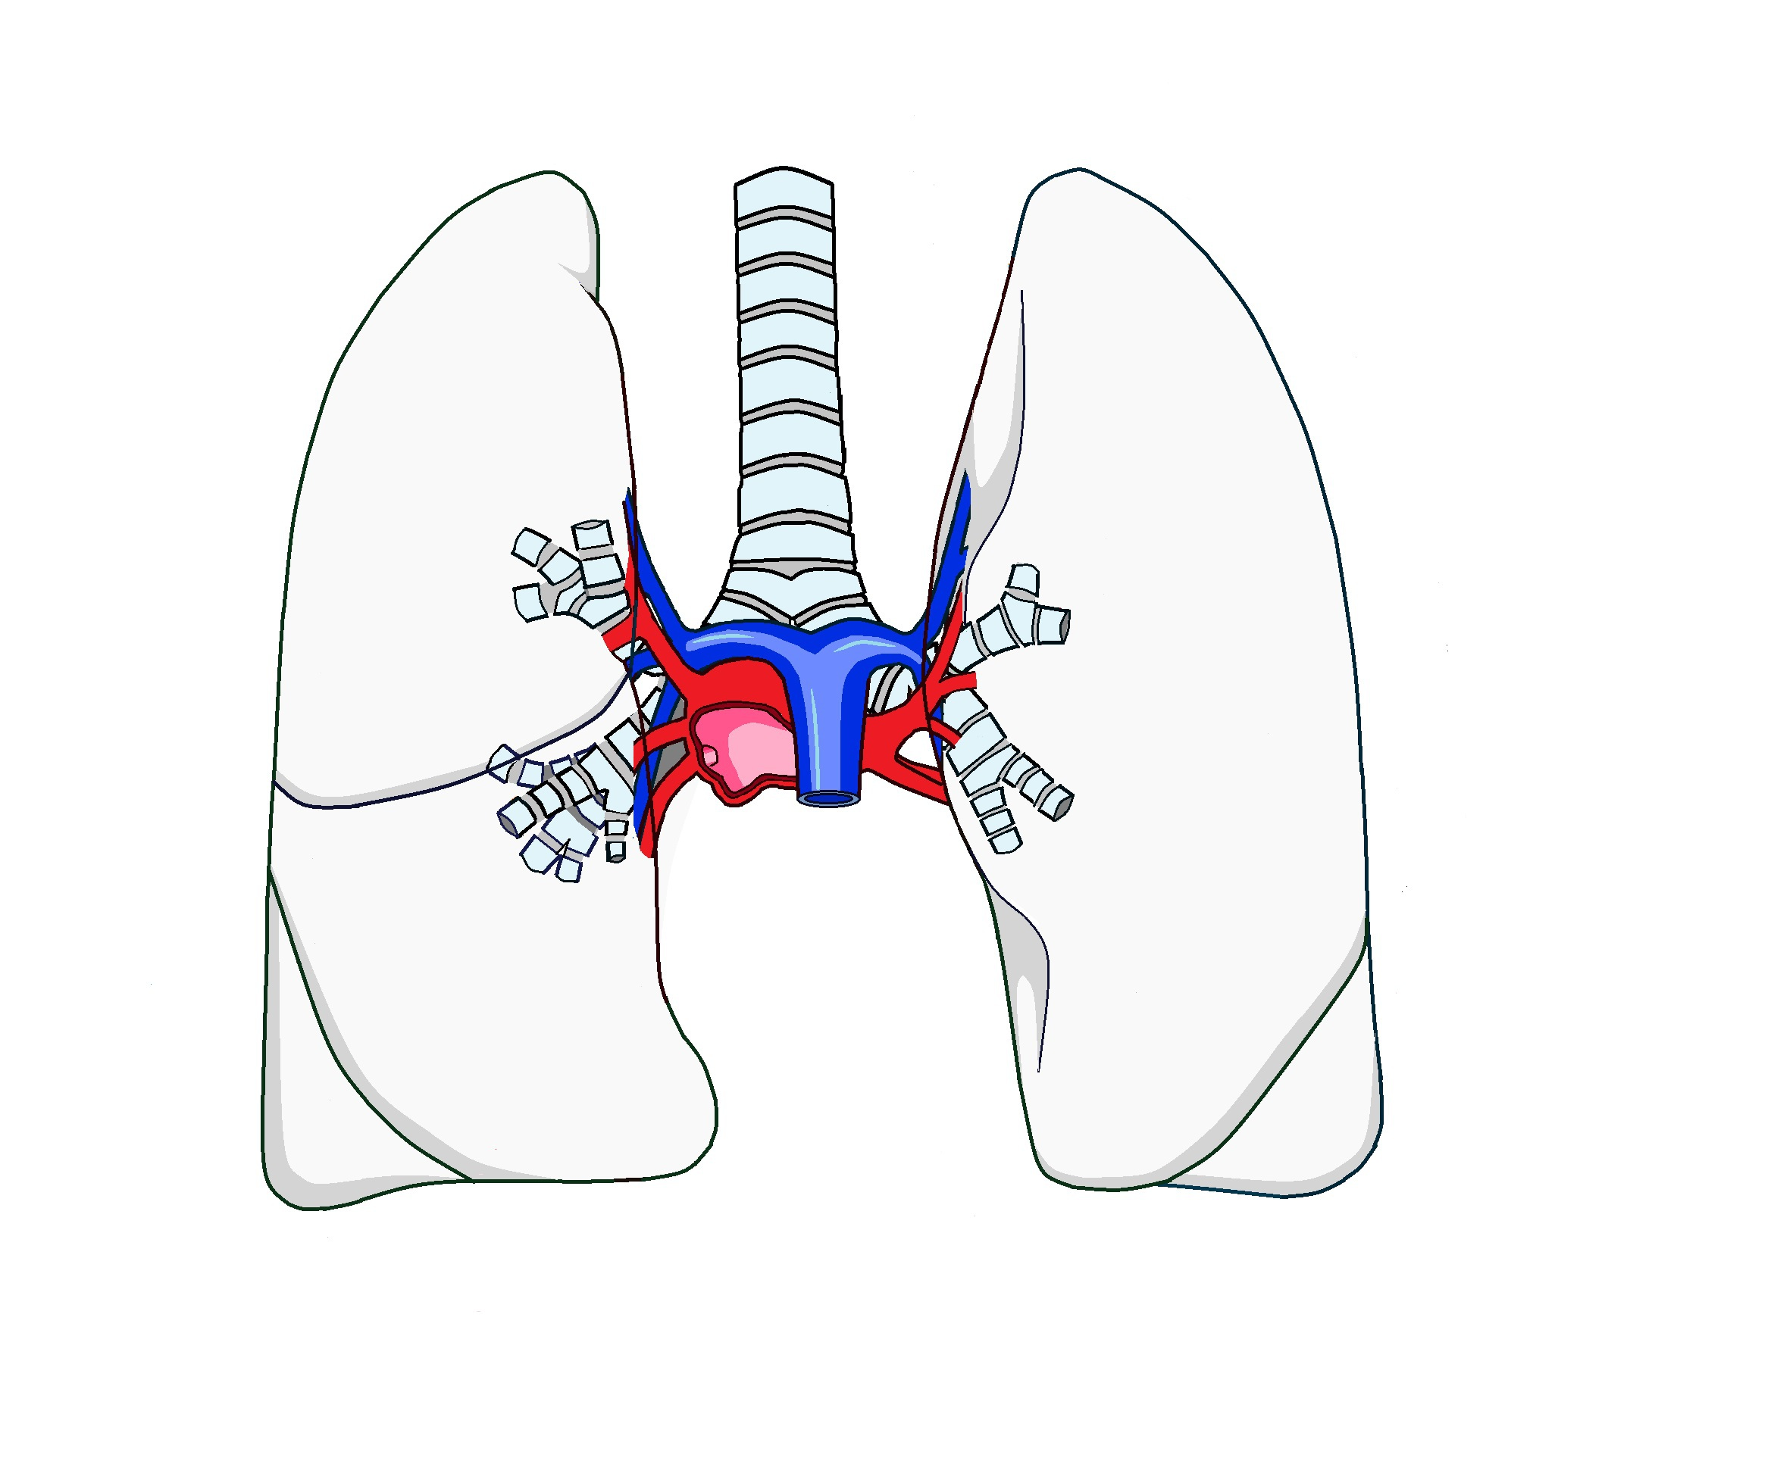
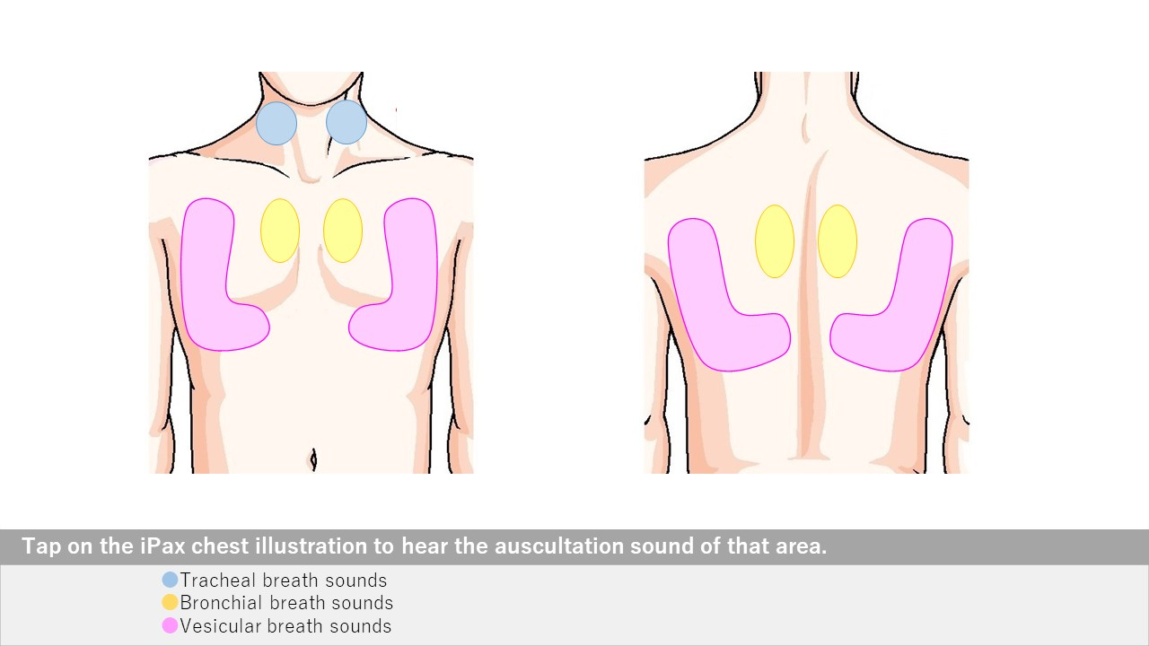
Free
Normal lung sound
Open iPax
2234GA91
Pressing this button will open iPax.
2531GA91
Pressing this button will open mp4.
Tracheal Breath Sound Video
2590GA91
Bronchial Breath Sound Video
2591GA91
Vesicular Breath Sound Video
2592GA91
Dedicated iPax site
https://kikuzosound.com/home
Recording, including screen captures and recordings via online meeting systems, is strictly prohibited. Please adhere to the terms of use while using this service.
iPax Information Page
https://telemedica.site/en/ipax24lp-paypal-en7-features-of-ipax2b/

Slide 5
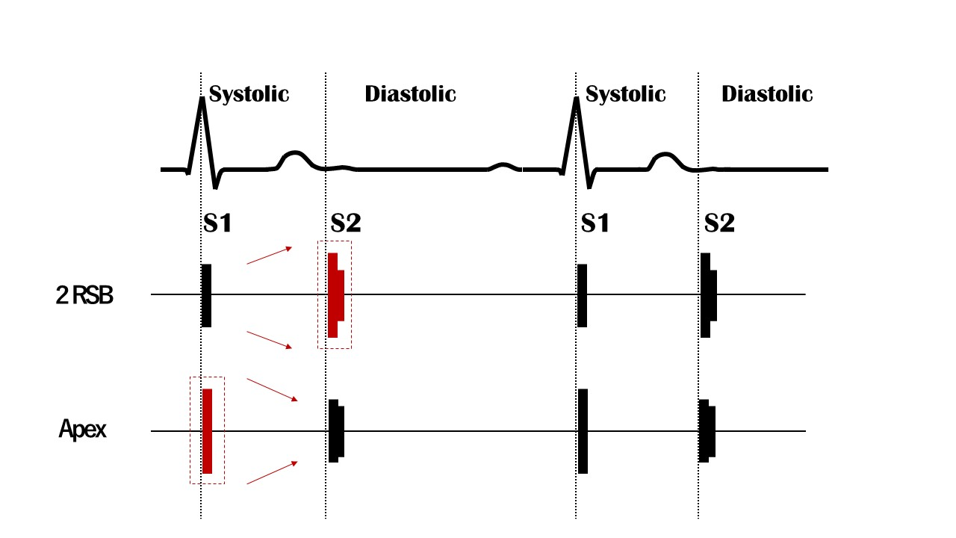
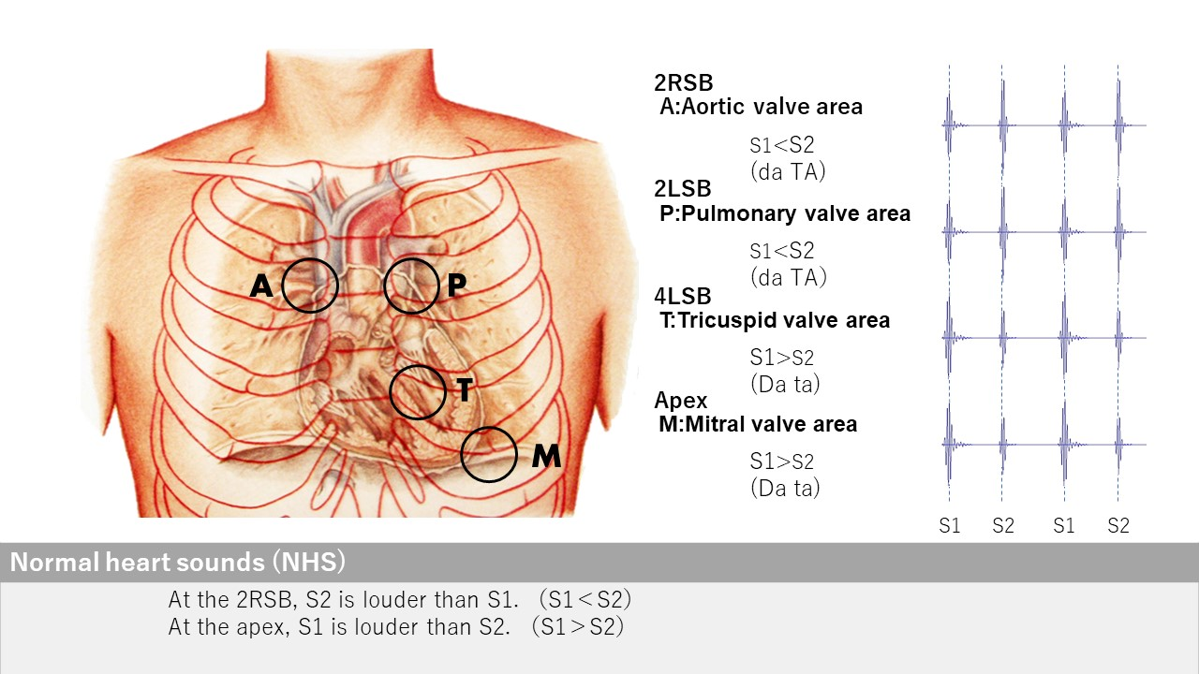
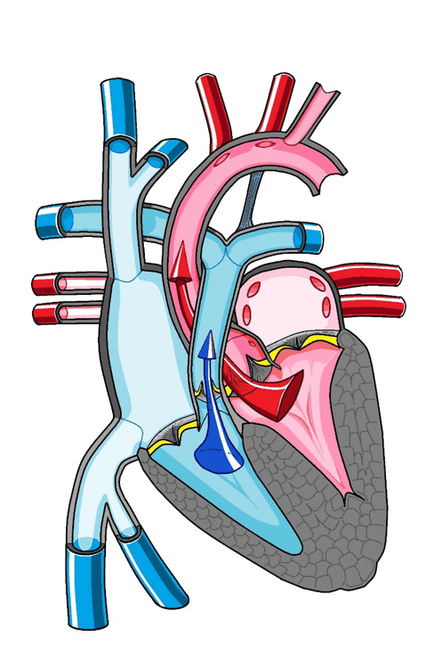
Free
Normal Heart Sound
Normal body illustration
Skeleton body
Open iPax
2234GA91
Open iPax
1810GA91
Pressing this button will open iPax.
2569GA91
Dedicated iPax site
https://kikuzosound.com/home
Recording, including screen captures and recordings via online meeting systems, is strictly prohibited. Please adhere to the terms of use while using this service.
iPax Information Page
https://telemedica.site/en/ipax24lp-paypal-en7-features-of-ipax2b/

Slide 6
Free
Korotkov sound
Blood Pressure Video
2593GA91
Pressing this button will open iPax.
2593GA91
Paid content includes materials for blood pressure measurement palpation training, as well as bowel sounds and dialysis shunt sounds.
Dedicated iPax site
https://kikuzosound.com/home
Recording, including screen captures and recordings via online meeting systems, is strictly prohibited. Please adhere to the terms of use while using this service.
iPax Information Page
https://telemedica.site/en/ipax24lp-paypal-en7-features-of-ipax2b/

Slide 7
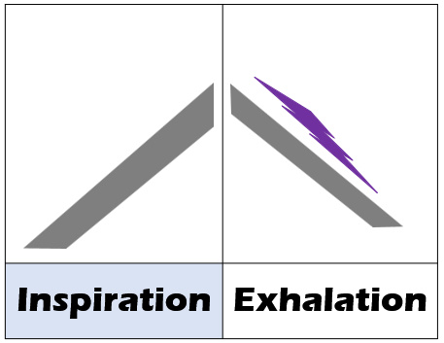
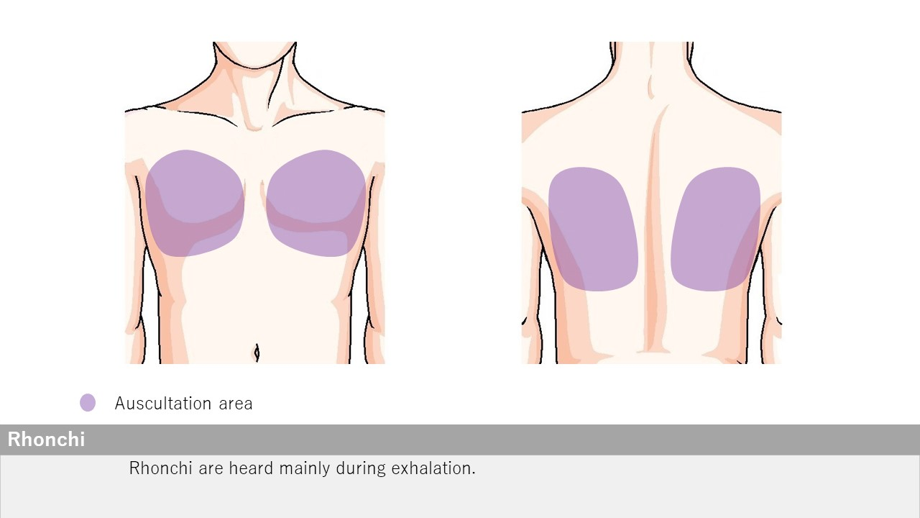
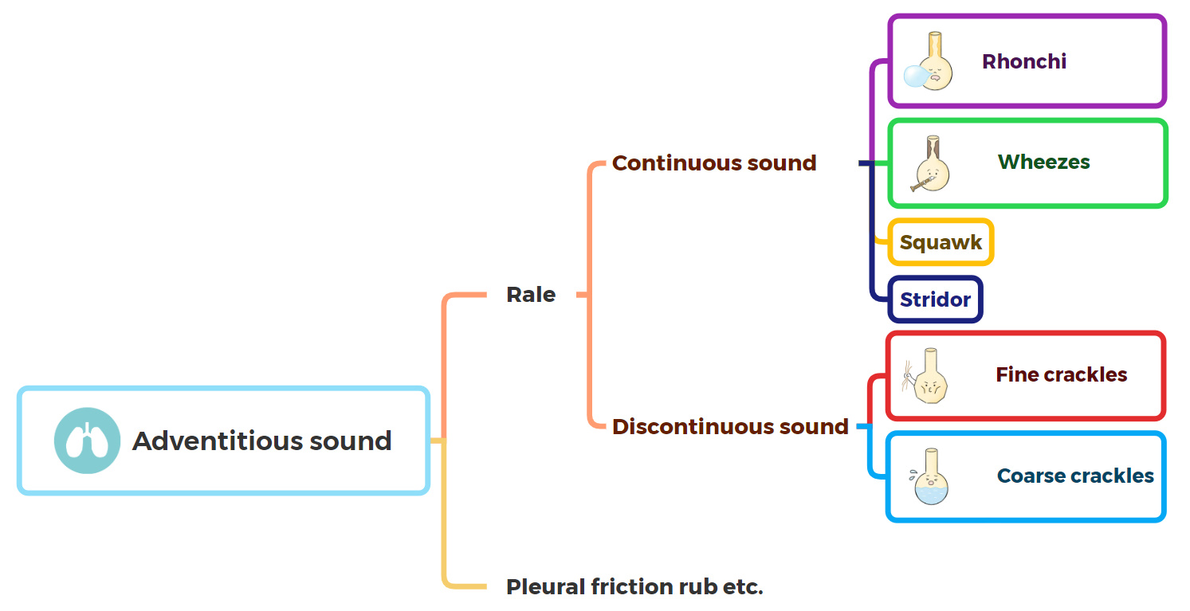
Rhonchi
Open iPax
2255GA91
Pressing this button will open iPax.
2528GA91
Dedicated iPax site
https://kikuzosound.com/home
Recording, including screen captures and recordings via online meeting systems, is strictly prohibited. Please adhere to the terms of use while using this service.
iPax Information Page
https://telemedica.site/en/ipax24lp-paypal-en7-features-of-ipax2b/

Slide 8
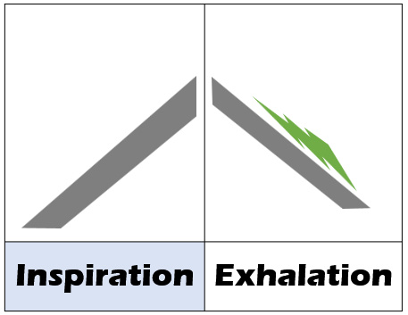
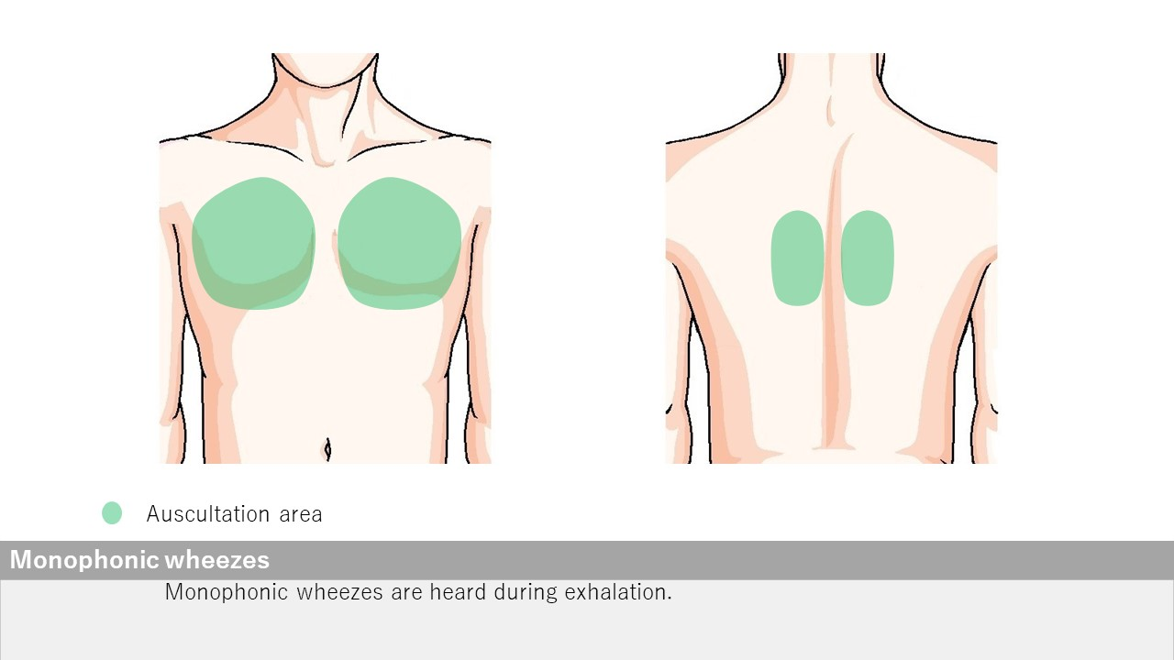
Wheezes monophonic
Open iPax
2254GA91
Pressing this button will open iPax.
2527GA91
Dedicated iPax site
https://kikuzosound.com/home
Recording, including screen captures and recordings via online meeting systems, is strictly prohibited. Please adhere to the terms of use while using this service.
iPax Information Page
https://telemedica.site/en/ipax24lp-paypal-en7-features-of-ipax2b/

Slide 9
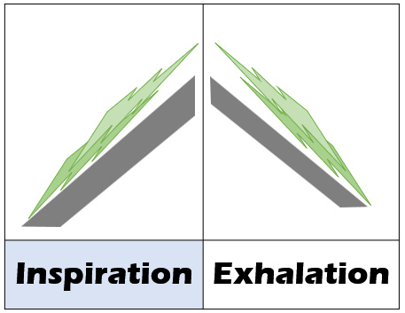
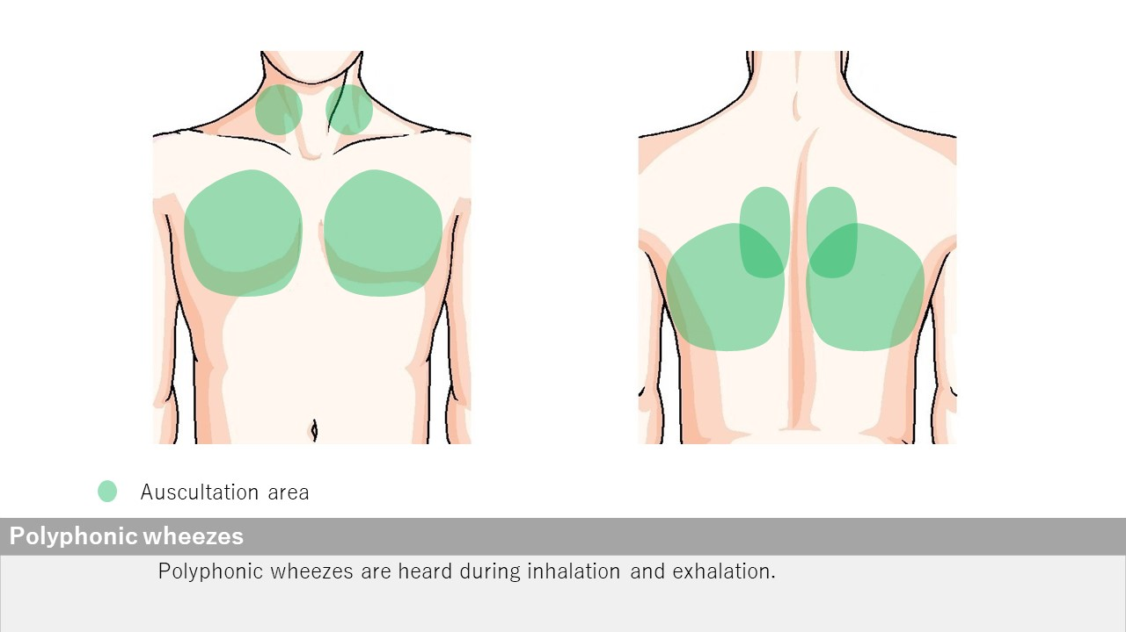
Wheezes polyphonic
Open iPax
2253GA91
Pressing this button will open iPax.
2526GA91
Dedicated iPax site
https://kikuzosound.com/home
Recording, including screen captures and recordings via online meeting systems, is strictly prohibited. Please adhere to the terms of use while using this service.
iPax Information Page
https://telemedica.site/en/ipax24lp-paypal-en7-features-of-ipax2b/

Slide 10
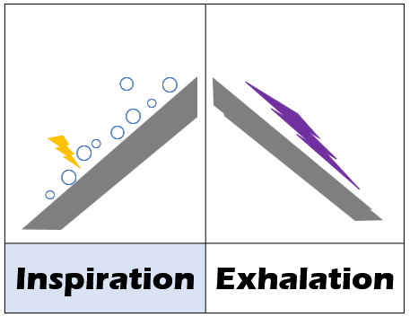
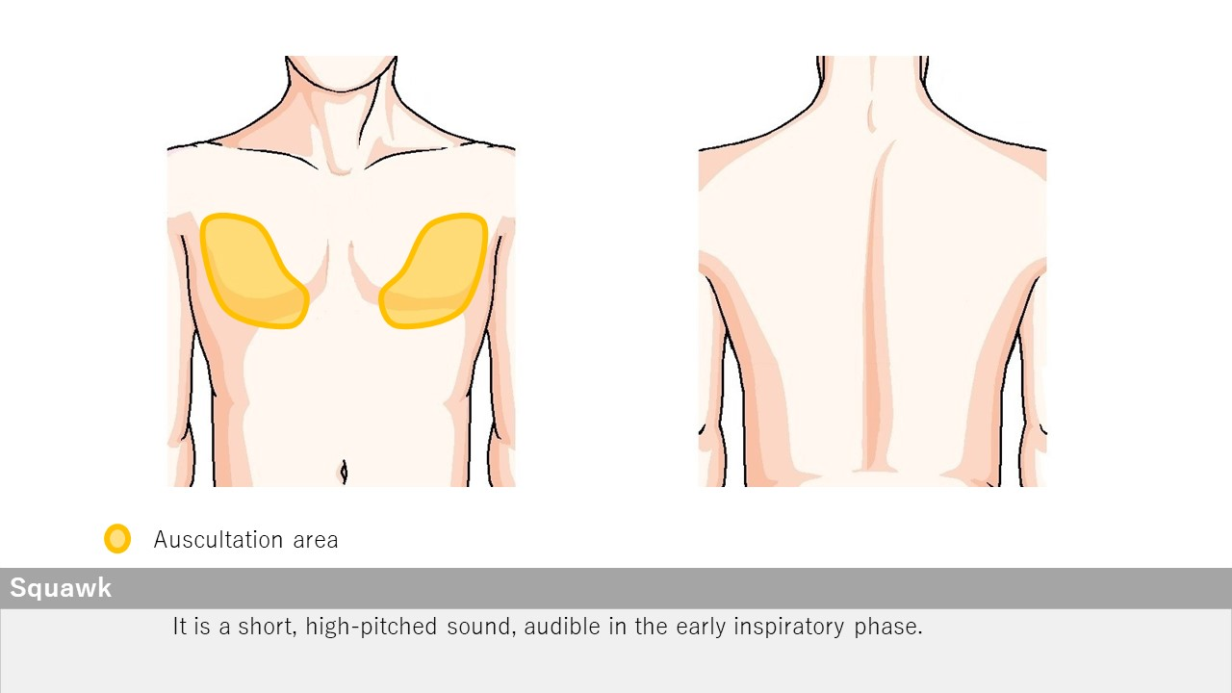
Squawk
Open iPax
2252GA91
Pressing this button will open iPax.
2525GA91
Dedicated iPax site
https://kikuzosound.com/home
Recording, including screen captures and recordings via online meeting systems, is strictly prohibited. Please adhere to the terms of use while using this service.
iPax Information Page
https://telemedica.site/en/ipax24lp-paypal-en7-features-of-ipax2b/

Slide 11
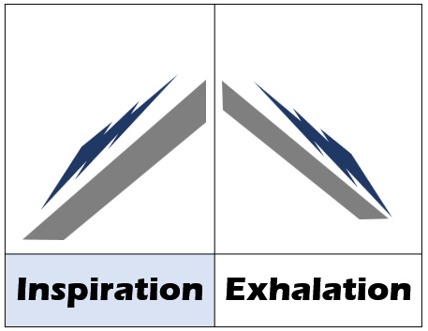
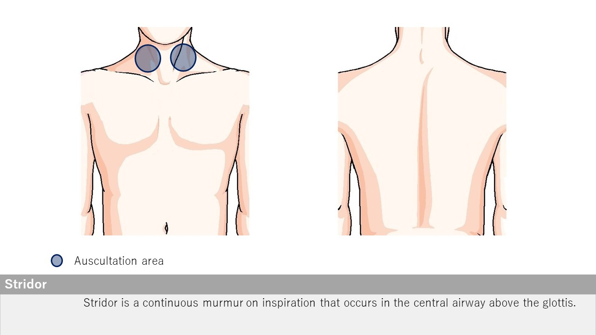
Stridor
Open iPax
2251GA91
Pressing this button will open iPax.
2524GA91
Dedicated iPax site
https://kikuzosound.com/home
Recording, including screen captures and recordings via online meeting systems, is strictly prohibited. Please adhere to the terms of use while using this service.
iPax Information Page
https://telemedica.site/en/ipax24lp-paypal-en7-features-of-ipax2b/

Slide 12
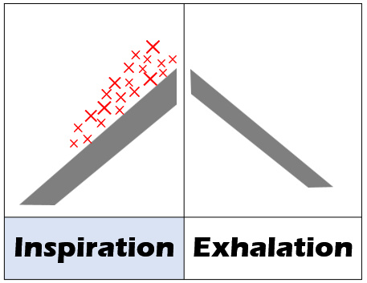
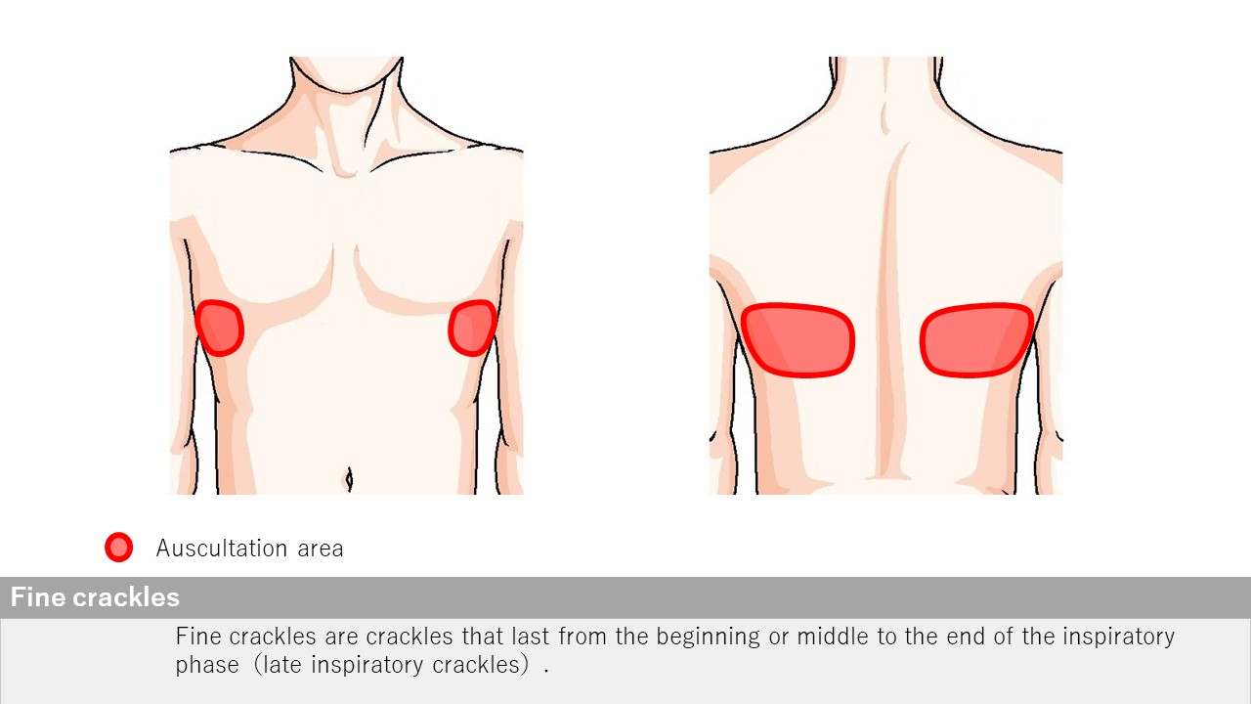
Fine crackles
Open iPax
2250GA91
Pressing this button will open iPax.
2523GA91
Dedicated iPax site
https://kikuzosound.com/home
Recording, including screen captures and recordings via online meeting systems, is strictly prohibited. Please adhere to the terms of use while using this service.
iPax Information Page
https://telemedica.site/en/ipax24lp-paypal-en7-features-of-ipax2b/

Slide 13
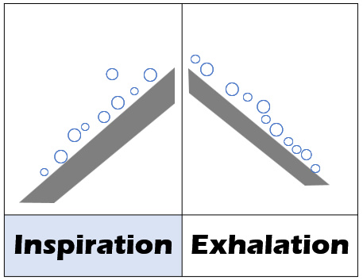
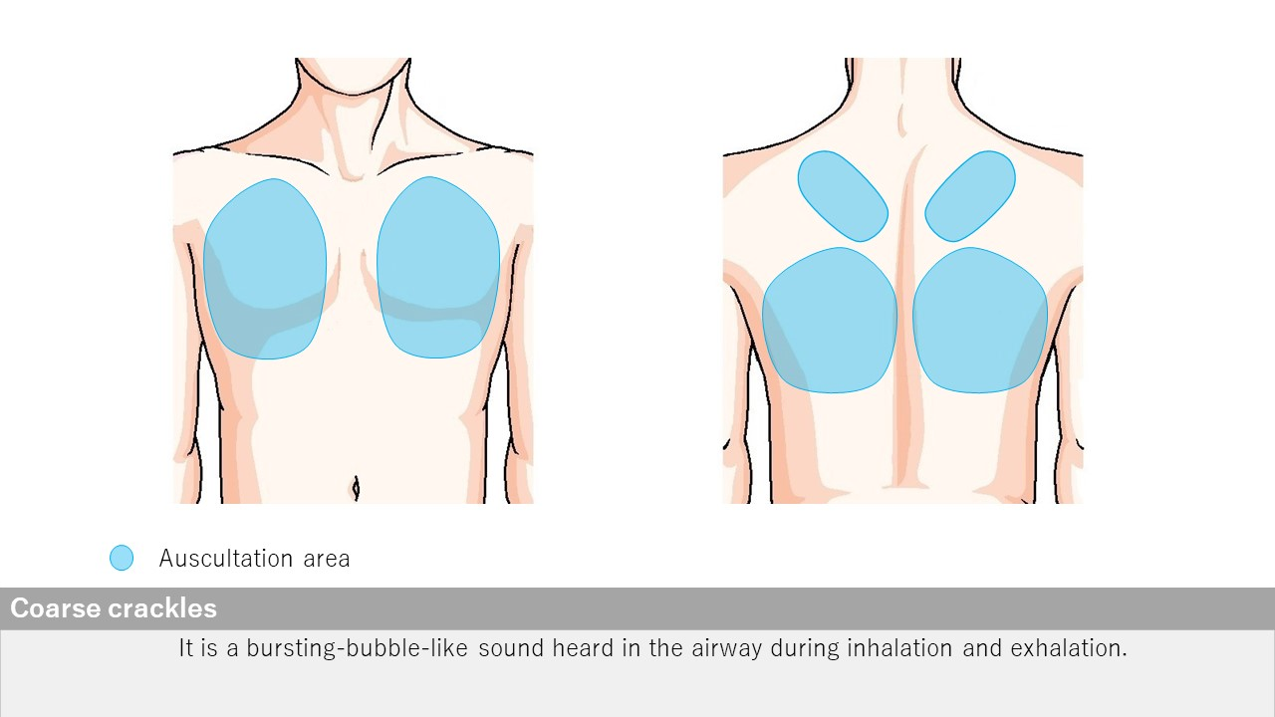
Coarse crackles
Open iPax
2249GA91
Pressing this button will open iPax.
2522GA91
Dedicated iPax site
https://kikuzosound.com/home
Recording, including screen captures and recordings via online meeting systems, is strictly prohibited. Please adhere to the terms of use while using this service.
iPax Information Page
https://telemedica.site/en/ipax24lp-paypal-en7-features-of-ipax2b/

Slide 14
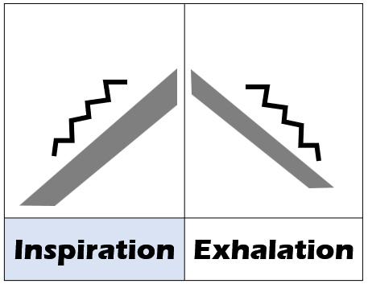
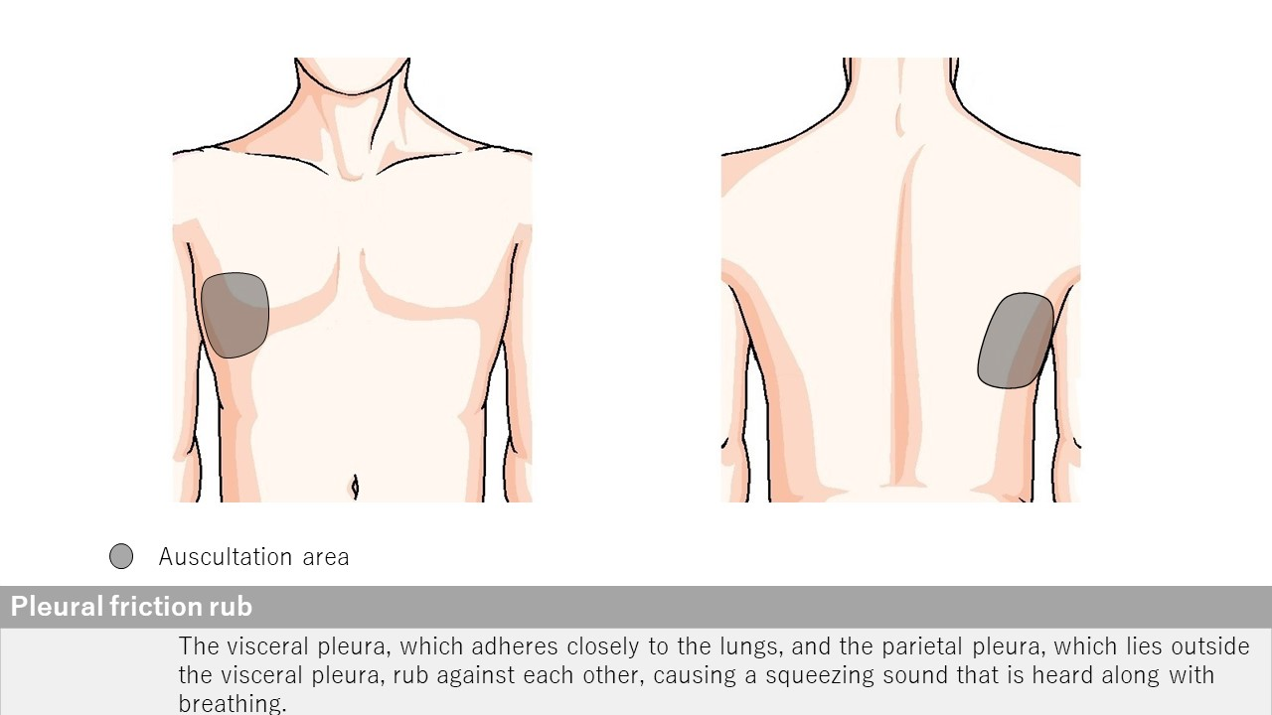
Pleural friction rub
Open iPax
2248GA91
Pressing this button will open iPax.
2522GA91
Dedicated iPax site
https://kikuzosound.com/home
Recording, including screen captures and recordings via online meeting systems, is strictly prohibited. Please adhere to the terms of use while using this service.
iPax Information Page
https://telemedica.site/en/ipax24lp-paypal-en7-features-of-ipax2b/

Slide 15
Decreased Bronchial Breath Sounds Airway narrowing caused by malignant lymphoma
Changes in Breath Sound Cavernous Breath Sound
Case: A 60-year-old woman with pulmonary adenocarcinoma
Case: An 84-year-old woman with airway narrowing caused by malignant lymphoma
Auscultation Findings: In the dorsal lower right lung field, "bronchial breath sounds replacing vesicular breath sounds" are observed. Fine crackles are heard in the dorsal lower left lung field.
Auscultation Findings: Decreased breath sounds are observed in the left bronchial region.
Open iPax
2242GA91
Open iPax
2241GA91
Pressing this button will open iPax.
Pressing this button will open iPax.
Dedicated iPax site
https://kikuzosound.com/home
Recording, including screen captures and recordings via online meeting systems, is strictly prohibited. Please adhere to the terms of use while using this service.
iPax Information Page
https://telemedica.site/en/ipax24lp-paypal-en7-features-of-ipax2b/

Slide 16
Coarse Crackles and Rhonchi Mucinous Adenocarcinoma of the Lung
Wheezes Acute Exacerbation of COPD
Case: A case of acute exacerbation of COPD
Case: A 70-year-old woman with a one-year history of productive cough and hemoptysis.
Auscultation Findings: Expiratory wheezes are heard during neck auscultation, with the expiratory phase prolonged to approximately a 1:3 ratio.
Auscultation Findings: Coarse crackles and rhonchi are heard in the right middle lung field.
Open iPax
2310GA91
Open iPax
2238GA91
Pressing this button will open iPax.
Pressing this button will open iPax.
Dedicated iPax site
https://kikuzosound.com/home
Recording, including screen captures and recordings via online meeting systems, is strictly prohibited. Please adhere to the terms of use while using this service.
iPax Information Page
https://telemedica.site/en/ipax24lp-paypal-en7-features-of-ipax2b/

Slide 17
Coarse Crackles A Case of Viral Infection
Coarse Crackles Legionella Pneumonia
Case: A patient presenting with cough and a fever of 38°C, diagnosed with a viral infection.
Case: A man with a fever in the 38°C range and a productive cough.
Auscultation Findings: Coarse crackles are heard in the right anterior chest, and coarse crackles with slight rhonchi are noted in the left dorsal lung base.
Auscultation Findings: Coarse crackles are heard, more prominent in the right lung field than in the left lung field.
Open iPax
2313GA91
Open iPax
2245GA91
Pressing this button will open iPax.
Pressing this button will open iPax.
Dedicated iPax site
https://kikuzosound.com/home
Recording, including screen captures and recordings via online meeting systems, is strictly prohibited. Please adhere to the terms of use while using this service.
iPax Information Page
https://telemedica.site/en/ipax24lp-paypal-en7-features-of-ipax2b/

Slide 18
Fine Crackles | At Diagnosis Anti-MDA-5 Antibody-Positive Dermatomyositis
Fine Crackles | After Treatment Anti-MDA5 Antibody Positive Dermatomyositis
Case: Interstitial pneumonia in a patient with anti-MDA5 antibody-positive dermatomyositis (at the time of diagnosis).
Case: Interstitial pneumonia in a patient with anti-MDA5 antibody-positive dermatomyositis (after treatment).
Auscultation Findings: Fine crackles are heard in the left lung base. In interstitial pneumonia with anti-MDA5 antibody positivity, the sounds are perceived as lower-pitched (low-frequency) compared to those in idiopathic pulmonary fibrosis (IPF).
Auscultation Findings: The fine crackles previously heard in the left lung base at the time of diagnosis are now minimal.
Open iPax
2308GA91
Open iPax
2309GA91
Pressing this button will open iPax.
Pressing this button will open iPax.
Dedicated iPax site
https://kikuzosound.com/home
Recording, including screen captures and recordings via online meeting systems, is strictly prohibited. Please adhere to the terms of use while using this service.
iPax Information Page
https://telemedica.site/en/ipax24lp-paypal-en7-features-of-ipax2b/

Slide 19
Fine Crackles | Forced Inspiration Idiopathic Pulmonary Fibrosis (IPF)
Fine Crackles | Resting Respiration Idiopathic Pulmonary Fibrosis (IPF)
Case: A case of idiopathic pulmonary fibrosis (IPF).
Case: A case of idiopathic pulmonary fibrosis (IPF).
Auscultation Findings: Fine crackles are heard in the lateral chest bilaterally and in the dorsal lung bases during deep inspiration.
Auscultation Findings: Fine crackles heard during forced inspiration are only faintly audible during resting respiration.
Open iPax
2304GA91
Open iPax
2305GA91
Pressing this button will open iPax.
Pressing this button will open iPax.
Dedicated iPax site
https://kikuzosound.com/home
Recording, including screen captures and recordings via online meeting systems, is strictly prohibited. Please adhere to the terms of use while using this service.
iPax Information Page
https://telemedica.site/en/ipax24lp-paypal-en7-features-of-ipax2b/

Slide 20
Fine Crackles Drug-Induced Pneumonitis Caused by Kampo Medicine
Fine Crackles Cryptogenic Organizing Pneumonia (COP)
Case: A 75-year-old man with a cough lasting for several days.
Case: A 60-year-old woman with no prior medical history or medications. She developed shortness of breath, cough, and low-grade fever one month ago. Vital signs are normal except for a fever of 37°C.
Auscultation Findings: Fine crackles are heard in the lateral chest bilaterally and in the dorsal lung bases.
Auscultation Findings: Fine crackles are heard in the left chest.
Open iPax
2246GA91
Open iPax
2312GA91
Pressing this button will open iPax.
Pressing this button will open iPax.
Dedicated iPax site
https://kikuzosound.com/home
Recording, including screen captures and recordings via online meeting systems, is strictly prohibited. Please adhere to the terms of use while using this service.
iPax Information Page
https://telemedica.site/en/ipax24lp-paypal-en7-features-of-ipax2b/

Slide 21
Fine Crackles Pneumocystis Pneumonia in an HIV-Positive Patient
Fine Crackles COVID-19
Case: A 50-year-old man with a one-month history of dry cough and low-grade fever.
Case: A 31-year-old woman with a 5-day history of fatigue, fever in the 38°C range, sore throat, and cough.
Auscultation Findings: Fine crackles are heard in the left anterior chest.
Auscultation Findings: Fine crackles are heard in the lateral chest (lower lung fields) and the dorsal lung bases.
Open iPax
2244GA91
Open iPax
2247GA91
Pressing this button will open iPax.
Pressing this button will open iPax.
Dedicated iPax site
https://kikuzosound.com/home
Recording, including screen captures and recordings via online meeting systems, is strictly prohibited. Please adhere to the terms of use while using this service.
iPax Information Page
https://telemedica.site/en/ipax24lp-paypal-en7-features-of-ipax2b/

Slide 22
Pleural Friction Rub and Fine Crackles Pleuritis in a Patient with Rheumatoid Arthritis
Fine Crackles Idiopathic Pulmonary Fibrosis (IPF)
Case: A case of interstitial pneumonia associated with rheumatoid arthritis and COPD Stage II.
Case: A case of idiopathic pulmonary fibrosis (IPF).
Auscultation Findings: Pleural friction rubs are heard in the right lung and the dorsal right lung base, while fine crackles are heard in the left lung and the dorsal left lung base.
Auscultation Findings: Fine crackles are heard in the bilateral lateral chest and bilateral lung bases.
Open iPax
2243GA91
Open iPax
2377GA91
Pressing this button will open iPax.
Pressing this button will open iPax.
Dedicated iPax site
https://kikuzosound.com/home
Recording, including screen captures and recordings via online meeting systems, is strictly prohibited. Please adhere to the terms of use while using this service.
iPax Information Page
https://telemedica.site/en/ipax24lp-paypal-en7-features-of-ipax2b/

Slide 23
Vocal Sound Auscultation
Auscultatory Percussion
Auscultation is performed while asking the patient to say "ah" continuously.
Auscultatory percussion is a technique where percussion is performed near the sternal angle while auscultating along the midaxillary line. In areas with pleural effusion, the sound changes to dullness.
Auscultation Findings: Vocal sounds are heard muffled in the left middle lung field region.
Auscultation Findings: Percussion sounds change to dullness near the central area of the midaxillary line (blue line).
Open iPax
2236GA91
Open iPax
2237GA91
Pressing this button will open iPax.
Pressing this button will open iPax.
Dedicated iPax site
https://kikuzosound.com/home
Recording, including screen captures and recordings via online meeting systems, is strictly prohibited. Please adhere to the terms of use while using this service.
iPax Information Page
https://telemedica.site/en/ipax24lp-paypal-en7-features-of-ipax2b/

Slide 24
Coarse Crackles and Rhonchi Carcinomatous Lymphangitis Caused by Lung Cancer
Wheezes Atelectasis
Case: A 63-year-old woman with secondary pulmonary hypertension associated with carcinomatous lymphangitis.
Case: A patient with airway narrowing caused by mediastinal lymph node metastasis of a tumor, resulting in complete obstruction of the right bronchus and subsequent atelectasis.
Auscultation Findings: Coarse crackles are heard at the end of inspiration in the bilateral lower lung fields, and rhonchi are heard throughout all lung fields. Increased intensity of the second pulmonary sound (Ⅱp) is noted, associated with secondary pulmonary hypertension caused by carcinomatous lymphangitis.
Auscultation Findings: Wheezes are heard in the right bronchial region (recorded along with the sound of Nasal High Flow therapy).
Open iPax
2378GA91
Open iPax
2141GA91
Pressing this button will open iPax.
Pressing this button will open iPax.
Dedicated iPax site
https://kikuzosound.com/home
Recording, including screen captures and recordings via online meeting systems, is strictly prohibited. Please adhere to the terms of use while using this service.
iPax Information Page
https://telemedica.site/en/ipax24lp-paypal-en7-features-of-ipax2b/

Slide 25
Subcutaneous Crackling Sound | Subcutaneous Emphysema Auscultation with the Stethoscope Pressed Firmly
Subcutaneous Crackling Sound | Subcutaneous Emphysema Auscultation at Normal Pressure
Case: A case of left pneumothorax, mediastinal emphysema, and subcutaneous emphysema (auscultated at normal pressure).
Case: A case of left pneumothorax, mediastinal emphysema, and subcutaneous emphysema (auscultated with the stethoscope pressed firmly).
Auscultation Findings: A crackling sound of air is heard in the left anterior chest.
Auscultation Findings: The stethoscope is pressed firmly against the left anterior chest during auscultation.
Open iPax
2375GA91
Open iPax
2376GA91
Pressing this button will open iPax.
Pressing this button will open iPax.
On a Kikuzo Silicone Surface (at maximum volume), a palpable crackling sensation of air can be felt.
Dedicated iPax site
https://kikuzosound.com/home
Recording, including screen captures and recordings via online meeting systems, is strictly prohibited. Please adhere to the terms of use while using this service.
iPax Information Page
https://telemedica.site/en/ipax24lp-paypal-en7-features-of-ipax2b/

Slide 26
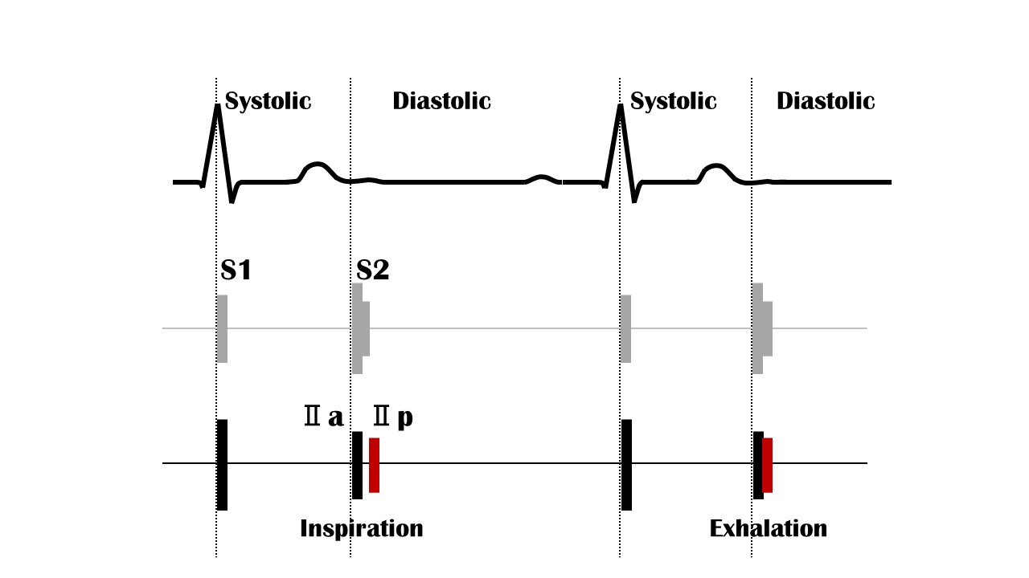
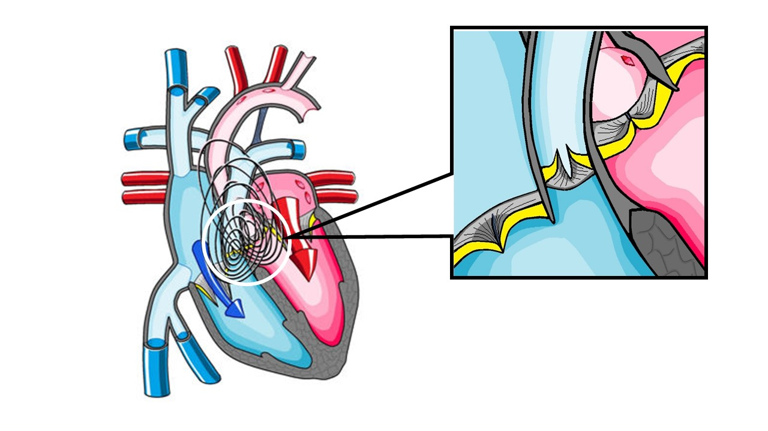
Respiratory S2 split
２LSB
Open iPax
2233GA91
Pressing this button will open iPax.
2568GA91
Dedicated iPax site
https://kikuzosound.com/home
Recording, including screen captures and recordings via online meeting systems, is strictly prohibited. Please adhere to the terms of use while using this service.
iPax Information Page
https://telemedica.site/en/ipax24lp-paypal-en7-features-of-ipax2b/

Slide 27
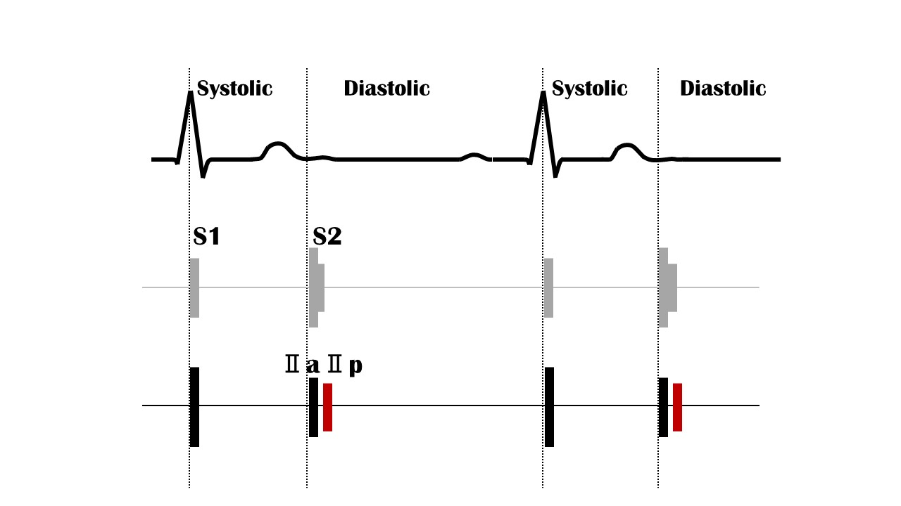
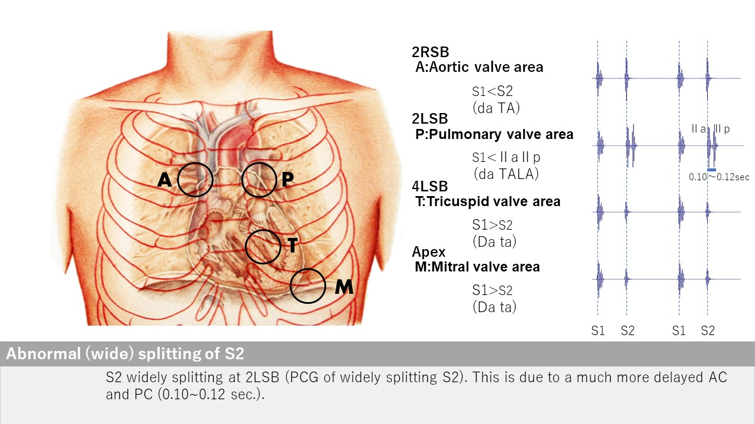
Abnormal S2 split
２LSB
Open iPax
2232GA91
Pressing this button will open iPax.
2567GA91
Dedicated iPax site
https://kikuzosound.com/home
Recording, including screen captures and recordings via online meeting systems, is strictly prohibited. Please adhere to the terms of use while using this service.
iPax Information Page
https://telemedica.site/en/ipax24lp-paypal-en7-features-of-ipax2b/

Slide 28
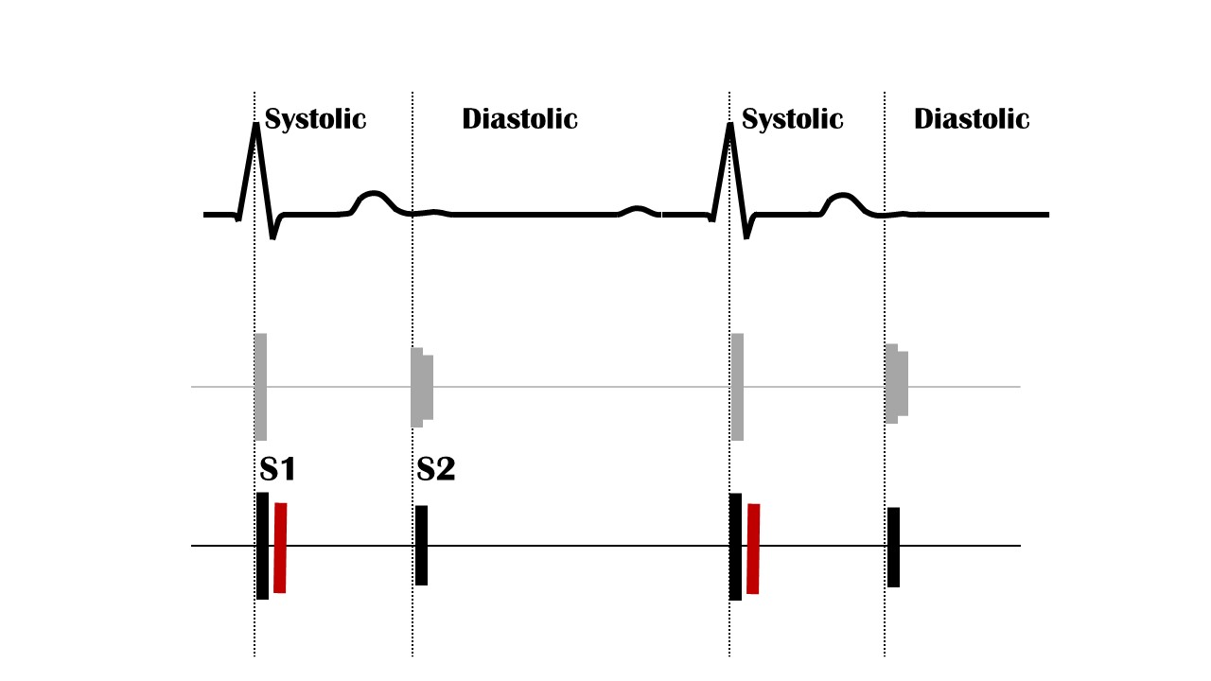
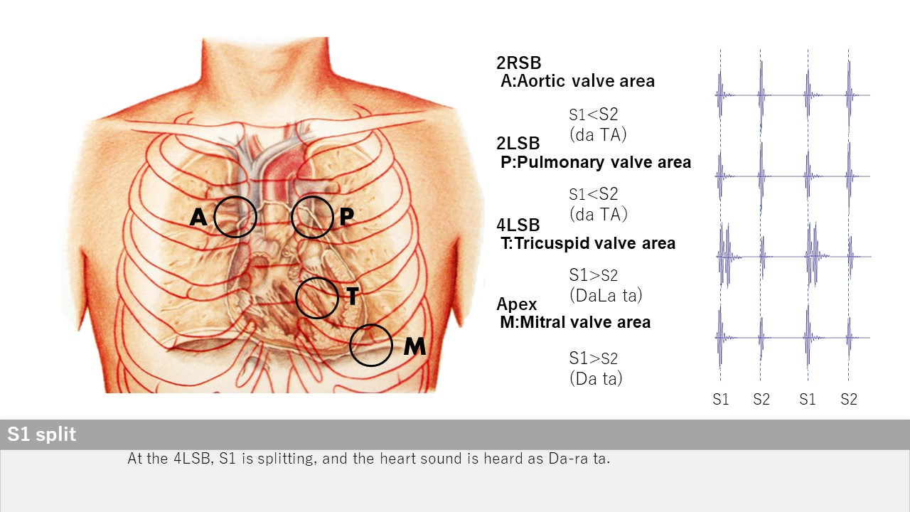
S１ split
４LSB
Open iPax
2231GA91
Pressing this button will open iPax.
2566GA91
Dedicated iPax site
https://kikuzosound.com/home
Recording, including screen captures and recordings via online meeting systems, is strictly prohibited. Please adhere to the terms of use while using this service.
iPax Information Page
https://telemedica.site/en/ipax24lp-paypal-en7-features-of-ipax2b/

Slide 29
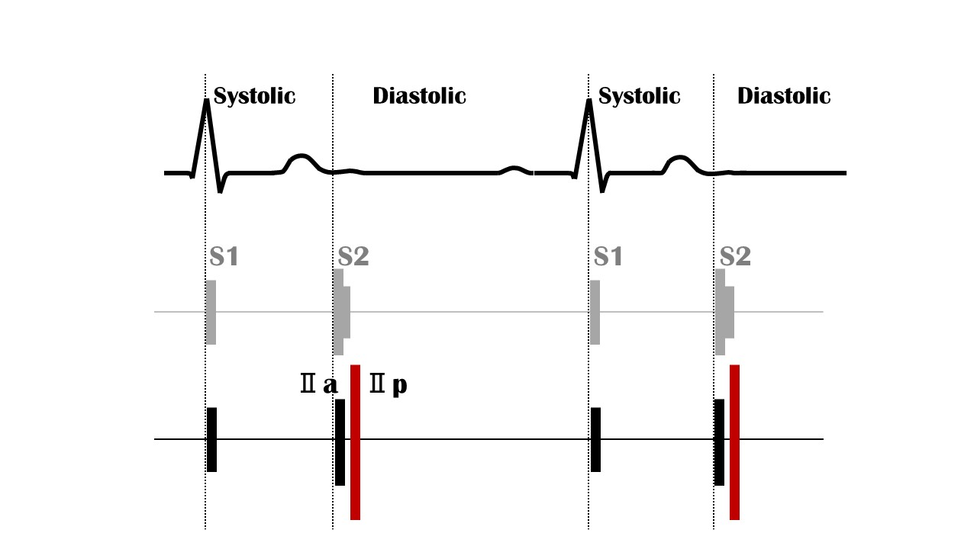
Loud Ⅱp
２LSB
Open iPax
2230GA91
Pressing this button will open iPax.
2565GA91
The lung sounds in this case are set with adventitious sounds.
Dedicated iPax site
https://kikuzosound.com/home
Recording, including screen captures and recordings via online meeting systems, is strictly prohibited. Please adhere to the terms of use while using this service.
iPax Information Page
https://telemedica.site/en/ipax24lp-paypal-en7-features-of-ipax2b/

Slide 30
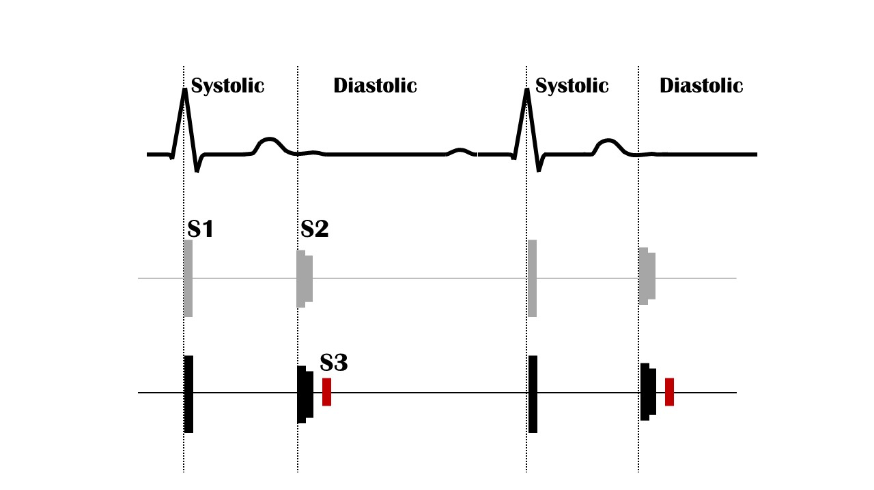
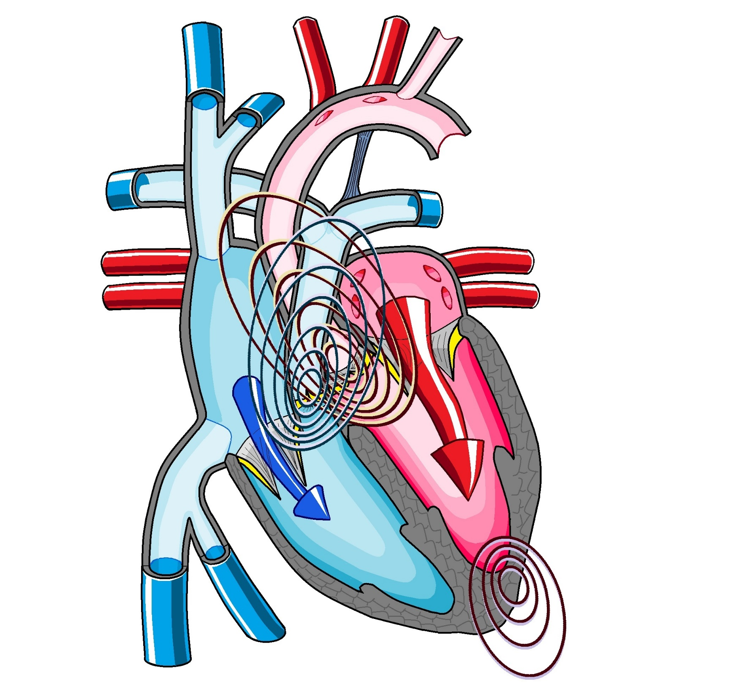
S3 gallop
Apex
Normal S3 volume
Open iPax
2228GA91
Pressing this button will open iPax.
2561GA91
By connecting the Kikuzo and maximizing the volume, the S3 sound can be confirmed through palpation.
Emphasized S3 volume
Open iPax
2229GA91
2563GA91
Dedicated iPax site
https://kikuzosound.com/home
Recording, including screen captures and recordings via online meeting systems, is strictly prohibited. Please adhere to the terms of use while using this service.
iPax Information Page
https://telemedica.site/en/ipax24lp-paypal-en7-features-of-ipax2b/

Slide 31
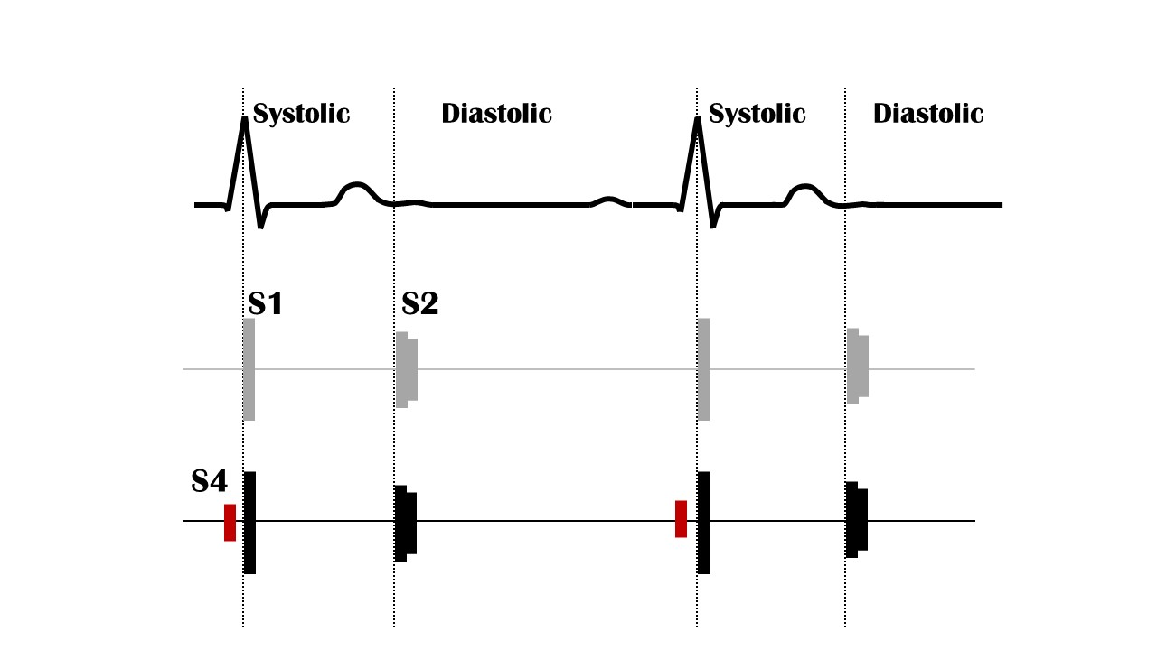
S４ gallop
Apex
Normal S4 volume
Open iPax
2226GA91
Pressing this button will open iPax.
2560GA91
By connecting the Kikuzo and maximizing the volume, the S4 sound can be confirmed through palpation.
Emphasized S4 volume
Open iPax
2227GA91
2562GA91
Dedicated iPax site
https://kikuzosound.com/home
Recording, including screen captures and recordings via online meeting systems, is strictly prohibited. Please adhere to the terms of use while using this service.
iPax Information Page
https://telemedica.site/en/ipax24lp-paypal-en7-features-of-ipax2b/

Slide 32
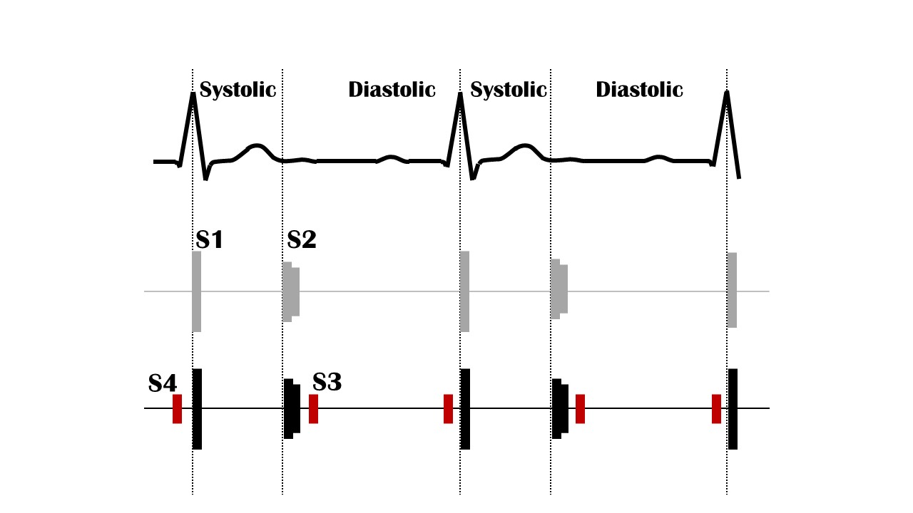
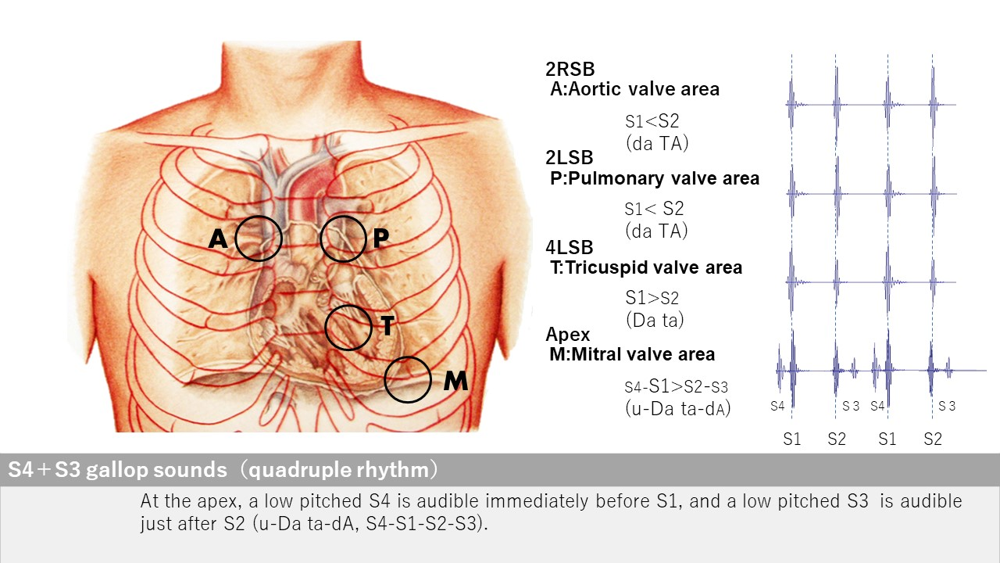
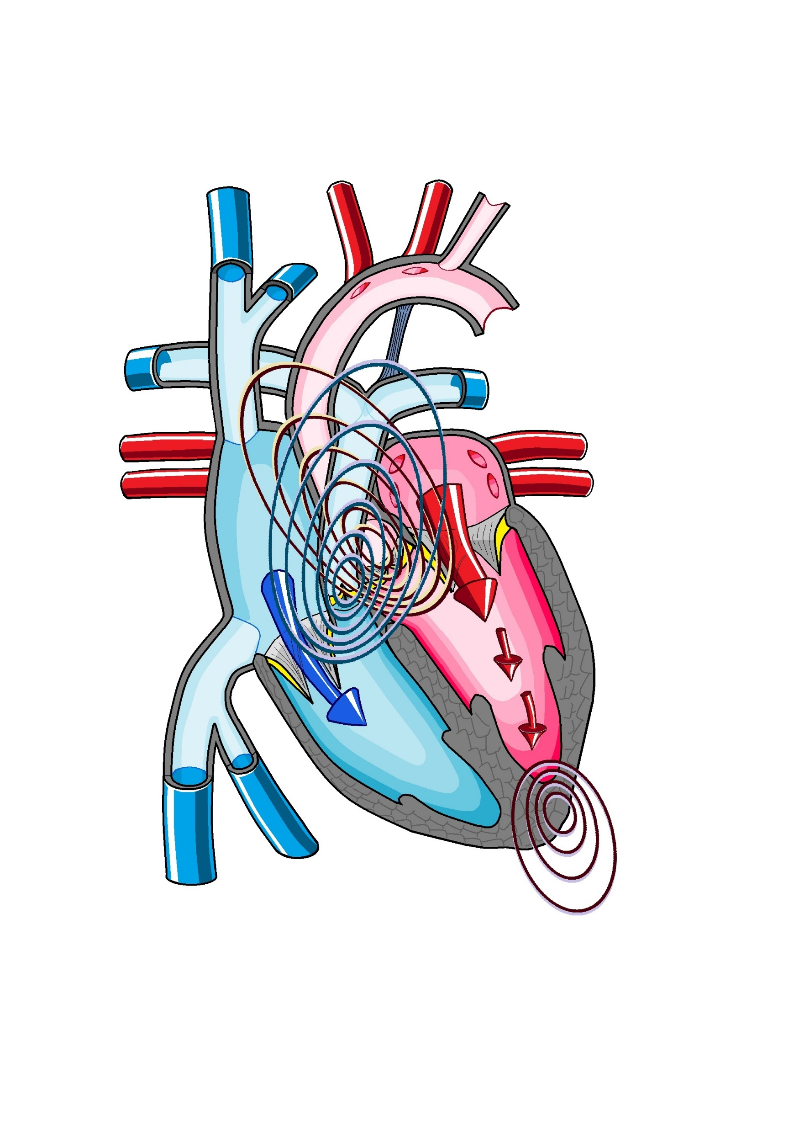
S４+S3
Apex
Open iPax
2225GA91
Pressing this button will open iPax.
2559GA91
Dedicated iPax site
https://kikuzosound.com/home
Recording, including screen captures and recordings via online meeting systems, is strictly prohibited. Please adhere to the terms of use while using this service.
iPax Information Page
https://telemedica.site/en/ipax24lp-paypal-en7-features-of-ipax2b/

Slide 33
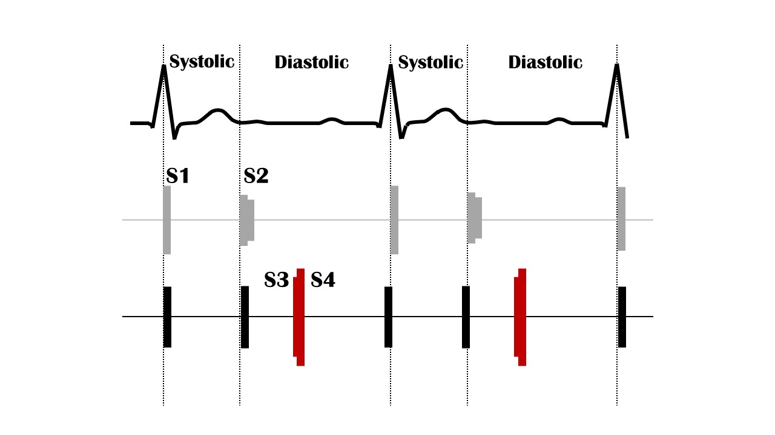
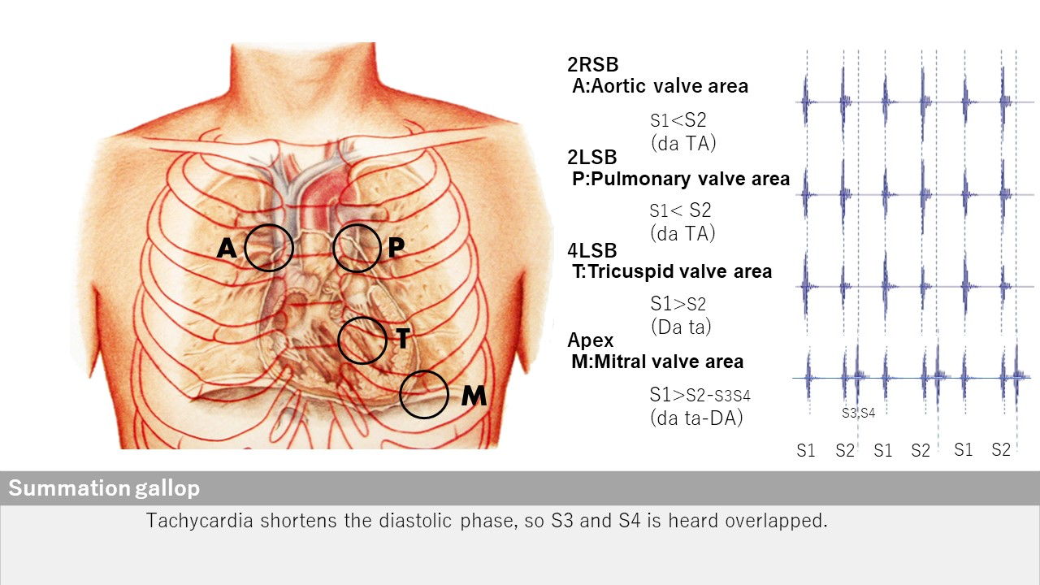
Summation gallop
Apex
Open iPax
2224GA91
Pressing this button will open iPax.
2558GA91
Dedicated iPax site
https://kikuzosound.com/home
Recording, including screen captures and recordings via online meeting systems, is strictly prohibited. Please adhere to the terms of use while using this service.
iPax Information Page
https://telemedica.site/en/ipax24lp-paypal-en7-features-of-ipax2b/

Slide 34
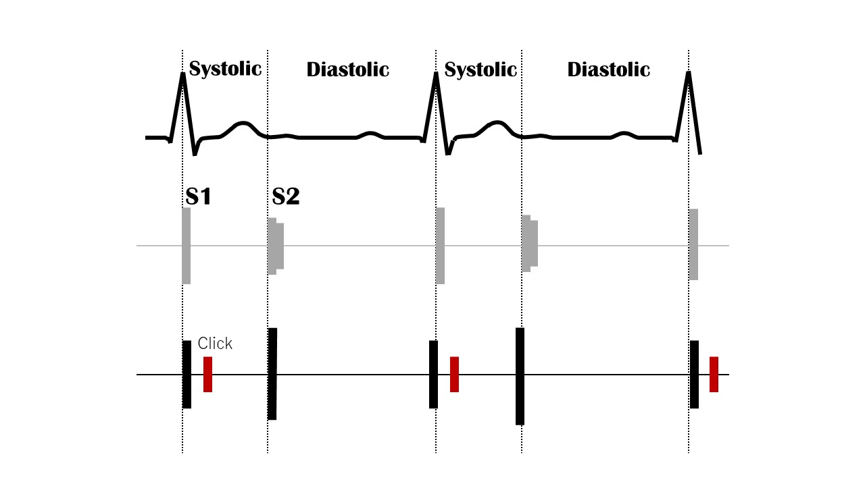
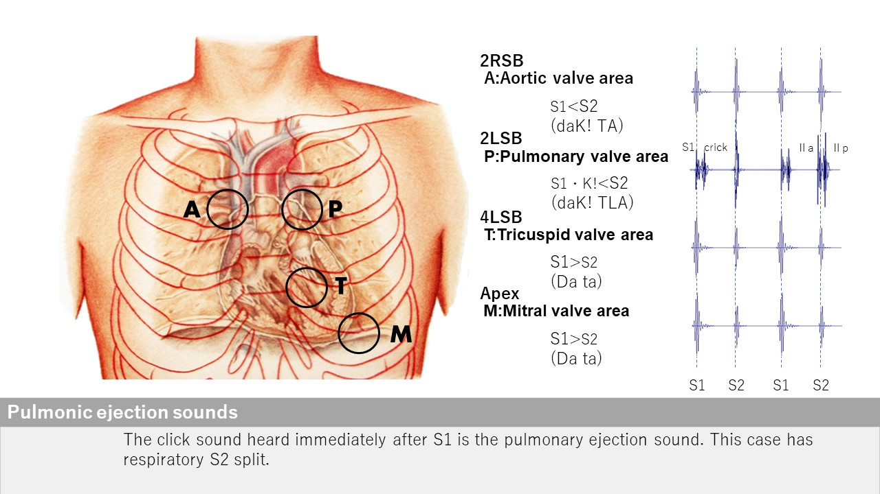
Pulmonic ejection sound
2LSB
Open iPax
2223GA91
Pressing this button will open iPax.
2557GA91
Dedicated iPax site
https://kikuzosound.com/home
Recording, including screen captures and recordings via online meeting systems, is strictly prohibited. Please adhere to the terms of use while using this service.
iPax Information Page
https://telemedica.site/en/ipax24lp-paypal-en7-features-of-ipax2b/

Slide 35
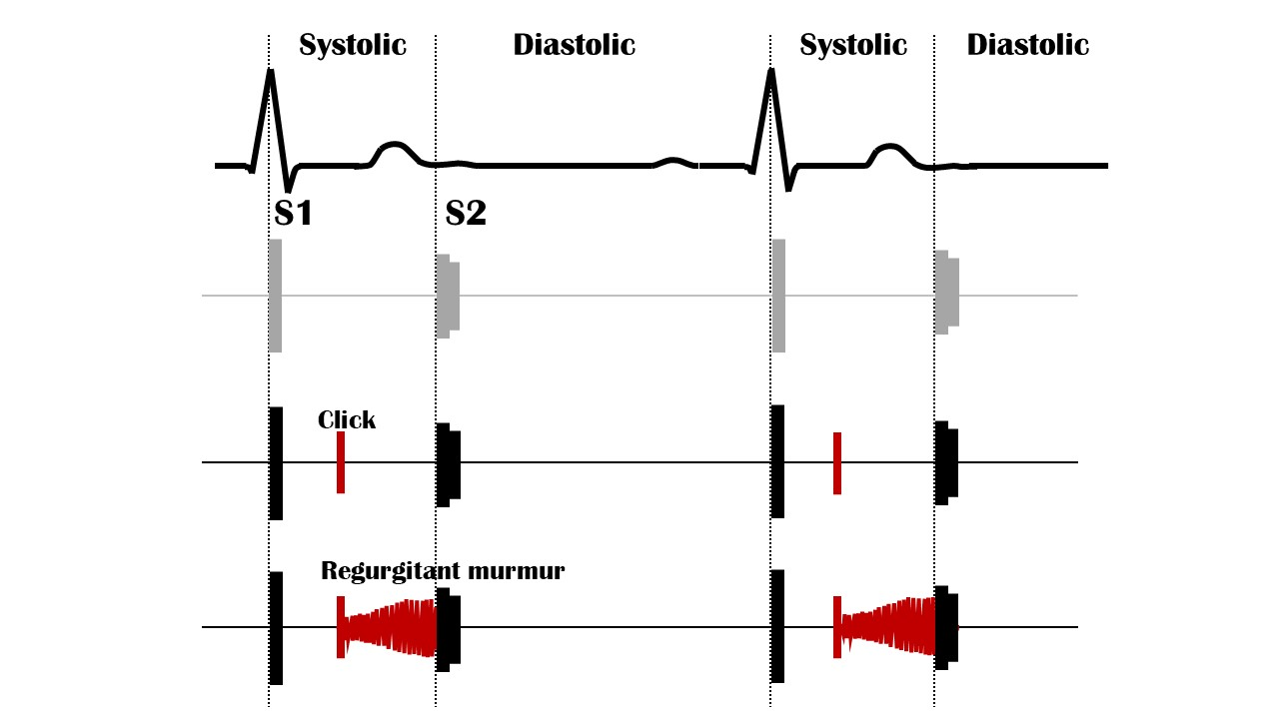
Click sound
Apex
Open iPax
2222GA91
Pressing this button will open iPax.
2556GA91
Dedicated iPax site
https://kikuzosound.com/home
Recording, including screen captures and recordings via online meeting systems, is strictly prohibited. Please adhere to the terms of use while using this service.
iPax Information Page
https://telemedica.site/en/ipax24lp-paypal-en7-features-of-ipax2b/

Slide 36
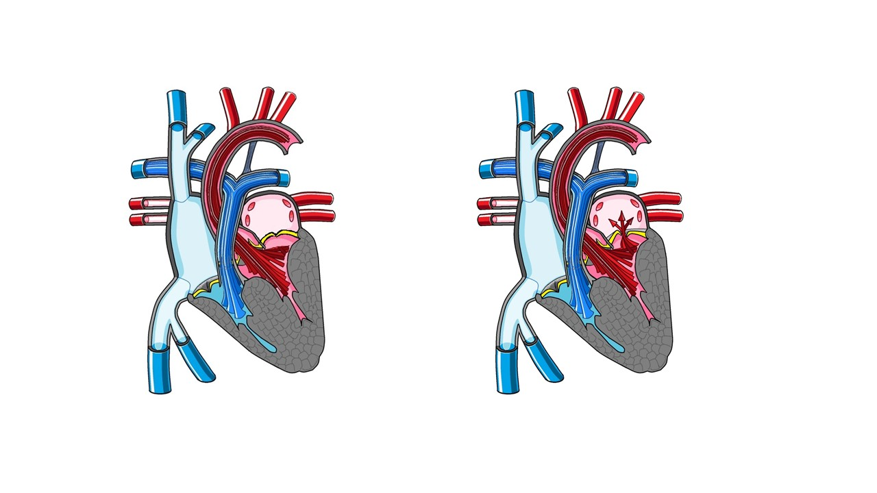
Click + Regurgitant murmur
Apex
Open iPax
2221GA91
Pressing this button will open iPax.
2555GA91
Dedicated iPax site
https://kikuzosound.com/home
Recording, including screen captures and recordings via online meeting systems, is strictly prohibited. Please adhere to the terms of use while using this service.
iPax Information Page
https://telemedica.site/en/ipax24lp-paypal-en7-features-of-ipax2b/

Slide 37
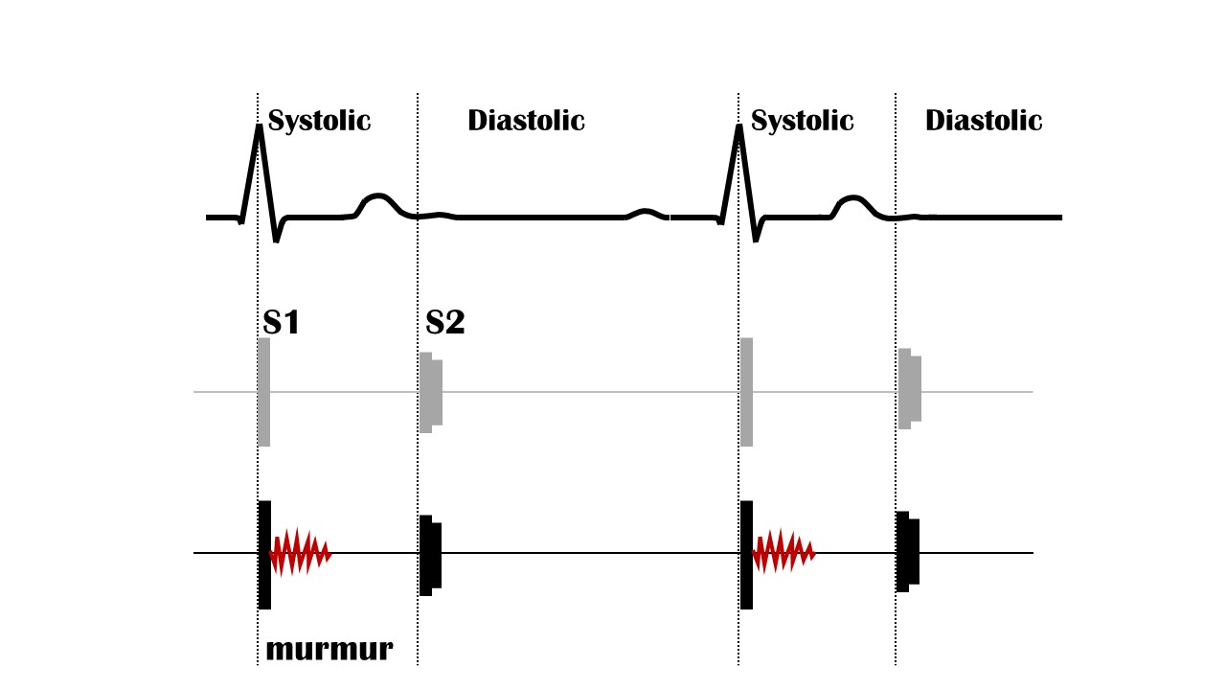
機能性雑音
2LSB
Open iPax
2220GA91
Pressing this button will open iPax.
2553GA91
Dedicated iPax site
https://kikuzosound.com/home
Recording, including screen captures and recordings via online meeting systems, is strictly prohibited. Please adhere to the terms of use while using this service.
iPax Information Page
https://telemedica.site/en/ipax24lp-paypal-en7-features-of-ipax2b/

Slide 38
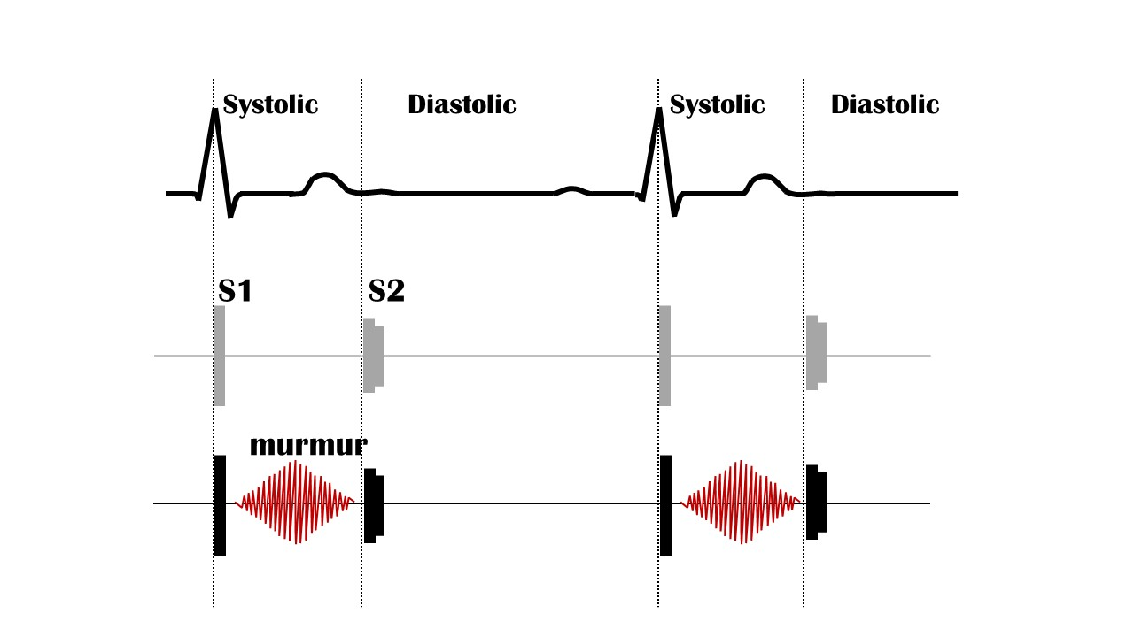
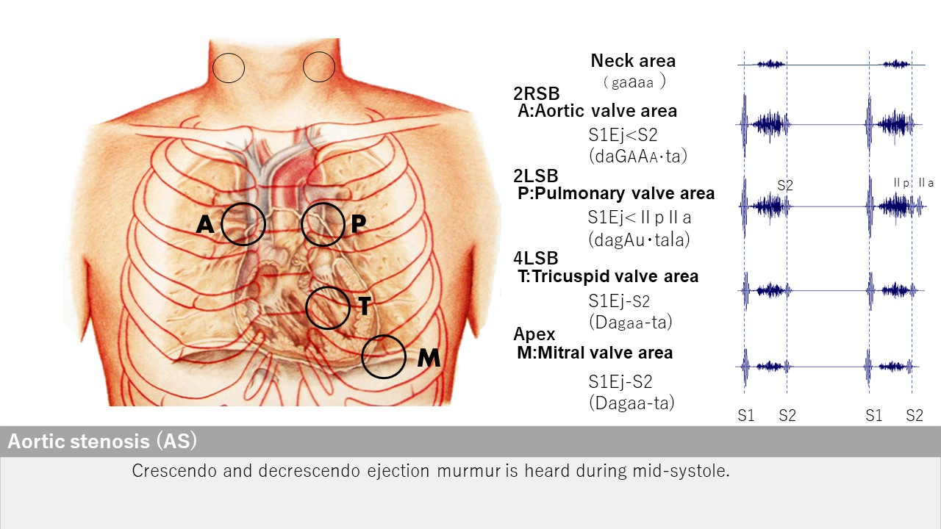
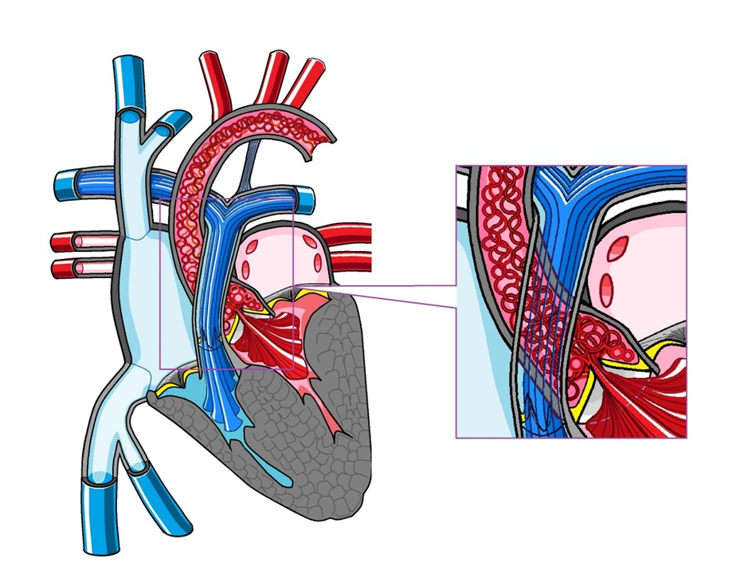
Aortic stenosis
2RSB
Open iPax
2219GA91
Pressing this button will open iPax.
2552GA91
By connecting the Kikuzo and maximizing the volume, you can feel the thrill using the Kikuzo.
Dedicated iPax site
https://kikuzosound.com/home
Recording, including screen captures and recordings via online meeting systems, is strictly prohibited. Please adhere to the terms of use while using this service.
iPax Information Page
https://telemedica.site/en/ipax24lp-paypal-en7-features-of-ipax2b/

Slide 39
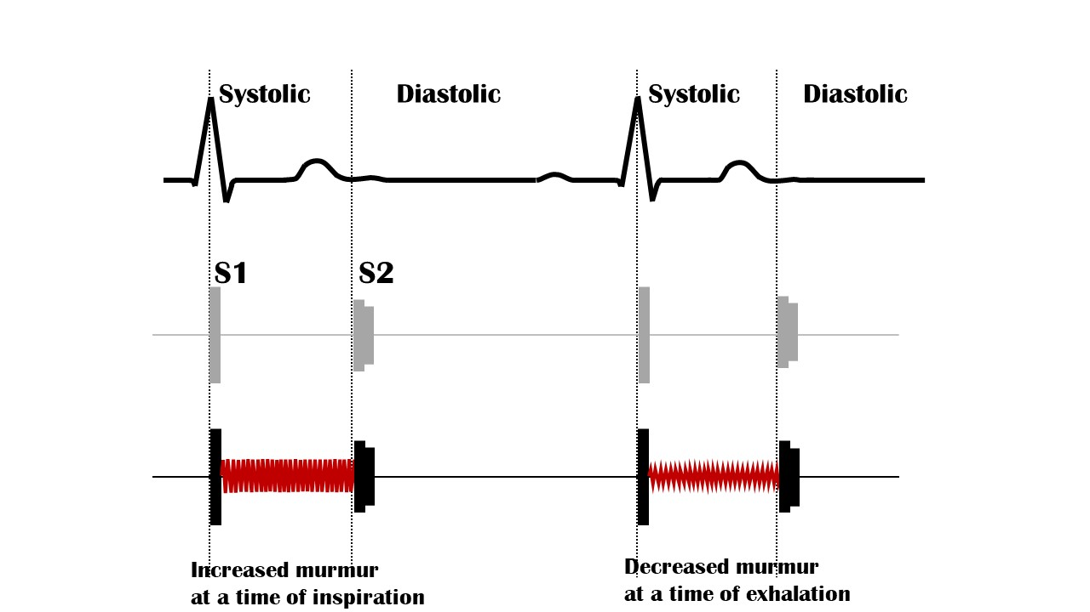
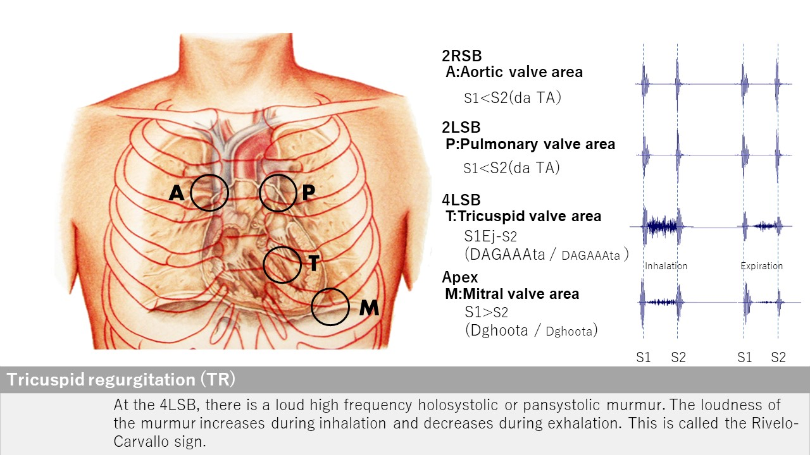
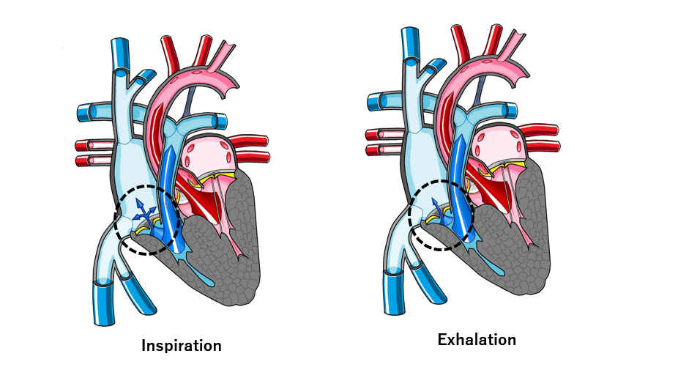
Tricuspid regurgitation
４LSB
Open iPax
2217GA91
Pressing this button will open iPax.
2550GA91
Enhanced
Rivelo-Carvallo sign
Open iPax
2218GA91
2551GA91
Dedicated iPax site
https://kikuzosound.com/home
Recording, including screen captures and recordings via online meeting systems, is strictly prohibited. Please adhere to the terms of use while using this service.
iPax Information Page
https://telemedica.site/en/ipax24lp-paypal-en7-features-of-ipax2b/

Slide 40
Mitral regurgitation
Apex
Open iPax
2216GA91
Pressing this button will open iPax.
2549GA91
Dedicated iPax site
https://kikuzosound.com/home
Recording, including screen captures and recordings via online meeting systems, is strictly prohibited. Please adhere to the terms of use while using this service.
iPax Information Page
https://telemedica.site/en/ipax24lp-paypal-en7-features-of-ipax2b/

Slide 41
Mitral valvular prolapse
Apex
Open iPax
2215GA91
Pressing this button will open iPax.
2548GA91
Dedicated iPax site
https://kikuzosound.com/home
Recording, including screen captures and recordings via online meeting systems, is strictly prohibited. Please adhere to the terms of use while using this service.
iPax Information Page
https://telemedica.site/en/ipax24lp-paypal-en7-features-of-ipax2b/

Slide 42
Hypertrophic cardiomyopathy
４LSB
Open iPax
2214GA91
Pressing this button will open iPax.
2547GA91
Dedicated iPax site
https://kikuzosound.com/home
Recording, including screen captures and recordings via online meeting systems, is strictly prohibited. Please adhere to the terms of use while using this service.
iPax Information Page
https://telemedica.site/en/ipax24lp-paypal-en7-features-of-ipax2b/

Slide 43
Dilated cardiomyopathy
Apex
Open iPax
2213GA91
Pressing this button will open iPax.
2546GA91
Dedicated iPax site
https://kikuzosound.com/home
Recording, including screen captures and recordings via online meeting systems, is strictly prohibited. Please adhere to the terms of use while using this service.
iPax Information Page
https://telemedica.site/en/ipax24lp-paypal-en7-features-of-ipax2b/

Slide 44
Aortic regurgitation
３LSB
Open iPax
2212GA91
Pressing this button will open iPax.
2545GA91
Dedicated iPax site
https://kikuzosound.com/home
Recording, including screen captures and recordings via online meeting systems, is strictly prohibited. Please adhere to the terms of use while using this service.
iPax Information Page
https://telemedica.site/en/ipax24lp-paypal-en7-features-of-ipax2b/

Slide 45
Mitral stenosis
Apex
Open iPax
2211GA91
Pressing this button will open iPax.
2544GA91
Dedicated iPax site
https://kikuzosound.com/home
Recording, including screen captures and recordings via online meeting systems, is strictly prohibited. Please adhere to the terms of use while using this service.
iPax Information Page
https://telemedica.site/en/ipax24lp-paypal-en7-features-of-ipax2b/

Slide 46
Pulmonic valvular stenosis
２LSB
Open iPax
2210GA91
Pressing this button will open iPax.
2543GA91
Dedicated iPax site
https://kikuzosound.com/home
Recording, including screen captures and recordings via online meeting systems, is strictly prohibited. Please adhere to the terms of use while using this service.
iPax Information Page
https://telemedica.site/en/ipax24lp-paypal-en7-features-of-ipax2b/

Slide 47
ASD + PH
２LSB, 4LSB
Open iPax
2209GA91
Pressing this button will open iPax.
2542GA91
Dedicated iPax site
https://kikuzosound.com/home
Recording, including screen captures and recordings via online meeting systems, is strictly prohibited. Please adhere to the terms of use while using this service.
iPax Information Page
https://telemedica.site/en/ipax24lp-paypal-en7-features-of-ipax2b/

Slide 48
ASD
２LSB
Open iPax
2208GA91
Pressing this button will open iPax.
2541GA91
Dedicated iPax site
https://kikuzosound.com/home
Recording, including screen captures and recordings via online meeting systems, is strictly prohibited. Please adhere to the terms of use while using this service.
iPax Information Page
https://telemedica.site/en/ipax24lp-paypal-en7-features-of-ipax2b/

Slide 49
VSD
４LSB
Open iPax
2207GA91
Pressing this button will open iPax.
2540GA91
Dedicated iPax site
https://kikuzosound.com/home
Recording, including screen captures and recordings via online meeting systems, is strictly prohibited. Please adhere to the terms of use while using this service.
iPax Information Page
https://telemedica.site/en/ipax24lp-paypal-en7-features-of-ipax2b/

Slide 50
Patent ductus arteriosus
２LSB
Open iPax
2206GA91
Pressing this button will open iPax.
2538GA91
Dedicated iPax site
https://kikuzosound.com/home
Recording, including screen captures and recordings via online meeting systems, is strictly prohibited. Please adhere to the terms of use while using this service.
iPax Information Page
https://telemedica.site/en/ipax24lp-paypal-en7-features-of-ipax2b/

