Slide 1
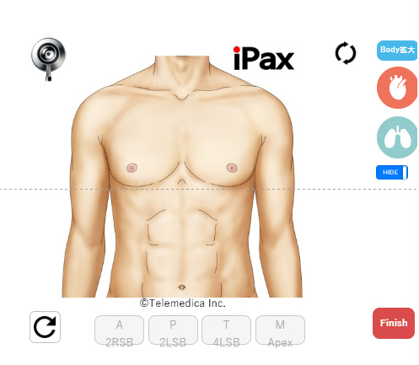
How to use iPax, a virtual auscultation simulator｜Internet environment required
Depending on your Powerpoint version and environment, this content may not be available.
Use ipax-ppt as a slide show.
Tap the auscultation site on the chest illustration to listen to the sound of that site.
Use the arrow at upper right to switch to posterior auscultation.
When the sound is inaudible, press the arrow (flashing) in the lower left corner to reset the sound.
To finish using iPax, press the Finish button.
This iPax contents can be copied into your PPT.
For inquiries about iPax, please contactTelemedica Customer Center
3sp@telemedica.co.jp
There are numerous cardiac and pulmonary sound cases in iPax.
iPax information webpage
https://telemedica.site/ipax23-lp-en/
Switching to the back
Tap on the chest illustration
Auscultation
Restart
Press when exiting or moving to the next slide

Slide 2

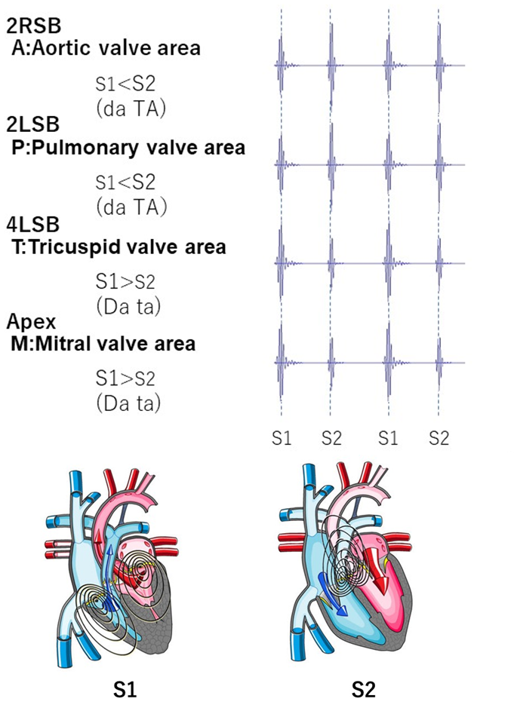
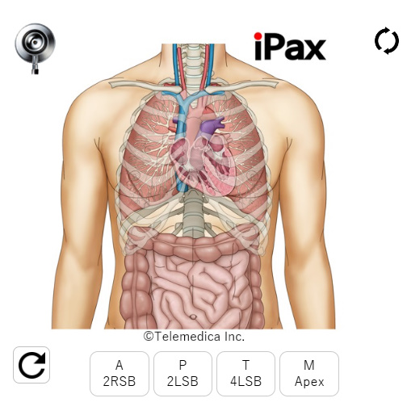
Normal heart, normal lung sound case of iPax
Click to open iPax

Slide 3
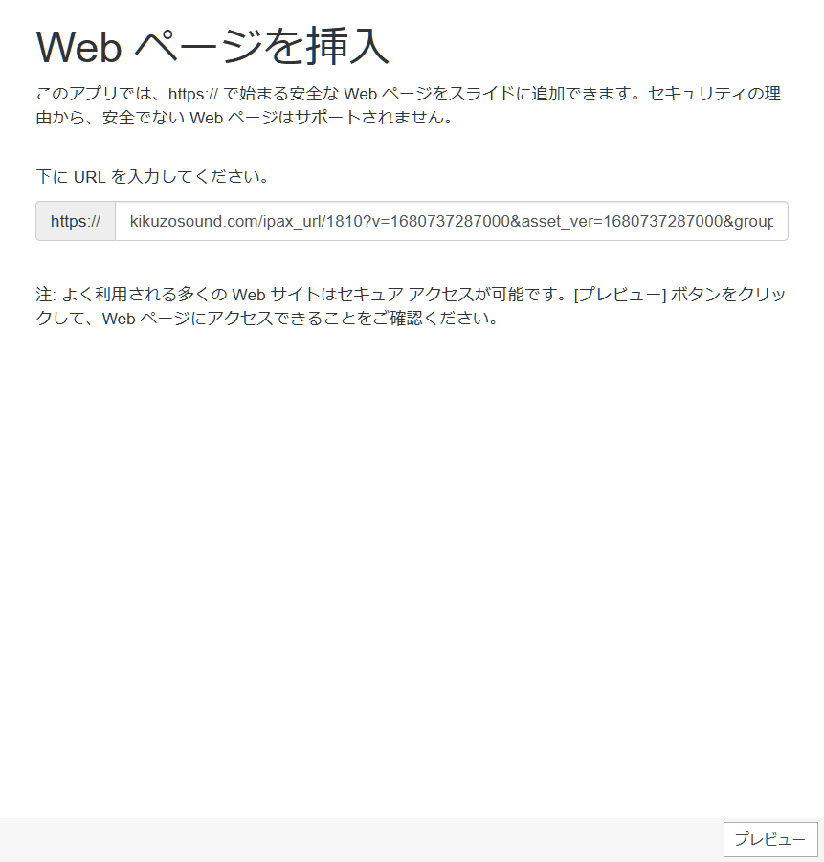
Normal heart, normal lung sound case of iPax

